Slide 1
ZeroV Survivor Resources: Housing
Andrea Miller, Chief Housing Officer amiller@zerov.org
859-608-1375
October 2024

Slide 2
About ZeroV
ZeroV is a statewide voice on ending intimate partner abuse in our homes and communities.
Intimate partner violence is a form of power-based violence and is part of a systemic pattern of oppression.
ZeroV acknowledges intersecting forms of oppression and social inequities including gender-based violence, racism, homelessness, and poverty.
Member network of the fifteen state & federally-funded regional domestic violence shelters serving all 120 counties
Shelter and outreach programs provide safe, affirming care that is trauma-informed, presumes cultural competency, and fosters meaningful access to services and resources.
ZeroV recognizes the diverse and often complicated issues that can affect survivor’s social and emotional well-being.

Slide 3
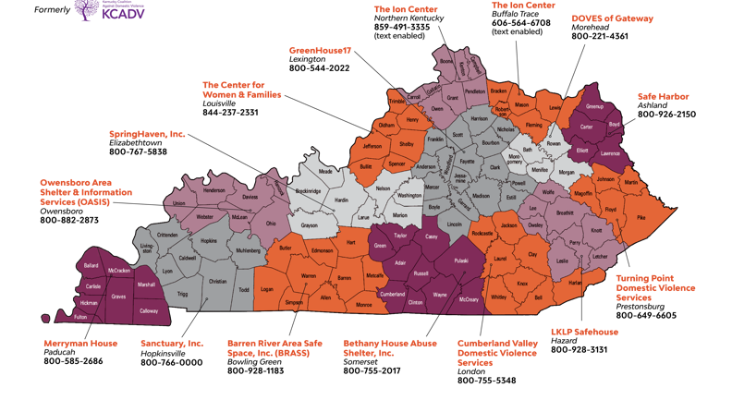

Slide 4
Survivor Challenges in Housing
Simply not enough units of affordable housing
Lengthy waitlists for public housing and Housing Choice Voucher (HCV) programs
Systems barriers
  Poor rental history
  Eviction history
  Lack of income and/or finances to get into a unit
  Criminal history
  Old housing or utility debt
  Lack of understanding on VAWA protections and KY law on housing protections for survivors

Slide 5
Housing at ZeroV
ZeroV annually operates $2.8M in housing funding
HOME TBRA
CoC Rapid Rehousing grant
DV Bonus Rapid Rehousing grant
84 tax credit units across KY
Survivor housing needs based on October LPC data: 215
Louisville RRH grant
OVW Transitional Housing grant

Slide 6
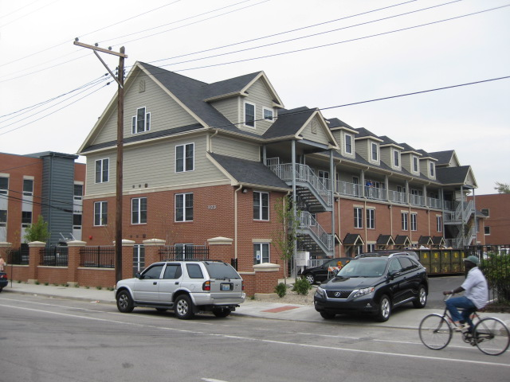
Villager-KDVA Homes
21 units on campus of Center for Women and Families in downtown Louisville; Rental assistance through LMHA and ZeroV

Slide 7
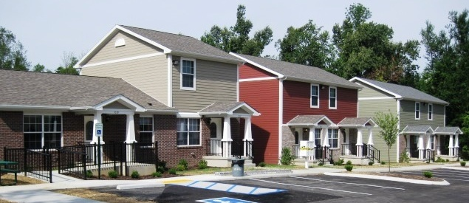
Paducah
Residents of 12 duplex-style units on shelter campus receive rental assistance through Section 8 housing vouchers from city of Paducah, ZeroV, or Merryman House

Slide 8
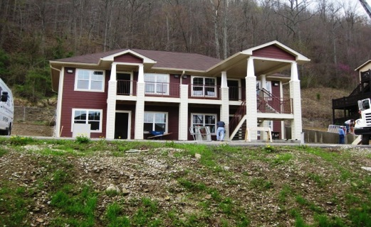
Morehead
Families in six townhouse-style units in the Appalachian foothills receive rental assistance through DOVES housing programming.

Slide 9
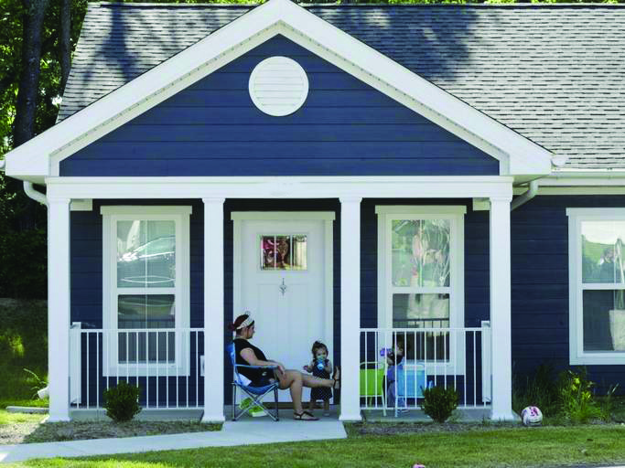
ZeroV Homes Lexington – 24 apartments; Rental assistance through LHA block grant
$4.6 million project
Notes:
Kentucky Housing Corporation made the $4.6 million project possible with Low-Income Housing Tax Credits and a low-interest loan from the state’s Affordable Housing Trust Fund. We also want to thank the Lexington-Fayette Urban County Government which contributed almost $500,000 in federal HOME funds and a $560,000 loan through its Affordable Housing Trust Fund. Finally, none of this would be happening without the Lexington Housing Authority which is providing rental assistance for all of the residents. Thanks to Austin Simms and his staff for helping us. We’re pleased that Aldean Pleasant, who runs the Section 8 program, is here representing the Housing Authority.

Slide 10
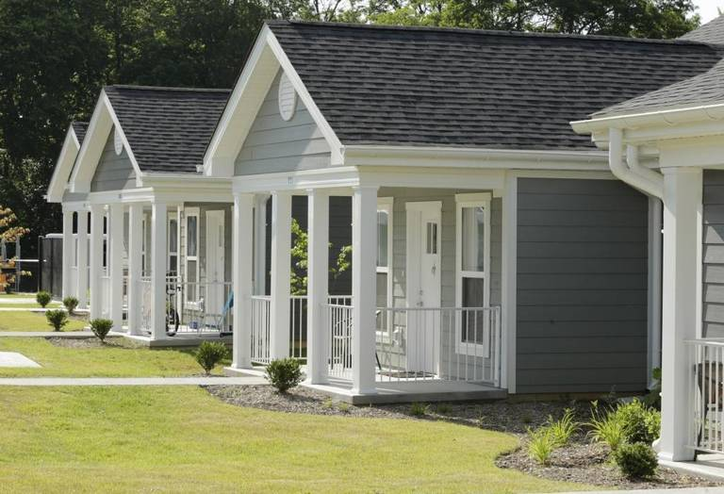
12 units on GreenHouse17 - a working farm and 12 rehabbed apartments near the city center
Notes:
Project architect Jim Burris designed the 12 single-story, cottage-style duplexes so they would fit into the landscape of GreenHouse17’s campus which is also a working farm. The 12 rehabbed are on bus lines and in neighborhoods with shopping, jobs and access to social services.

Slide 11
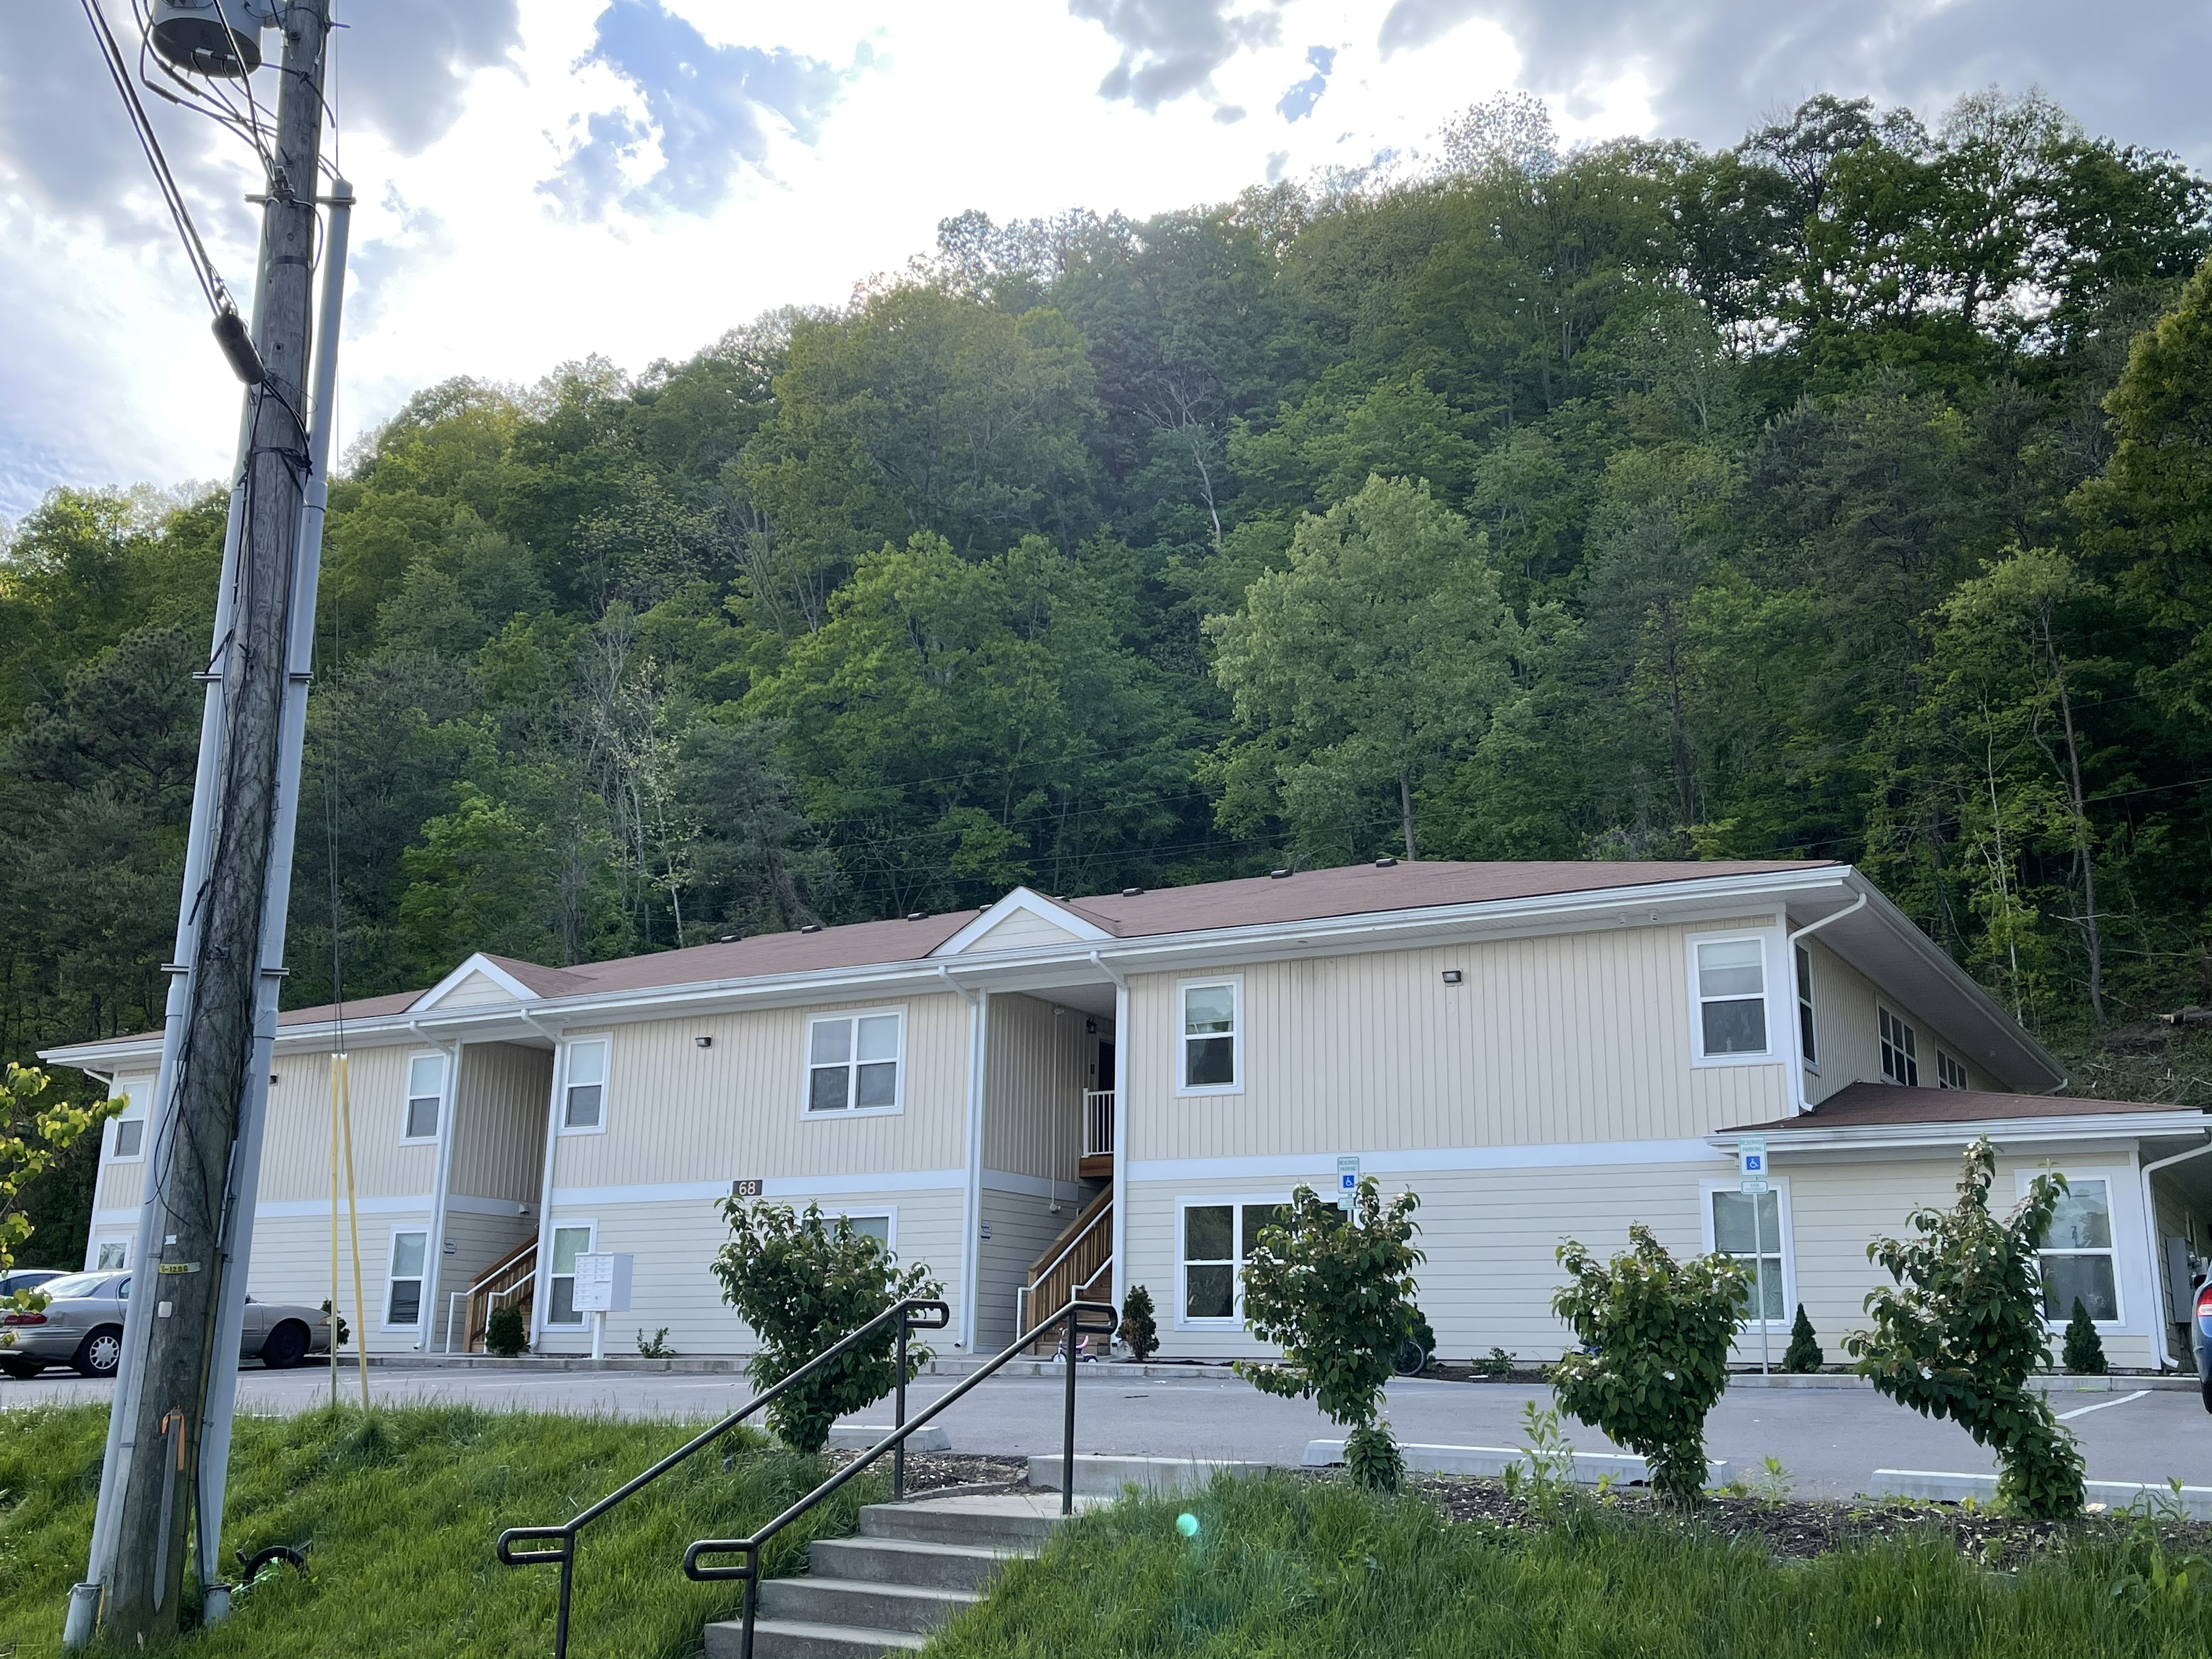
Hazard
Tax credits awarded in 2017 for $2.78 million project
Fair housing complaint settled in September 2019 .
With land provided by the city of Hazard, we built 12 units of housing in the Appalachian mountains
Rental assistance primarily through ZeroV
Notes:
Kentucky needs almost 200,000 affordable rental units to meet the demand for low and-moderate income families, according to Kentucky Housing Corporation’s 2015 Consolidated Plan. Rental housing affordable to households at or below 30% of AMI is in very short supply. For every three households in this income category who need housing, only one unit available. For households between 30% and 50% of AMI, only three units are available for every four families in need.
The affordable housing shortage is especially acute in Perry County, where only 6.9% to 11.5% of the existing housing is affordable to extremely low-income renters. The quality of the existing rental housing is also a problem, according to KHC’s Consolidated Plan. Housing in Eastern Kentucky is more likely to fail a Housing Quality Inspection (HQS) required by HUD for rental assistance. A total of 20% of Kentucky’s housing failed the HQS with the highest rates of failure occurring in Eastern Kentucky.

Slide 12
Continuum of Care – Crash Course
Formerly HEARTH
System for serving homeless populations across the country – every state has Continuums of Care and a lead applicant for CoC HUD Competitions
Three CoCs in KY
HUD Interim/Final Rule
Coordinated Entry required to ensure systems are allocating resources to the most vulnerable homeless populations
ALL programs with ESG and CoC funding MUST pull clients from Coordinated Entry before spending funds or providing services to clients

Slide 13
Coordinated Entry Updates
KY BoS process/required monthly updates
Lex/Lou have their own assessment tools and process
VAWA transfers across CoCs
  If the survivor is currently housed in the CoC
  If the survivor is seeking housing

Slide 14

ZeroV CoC & DV Bonus Rapid Rehousing
Offers up to a maximum of 24 months of rental assistance in ALL counties in KY except Fayette
92-100% exits to permanent housing (HCV is the outcome for most)
Requires Coordinated Entry (prioritization) based on assmt tool
Client needs to meet acuity standards AND meet Category 1 OR Category 4 of homeless definition
Includes supportive services

Slide 15

Rapid Rehousing continued
Rental assistance is initially provided up to 12 months, can be up to another 12 depending on funding availability
  Assistance amount is dependent upon the client’s income
  ZeroV typically uses 30% of client’s AGI towards total housing cost (utilities plus rent)
  There is no maximum rent amount; program utilizes rent reasonableness NOT Fair Market Rent or Payment Standard
  Reasonable occupancy standards apply
  Can relocate clients who have safety or tenancy issues
  Grants are renewed based on the availability of HUD funding

Slide 16
Rapid Rehousing Timeline
Client identified/assmt completed by member programs/community partners
Referral is made to Coordinated Entry System (CES)
ZeroV asks for referrals from CES when we have housing money available
Program application, briefing packet, social security cards*, birth certificates, verification of all income shared with ZeroV
Client approved by ZeroV staff

Slide 17
Rapid Rehousing Timeline
Client and housing advocate (including ZeroV staff) look for appropriate housing
Once unit is located, landlord/property manager fills out Request for Unit Approval form and sends to ZeroV
ZeroV will confirm rent reasonableness and arrange for a unit inspection
Once unit passes HQS inspection, ZeroV will approve the unit
Client/LL signs lease agreement and VAWA lease addendum
Landlord/property manager and ZeroV enter into Rental Assistance Contract
ZeroV authorizes payments for security deposit/rent
The entire process from referral to lease up can take about 16-40 hours per client

Slide 18
HOME TBRA
Provides assistance for minimum of 12 months; recertification required if assistance is to continue
  TBRA grants are for 24 months and allow security deposit, utility deposits, rental subsidies and utility allowances for those that qualify
  Current TBRA grant runs through June 2025; we are close to capacity
Vouchers are tenant-based within service area and are dependent upon a payment standard (defined by HUD as 90-110% of FMR)
Households must be at or below 60% of AMI
Income from ALL members of the household is counted for eligibility purposes
At any time, if household income increases above 80% of AMI, the household is no longer eligible
Does NOT require Coordinated Entry

Slide 19
Roles and Responsibilities
ZeroV
Referral Partners
Obtain application/verification for eligibility
Complete briefing
Housing searches/inspections
Calculate rental shares
Utility deposits
Work with LLs for leasing paperwork
Moving assistance
Case management welcome/confirm needs
Ongoing case management
Maintain contact with clients/update CES as required
Ensure clients have personal documentation for housing
Assess household needs and help client prepare for housing; clear old debt; gather household goods
Work with ZeroV staff to gather documents/facilitate meetings/complete paperwork
Assist with housing searches/RFUA/Inspections if possible
Leverage funding (ESG supports, unrestricted, community agencies)

Slide 20
Basic
Housing Case Management
Voluntary Services for case management. Clients actively working with advocates tend to fare better.
How often clients and case managers meet varies, but meetings should occur at least monthly
Meetings can take place in person or via technology
All clients should have a housing stability plan
Plan should be based on the specific stability needs of the client
Goals are client driven and should focus on housing stability and self sufficiency
Case management should address a plan for sustainability
What is the client planning to do when assistance ends?
ZeroV Case Managers support/facilitate local case management

Slide 21

Housing is FUN-damental!

Slide 22

What can happen when we meaningfully invest in people
Notes:
Taniesha Miller left her abusive husband and moved into her own home in February 2019 with help from an advocate at the Center for Women and Families.
While living at the tax credit development she heard about matched savings account from her advocate and she opened her IDA in July 2016 to help her buy a car. She watched while her savings were matched dollar for dollar.
She enrolled in financial education classes to prepare for her new investment. Making a budget, was “like a reality check for me,” Taniesha said, “because I wasn’t paying attention to certain details of my income and spending.” She was also able to get a credit card and build her credit by limiting her spending to 30 percent of the card’s maximum and paying her bill in full and on time. “It was challenging to save, but I made sacrifices. Somebody is going to help me, so I should be able to help myself also. That motivated me.”
Nine months later Taniesha purchased this 2007 Toyota Camry. The car led to a better job which led to exit from the program and a permanent housing voucher. On January 22, 2019, Taniesha closed on her own home – thanks to another matched savings program through ZeroV where her funds were matched 4:1.

