Slide 1
September 15, 2023
Presented by: AppalReD Legal Aid

Slide 2
This project is supported by Grant Number VAWA-2022-Appalach-00029 awarded through the Kentucky Justice and Public Safety Cabinet by the Office on Violence Against Women, U.S. Department of Justice's STOP Formula Grant Program U.S. Department of Justice. The opinions, findings, conclusions, and recommendations expressed in this publication/program/exhibition are those of the author(s) and do not necessarily reflect the views of the Kentucky Justice and Public Safety Cabinet, the Office on Violence Against Women or the U.S. Department of Justice.

Slide 3
CONFERENCE MATERIALS
The conference materials and this PowerPoint are available for download on our website at www.ardfky.org
Direct link: https://www.ardfky.org/dv23
Conference funded by: VAWA-2022-Appalach-00029

Slide 4
CEU / CLE CREDITS
Please note the following:
For purposes of approval for Continuing Education and Continue Legal Education credit, as well as grant requirements, there are 3 surveys/evaluations for this conference:
Nursing attendees
Have a different survey than other healthcare and related providers
Must check in during the conference; information on how to do that is provided on a following slide
Nursing evaluation form must be returned at the end of the conference
All attendees will receive an email after the conference containing a link and QR code for the survey. This survey must be completed to receive a CEU certificate.
All attendees will receive a 2nd email containing a link to an overall conference evaluation.
ADDITIONAL INFORMATION IS AVAILABLE ON THE FOLLOWING SLIDES.
Conference funded by: VAWA-2022-Appalach-00029

Slide 5
NURSING CEU CREDITS
The Kentucky Board of Nursing (KBN) has approved this course for 6.6 contact hours.
Provider Offering No. 4-0031-12-24-016.
Nursing CEU’s will be provided by Highlands ARH Regional Medical Center, a KBN CEU Provider.
Follow the instructions on the next slide for check-in.
Early evaluations cannot be accepted.
Certificates will be emailed to you by Highlands ARH Regional Medical Center.
Conference funded by: VAWA-2022-Appalach-00029

Slide 6
NURSING CHECK-IN
If you are a nurse attending today’s conference virtually and wish to receive nursing CEU’s, you must email Kristie Stephens at ceuregistration@ardfky.org to be added to the attendee roster.
Please provide the following mandatory information in your email:
Name & Department (as appears on your license)
License Number or Last 4 digits of SSN
Valid email address (to which certificate can be sent)
Specify if you are a RN, LPN or “Other”
Whether your license is Active or Inactive
Upon receipt of your email and all information requested above, a nursing evaluation form will be emailed to you during the conference for completion. Once your evaluation is complete, email it to Kristie Stephens at ceuregistration@ardfky.org at the end of the conference.
Certificates will be distributed via email by Highlands ARH Regional Medical Center.
Conference funded by: VAWA-2022-Appalach-00029

Slide 7
CONTINUING EDUCATION CREDITS
CEU Credit Approvals and Hours
Clinical Alcohol & Drug Counselors TBD
Licensed Professional Counselors TBD
Psychologists TBD
Social Workers TBD
Nursing Home Administrators TBD
All have been approved. CEU hours will be noted on the certificate.
Conference funded by: VAWA-2022-Appalach-00029

Slide 8
CONTINUING EDUCATION CREDITS
Survey & CEU Certificate
Southeast KY AHEC provides CEU certificates for this conference.
You must complete the CEU conference survey in order to obtain your CEU certificate.
The survey link (through SurveyMonkey) will be emailed to all participants by AppalReD Legal Aid.
Check your SPAM FOLDER if you don’t see the email in your inbox.
The survey will close at 11:59 p.m. on October 13, 2023.
Once the CEU survey is completed, the CEU certificate will pop up on the screen. It must be printed or saved at that time. Once closed, there is no way to retrieve or recreate the certificate.
Conference funded by: VAWA-2022-Appalach-00029

Slide 9
ATTORNEY CLE CREDIT
ACTIVITY INFORMATION
Sponsor: AppalReD Legal Aid
Sponsor No.: 0736
Activity Title: 2023 Domestic Violence Conference
Activity No.: 254005
Total Credits: 5.50
Ethics Credits: 0.00
The Kentucky Bar Association has approved this conference for 5.50 CLE credits.
Attorneys can submit credit hours on the KBA website or by completing KBA Form 3.
Conference funded by: VAWA-2022-Appalach-00029

Slide 10
CERTIFICATE OF COMPLETION
A Certificate of Completion will be made available immediately upon completion of the Continuing Education Unit survey.
If you do not complete this survey, you will not receive a Certificate of Completion.
The Certificate must be saved or printed at the time it appears on your screen. It cannot be recreated or retrieved.
Conference funded by: VAWA-2022-Appalach-00029

Slide 11
CONFERENCE EVALUATION
You will receive a follow-up evaluation survey from AppalReD Legal Aid regarding your experience attending today’s conference.
This is a separate survey from the CEU survey to complete to obtain a CEU certificate.
We will email a link to the conference evaluation survey to the email address you provided at registration.
We value your feedback and use the information received in your evaluations to improve your experience at future conferences. Thank you in advance for taking the time to complete the evaluation!
Conference funded by: VAWA-2022-Appalach-00029

Slide 12
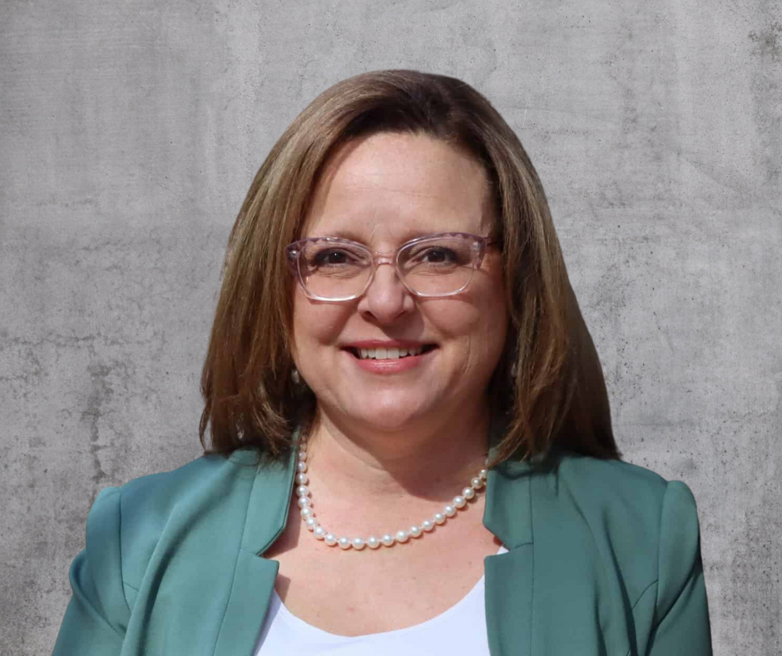
Angeleigh (Angie) Dorsey Executive Director
Meet AppalReD’s New Executive Director, Angeleigh Dorsey!
Angie is a lifelong legal aider who has spent over two decades working with rural communities. Angeleigh has impressive leadership experience; most recently, she served as the Western Regional Manager for Legal Aid of North Carolina, managing six field offices that cover 27 counties, mostly Appalachian.
Angie has tremendous expertise in senior law, elder abuse, Medicaid, and Social Security. She has given of her time in national, state, and regional leadership roles that have significantly contributed to quality of life in the communities she serves and lives in. She's made a difference for seniors and Medicaid beneficiaries over the course of her entire career.
Contact Angie:
(606) 886-9876 or 1-800-556-3876
angied@ardfky.org
https://www.linkedin.com/in/angeleighdorsey/
Conference funded by: VAWA-2022-Appalach-00029

Slide 13
GET CONNECTED STAY CONNECTED
https://www.linkedin.com/company/appalredlegalaid/
https://www.ardfky.org
https://www.facebook.com/AppalRedLegalAid
https://www.Instagram.com/AppalReDLegalAid
https://www.twitter.com/AppalReDLegal@AppalReDLegal
Conference funded by: VAWA-2022-Appalach-00029

Slide 14
AppalReD Legal Aid
It is the policy of AppalReD Legal Aid to make no distinction in the provision of legal assistance to eligible persons because of race, color, religion, sex, national origin or any other consideration prohibited by law.
Spread the word!
Check out AppalReD’s available job opportunities at:
https://www.ardfky.org/job-opportunities
AppalReD Legal Aid is an Equal Opportunity Employer.

Slide 15
Thank you for attending today’s conference!
We look forward to “seeing” you next year!
Presented by: AppalReD Legal Aid

