Slide 1
“Domestic Violence and Substance Use:
A Co-occurring Issue”
Geoff Wilson, LCSW, LCADC, CCS
Lexington Counseling & Psychiatry

Slide 2
Agenda
Will increase knowledge regarding the prevalence of domestic violence and substance use disorders
Will increase knowledge regarding the role that substance use can play as a barrier for individuals seeking supportive services

Slide 3
A Case
Julie is a 37 yr. old that’s been dating Marcus for 4 years now. He has an 8 yr. old son from a previous relationship, and she has a 12 yr. old daughter from her first marriage, they are all living together in a rented house. Marcus is often gone out of town for work and Julie is the primary caregiver for his son when he’s gone. Marcus can be demeaning and will regularly put Julie down, will use her anxiety against her, and often tells her she is lucky to have him and couldn’t find a guy that would put up with her. She recently discovered that he is cheating on her and when confronted he became threatening and tried to convince her it was all in her head. He often ridicules her for her weight and not having things together and often tells her that other women would never complain about his behavior towards her. Julie has a history of drinking alcohol and smoking weed going back to high school but had discontinued most of this when she started college and became an LPN. She was introduced to methamphetamine by Marcus shortly after they began dating and she has had prior attempts to stop using the drug but rarely can achieve more than a few days of sobriety. Marcus often encourages her to use it but will also demean her for doing so and tells her she is “just another dopehead”, and will at times threaten to call child protective services on her.

Slide 4
Domestic Violence Statistics
Intimate partner violence accounts for 15% of all violent crimes annually in the United States.
More than 1 in 3 women and 1 in 4 men have experienced either physical violence, rape, or stalking by an intimate partner in their lifetime. Victims are commonly abused by those who are closest to them.
Each day in the United States, over 20,000 calls are placed to domestic violence hotlines by individuals reporting incidents.
On average, 20 people per minute are physically abused by an intimate partner. This is an astounding number that shows just how prevalent this is in our society.
A weapon is used in 19% of domestic violence incidents.
Women who are victims of intimate partner violence are most likely to be between the ages of 18 to 24.
Having a gun in the home where domestic violence is taking place increases the likelihood of a homicide by 500%. In fact, 72% of all murder-suicides stem from intimate partner violence.

Slide 5
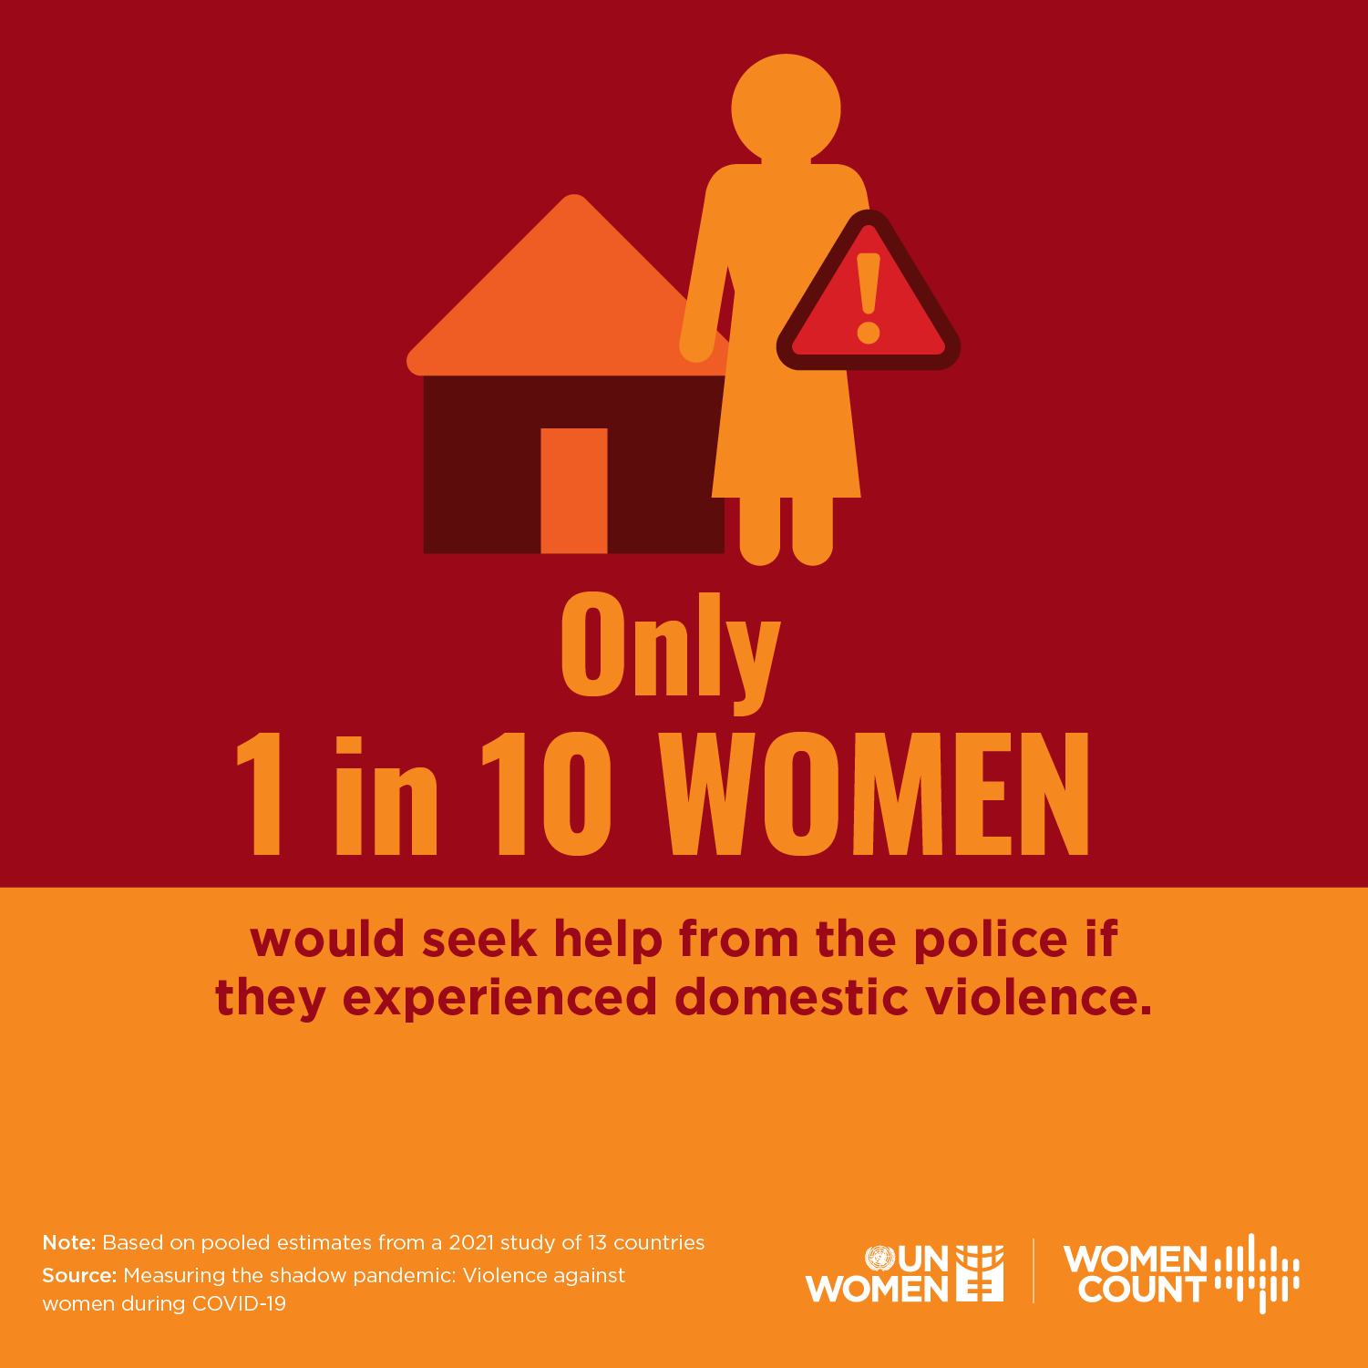
Seeking Help

Slide 6
Seeking Help
When asked who they thought women experiencing domestic violence would seek help from, 49% of respondents said women would seek help from their family, while only 11% said women would seek help from police, and 10% said they would go to support centers (shelters, women’s centers, etc.).

Slide 7
What is Domestic Violence
Domestic violence is a pattern of abusive behavior in any relationship that is used by one partner to gain or maintain power and control over another intimate partner.
Domestic violence can be physical, sexual, emotional, economic, psychological, or technological actions or threats of actions or other patterns of coercive behavior that influence another person within an intimate partner relationship.
This includes any behaviors that intimidate, manipulate, humiliate, isolate, frighten, terrorize, coerce, threaten, blame, hurt, injure, or wound someone. Examples of abusive behavior include:

Slide 8
What is Domestic Violence
Most often, the perpetrator of domestic violence is a current or former spouse or dating partner, or a person who has cohabitated with the victim, such as a family member or roommate. Sometimes, domestic violence can also be perpetrated by a caretaker, such as someone caring for an elderly relative, or a landlord who has used tactics of power and control over a tenant.

Slide 9
What is Domestic Violence
Physical Abuse: Hitting, slapping, shoving, grabbing, pinching, biting, hair pulling, etc. are types of physical abuse. This type of abuse also includes denying a partner medical care or forcing alcohol and/or drug use upon him or her.
Sexual Abuse: Coercing or attempting to coerce any sexual contact or behavior without consent. Sexual abuse includes, but is certainly not limited to, marital rape, attacks on sexual parts of the body, forcing sex after physical violence has occurred, or treating one in a sexually demeaning manner.

Slide 10
Physical Abuse
Hitting
Pushing or Shoving
Strangulation (sometimes called “choking”) or Suffocation
Using an object or a weapon to injure someone
Denying a victim medical treatment
Controlling what a victim eats
Forcing a victim to use drugs
Destroying a victim’s belongings

Slide 11
Sexual Abuse
Rape, including marital rape
Physical violence followed by force sexual acts
Violence directed at a victim’s breasts or genitalia
Withholding intimacy as a means to control
Withholding birth control or condoms
Forcing a victim to view pornography or participate in group sex
Using sexual insults to demean a victim
Incest

Slide 12
What is Domestic Violence?
Emotional Abuse: Undermining an individual's sense of self-worth and/or self-esteem is abusive. This may include, but is not limited to constant criticism, diminishing one's abilities, name-calling, or damaging one's relationship with his or her children.
Psychological Abuse: Elements of psychological abuse include - but are not limited to - causing fear by intimidation; threatening physical harm to self, partner, children, or partner's family or friends; destruction of pets and property; and forcing isolation from family, friends, or school and/or work.

Slide 13
Psychological, Emotional, Verbal
Psychological & Emotional
Verbal
Shaming, embarrassing or berating a victim behind closed doors or in a public setting
Calling a victim names
Frequent possessiveness or jealousy
Ignoring a victim for prolonged periods of time
Controlling or limiting where a victim goes, what they wear, who they see or whether or not they retain employment or attend school
Threats to hurt the victim, their family or their pets
Frequent infidelity while blaming the victim for it
Calling a victim “crazy”
Denying a victim sleep
Stalking

Slide 14
What is Domestic Violence?
Economic Abuse: Controlling or restraining a person’s ability to acquire, use, or maintain economic resources to which they are entitled. This includes using coercion, fraud, or manipulation to restrict a person’s access to money, assets, credit, or financial information; unfairly using a person’s personal economic resources, including money, assets, and credit, or exerting undue influence over a person’s financial and economic behavior or decisions, including forcing default on joint or other financial obligations, exploiting powers of attorney, guardianship, or conservatorship, or failing or neglecting to act in the best interests of a person to whom one has a fiduciary duty.

Slide 15
Economic Abuse
Controlling Behavior
Manipulative Behavior
Denying a victim access to shared bank accounts
Strictly controlling how money is spent
Giving a victim an “allowance” to live on
Mismanaging shared money and lying about it
Running up large debts or opening lines of credit without a victim’s permission
Forcing a victim to write bad checks or file fraudulent tax return
Sabotaging employment opportunities for victim
Forcing a victim to work for a family business without pay
Demanding a victim turn over paychecks or public benefit checks
Requiring receipts for all purchases a victim makes

Slide 16
Spiritual Abuse
This can have more than one meaning. Within a domestic situation, it can mean an abuser uses a victim’s religious beliefs to control them or prevents a victim from practicing their religion. Within a religious organization, spiritual abuse is when a religious leader shames or controls members using their position of power. In this guide, we’re going to focus on spiritual abuse within an intimate partner relationship, which would look like:

Slide 17
Spiritual Abuse
An abuser preventing a victim from praying, attending church, keeping kosher or otherwise practicing their religion
An abuser ridiculing their partner’s beliefs
An abuser using their partner’s religion to berate them
Manipulating a victim using religion (cherry-picking religious verses to fit an abuser’s tactics of control, aka, “The bible says you have to obey your husband.”)
An abuser insisting your children be raised in a faith you don’t agree to

Slide 18
What is Domestic Violone?
Technological Abuse: An act or pattern of behavior that is intended to harm, threaten, control, stalk, harass, impersonate, exploit, extort, or monitor another person that occurs using any form of technology, including but not limited to: internet enabled devices, online spaces and platforms, computers, mobile devices, cameras and imaging programs, apps, location tracking devices, or communication technologies, or any other emerging technologies.

Slide 19
Recognizing Domestic Violence Warning Signs
Unfortunately, abusers don’t come into our lives waving big red flags. In reality, they can often be some of the most charming, thoughtful and romantic people you’ll ever meet. It’s only once you’re entrenched in the relationship that an abuser will begin to exhibit tactics of control, intimidation and violence. If we can spot an abuser before ever reaching this point, our chances of making it to safety multiply tenfold.

Slide 20
A Veil of Silence
“Higher-income people hide behind what I call a veil of silence,” Susan Weitzman, Ph.D., told The Daily Beast in in a 2013 interview. “They believe it’s only happening to them. No one can hear you scream on a 3-acre lot.”

Slide 21
Controlling behaviors are one of the biggest red flags counselors should be listening for to determine if a client might be involved in an abusive relationship, either as a perpetrator or a victim.
Clients who clam up in session or appear to be afraid of their partner
Clients who are isolated from friends and family
Clients who feel they can’t go to work, school or social engagements because it upsets their partner
If one partner is the sole decision-maker or in complete control of the couple’s finances
If one of the partners continually feels guilty for their behavior
A partner who exhibits extreme jealousy
Clients who mention “walking on eggshells” around their partners
Clients who are having thoughts of suicide or threatening to harm themselves or their abuser
A partner who pressures the other partner to use drugs or alcohol or to not use contraception (or who lies about their own use of contraceptives)
A partner who pressures the other partner to have sex or to perform sexual acts that the person is uncomfortable with
Clients who talk about a partner belittling or embarrassing them in front of other people

Slide 22
DV and Substance Use
Longitudinal studies from the American Psychological Association, the National Coalition Against Domestic Violence, the Substance Abuse and Mental Health Services Administration (SAMHSA) and countless other organizations reveal a distinct relationship between the two issues and show how they can co-occur. But regardless of which issue is present first, drug use and acts of violence only exacerbate each other’s effects.

Slide 23
DV and Substance Use
Young adults who experience past-year physical dating violence are more likely to have mental health and substance use disorders within six months of the abuse.
Teen victims of dating violence are more likely than their non-abused peers to smoke, use drugs, engage in unhealthy diet behaviors, engage in risky sexual behaviors, and attempt or consider suicide.
According to the American Society of Addiction Medicine (ASAM), substance abuse is involved in about 40–60 percent of all intimate partner violence (IPV) incidents.
Domestic abuse victims are 70 percent more likely to drink excessive amounts of alcohol than those in healthy relationships.
More than 20 percent of male perpetrators report using alcohol or illicit drugs prior to the most recent and severe acts of violence.
On days of heavy drug and/or alcohol use, physical violence was 11 times more likely among IPV batterers and victims.

Slide 24
Data shows a strong connection between correlate substance use and domestic violence:
Domestic violence survivors are nearly 6 times more likely to develop alcohol addiction.
Nearly 50% of women who enter addiction treatment are domestic violence survivors. The rates are much higher for women in opioid addiction treatment.
When both people in a relationship use substances, their risk of interpersonal violence goes up.
39% of incarcerated abusers have a history of alcohol addiction.
22% of incarcerated abusers have a history of drug addiction.
Substance use is involved in up to 80% of child abuse cases.
Teens and young adults who were abused in childhood have a higher risk of addiction.
Serious physical violence occurs in 8-13% of all marriages.
Women who abuse substances are at a higher risk of domestic violence.

Slide 25
Using Substances to Cope!
Many people cope with the trauma of intimate partner violence (IPV) by using drugs or alcohol. For many survivors, this occasional coping method quickly turns into addiction—especially if you lack other coping strategies. Survivors of IPV also tend to have more severe addiction symptoms.
Physical injuries from IPV can also lead to addiction. For example, it’s common for IPV to result in chronic pain or traumatic brain injury. Both of these conditions increase your risk of addiction. But developing an addiction also increases your risk of experiencing IPV again, and this can quickly become a cycle. Seeking treatment can keep you safe from further violence.

Slide 26
Special Considerations for Men Who Have Survived Domestic Violence
Although most research focuses on women survivors, 25-50% of people who survive IPV each year are men. And like women, studies show that male survivors of domestic violence are more likely to develop addiction. But the cultural stigma that male survivors face can be a barrier to treatment and recovery.

Slide 27
DV and Substance Use
It’s important to note that most people experiencing addiction are not violent towards others. However, the influence of drugs or alcohol can make people with violent tendencies more likely to act on them.

Slide 28
DV and Substance Use
By definition, being drunk or high changes your brain chemistry. As a result, drinking or using drugs can change the way you think, feel, and react to stress. You might be less capable of controlling your anger, making violence more likely. Ongoing drug use increases your risk of violent behavior7 over time. (The Link Between Substance Abuse and Domestic Violence: Understanding and Breaking the Cycle, May 31st, 2023).

Slide 29
DV and Substance Use
Social norms can also contribute to higher rates of violence. In some cultures, “I was drunk” is an acceptable excuse for a wide range of negative behavior, from telling secrets to picking fights. When people feel like they can blame their actions on substances, they may drink or use drugs to justify ongoing violence. This mindset can also prevent them from getting the help they need.

Slide 30
DV and Substance Use
Women experiencing alcohol or drug addiction are also more likely to become victims of domestic violence. However, studies show that this often relates to their partners’ substance abuse issues even more than their own.
Substance use doesn’t cause domestic violence. And blaming violence on a person’s addiction—whether they’re the survivor or the perpetrator—removes the abuser’s responsibility.

Slide 31
Treatment for Addiction and Domestic Violence-Related Trauma
When you’re recovering from abuse and addiction, it’s ideal to find treatment that addresses both at the same time. Studies show that comprehensive treatment is more effective than seeking help for trauma and addiction separately.

Slide 32
Treatment Aspects
Most treatment programs that address both addiction and domestic violence offer trauma-informed care. Trauma affects everyone differently, and its impacts can be surprising. A trauma-informed approach accounts for your unique needs during recovery, even as those needs change.
Recognizing your triggers and respecting your boundaries is a huge part of this. For example, you’ll be able to say “stop” at any point in therapy, and take a break or change the subject. The physical environment will also be conducive to healing with well-lit common areas, no loud noises, and safety features like security personnel at entrances and exits.

Slide 33
Trauma-Informed
Acute Trauma
Chronic Trauma
Complex Trauma

Slide 34
Treatment Aspects
Integrated treatment also accounts for the role of trauma in addiction. For example, if you’re in cognitive behavioral therapy (CBT), you might learn how to cope with trauma triggers without using drugs or alcohol. These skills can help you navigate long-term recovery from both conditions.
The benefits of EMDR!!
The benefits of Mindfulness!!
The benefits of Exercise!!

Slide 35
Autonomic Nervous System
On a daily basis, our nervous systems experience periods of increasing arousal and periods of decreasing arousal. Each one of us has a “Window of Tolerance” or an “Optimal Arousal Zone” where we can experience nervous system fluctuations while still having the capacity to regulate ourselves .
Optimal Arousal Zone
Present, embodied, open,
curious, tolerable feelings,
relaxed yet alert, able to
think, relational

Slide 36
Sympathetic Hyperarousal
Anxious, panic, restless, hyperactive, hypervigilant, exaggerated startle,
emotional flooding, impulsivity,
risk-taking, poor judgment
Dysregulated
Arousal
Regulated
Arousal
Optimal Arousal Zone
Present, embodied, open,
curious, tolerable feelings,
relaxed yet alert, able to
think, relational
Parasympathetic Hypoarousal
Flat affect, depression, lethargy,
numb, disconnected, dissociation,
despair, self-loathing, hopeless,
full of shame, victim identity

Slide 37
The more severely we are dysregulated, and/or the longer the dysregulation lasts, the greater the chance we subjectively experience unbearable discomfort, or difficulty staying “within our own skin”.
Many people will begin self-medicating in order to move away from the pain and move towards pleasure.

Slide 38
Evidence-Based, Best Practices!!
“When substance disorder and psychiatric disorder co-exist, each disorder should be considered primary, and integrated dual primary treatment is recommended, where each disorder receives appropriately intensive diagnosis specific treatment.”
(K. Minkoff-”An Integrated Model for the Treatment of People with Co-Occurring Disorders in Managed Care Systems”).

Slide 39
No Wrong Door!
SAMHSA’s “no wrong door” policy states that effective systems must ensure that a person needing treatment will be identified, assessed, and receive treatment, either directly or through appropriate referral, no matter where he or she seeks services.
“No wrong door” means that people presenting for treatment for a mental disorder should be routinely screened for substance use disorder, and all people presenting for treatment for substance use disorders should be screened for mental disorders.

Slide 40
Aftercare Planning for Survivors of Domestic Violence
For survivors, aftercare includes more than ongoing mental health support. While that’s important, it’s just one part of your safety. In most programs, you can start planning for aftercare as soon as you enter treatment.
When you start rehab, your therapist may ask you to sign a no-contact contract, where you’ll agree not to communicate with your abuser during treatment. But after rehab, it’s not always that simple. If you have children with them or share assets like a house, the legal system may require some amount of contact.

Slide 41
Additional Challenges
It’s also common for survivors to be socially isolated and have fewer financial resources immediately after an abusive relationship. So, as one approaches the end of treatment, they will often work with their therapist to create a concrete safety plan for after they leave. That plan might include:
Intentions around if, when and how you’ll be in contact with your abuser, including information about your legal rights
A safe place to live
A new phone number, email address or other contact information your abuser won’t have access to
A local therapist
In-person support groups
Relevant hotlines for social services
Other community resources

Slide 42
Things to Remember….
Intimate partner violence is the breaking down of a human. They completely lose their sense of self and begin to believe everything the abuser has said about them. It happens smally and slowly.”
In addition to providing a safe space to be heard and empowered, counseling can be a place for victims of IPV to learn what a healthy relationship looks like. This is especially true for clients whose histories include past trauma (in addition to IPV) or who haven’t been exposed to healthy relationships in their life,

Slide 43
References
What Is Domestic Violence?: Resources to Help You Identify What Is Domestic Violence; domesticshelters.org Jan 17, 2021.
Kentucky Coalition Against Domestic Violence.
Mayo Clinic, Healthy Lifestyle-Adult Health: Domestic Violence Against Women.
“Considering and Navigating New Relationships During Recovery From Intimate Partner Violence”- Journal of Counseling & Development.
“Addressing intimate partner violence with clients” Bethany Bray; Counseling Today-American Counseling Association
K. Minkoff-”An Integrated Model for the Treatment of People with Co-Occurring Disorders in Managed Care Systems”).
(The Link Between Substance Abuse and Domestic Violence: Understanding and Breaking the Cycle, May 31st, 2023).

Slide 44
Thank you
Geoff Wilson, LCSW, LCADC, CCS
The Offices of Paul Dalton/Lexington
Counseling & Psychiatry
501 Darby Creek Rd., Suite 11
Lexington, KY 40509
859-229-5722
geoffwilson914@gmail.com

