Slide 1

Domestic Violence Law Update
A Deep Dive into the Statutes and Case Law
Miles Devon Skeens IV
Directing Attorney
Hazard Office

Slide 2

About AppalReD
Appalachian Research and Defense Fund of Ky, Inc.
Founded in 1970 as part of LBJ’s War on Poverty.
Currently funded by state and federal grants, along with funds from the Legal Services Corporation, a non-profit established and funded by Congress.
We are the exclusive LSC legal aid program for eastern and south-central Kentucky.
Currently staff offices in Barbourville, Hazard, Prestonsburg, Richmond, and Somerset, along with a satellite office in Pikeville.

Slide 3
What do we do?
Public Benefits
  KTAP
  SNAP
  Unemployment
  Loss of SSDI and SSI
  Overpayments
Consumer Defense
Housing
  Foreclosures
  Evictions
Healthcare
  Medicaid issues
  Qualified Income Trusts
  Medicare issues
Utility shutoffs/denials
Natural Disaster Benefits
Estate Planning
  Wills
  Powers of Attorney
  Living Wills
Family Law
  Divorce
  Custody
  Child Support
  Grandparent’s rights
Expungements
Tax issues
Education Law
  Wrongful suspension/expulsion
  Federal and state special education litigation
…All at NO COST to the client!

Slide 4
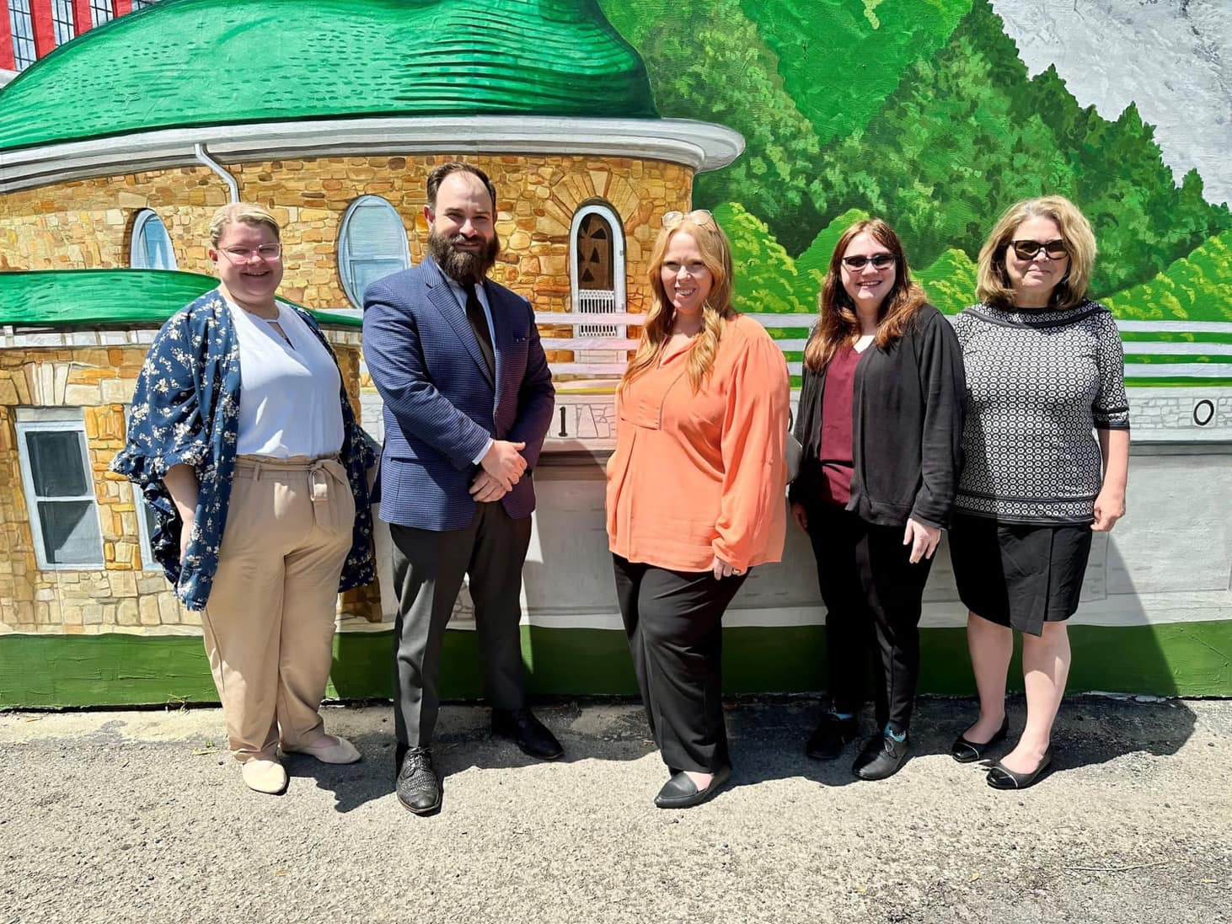
The Hazard Team
Monica Rice-Smith
  20+ year legal veteran
  Former worker’s compensation ALJ
  Leslie County native
Emma Jones
  20+ year legal veteran
  Former Public Defender
  More than a dozen trials
  Pike County native
Savannah Collett
  Disaster team paralegal
  Perry County native
  Has assisted hundreds of clients impacted by natural disasters
Sarah King
  Administrative Support specialist
  Has assisted hundreds of clients in all practice areas
  Letcher County native

Slide 5
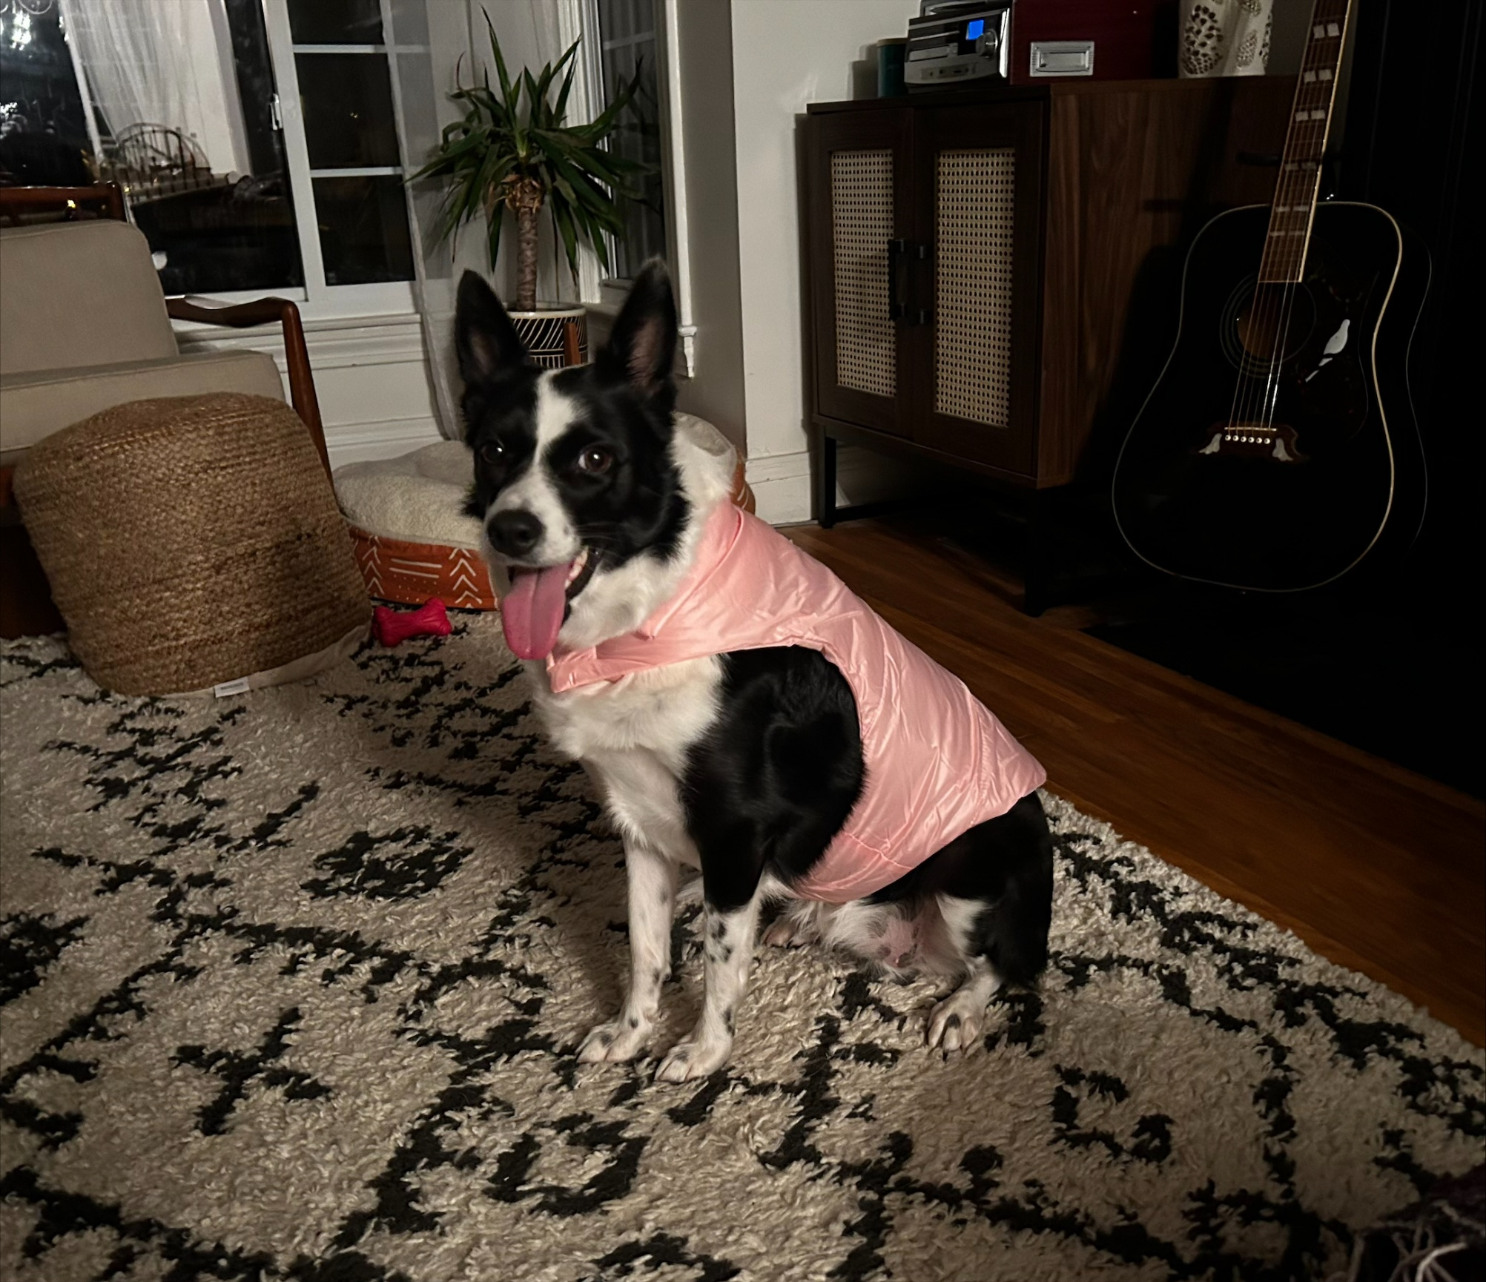
Miles Devon Skeens
Directing Attorney, AppalReD Hazard
Practicing domestic violence law since law school.
Mother was an OG victim’s advocate.

Slide 6
Agenda
  Types of Protective Orders / How to Qualify
  Process to Obtain an Order
  Petition
  Discovery
  Hearing
  Consequences / Outcomes
  Enforcement
01
APPALRED LEGAL AID

Slide 7
Types of Protective Orders
ARDFKY.ORG

Slide 8
EPO/DVO
  Originates in KRS chapter 403
  Petitioner and Respondent must have a qualifying relationship:
    A family member (spouse, including a former spouse, a grandparent, a grandchild, a parent, an adult sibling, a child, a stepchild, or any other person living in the same household as a child if the child is the alleged victim).
    A member of an unmarried couple (each member of an unmarried couple which allegedly has a child in common, any children of that couple, or a member of an unmarried couple who are living together or have formerly lived together).
01
APPALRED LEGAL AID

Slide 9
TIPO/IPO
  Originates in KRS chapter 456
  There must have been a qualifying type of abuse:
    Dating violence or abuse
    Stalking
    Sexual assault
    An adult on behalf of a minor who otherwise qualifies
01
APPALRED LEGAL AID

Slide 10
Protection
  For either type of order, some protection offered is the same:
    The Court can restrict Respondent’s contact with the Petitioner.
    The Court can restrict Respondent’s movement in relation to the Petitioner or Petitioner’s property or place of business.
    The Court can also enter similar protection for children of the Petitioner.
  For DVOs only, the Court can also enter Orders for custody and child support.
  For DVOs only, the Court can also enter firearm restrictions against the Respondent.
01
APPALRED LEGAL AID

Slide 11
Process to Obtain an Order
ARDFKY.ORG

Slide 12
Process
  Take out a petition
  On-call judge enters temporary order (TIPO or EPO) and sets court date.
  Attend court date
  Judge enters “permanent order” (IPO or DVO)
01
APPALRED LEGAL AID

Slide 13
Petition
ARDFKY.ORG

Slide 14
Places to Take Out a Petition
    Circuit Clerk’s Office
    Victim’s Advocate’s Office
    County Attorney’s Office
    Sheriff’s Department
    Police Department
    Law Enforcement can assist with petitions on-site
    Petitions can also be found online but must be filed in the appropriate Circuit Clerk’s office.
01
APPALRED LEGAL AID

Slide 15
Which County?
    Petitioners can file in:
      The county where they reside OR
      The county where they have fled to escape the violence.
01
APPALRED LEGAL AID

Slide 16
Immediate Review
    KRS 403.730 (EPO and DVO) and 456.040 (TIPO and IPO):
      Court shall review a petition for an order of protection immediately upon its filing.
      If this review indicates that covered violence has occurred, the Court shall summon the parties to an evidentiary hearing within 14 days.
      If review also indicates the presence of an immediate and present danger, the court shall issue an ex parte emergency order (TIPO or EPO).
01
APPALRED LEGAL AID

Slide 17
Discovery
ARDFKY.ORG

Slide 18
Discovery
  Definition – legal process of obtaining evidence for use in a legal case.
  Timeline for DV cases is normally condensed – Petitioners entitled to hearing within 14 days (if service obtained).
  This makes use of the normal discovery rules difficult.
  However….
01
APPALRED LEGAL AID

Slide 19
Discovery
  Kentucky courts have ruled that all civil rules normally used in civil cases are also available for use in DV cases. Wolfe v. Wolfe, 393 SW 3d 42, 44 (Ky. App. 2013).
  They have also ruled that due process requires a “full evidentiary hearing” in compliance with statutory and court rules. Hohman v. Dery, 371 SW 3d 780, 783 (Ky. App. 2012).
  Can be used to conduct discovery like depositions, interrogatories, requests for production of documents, etc.
01
APPALRED LEGAL AID

Slide 20
Discovery
  Some cases require more substantial discovery, some do not.
  On the Petitioner’s side, it is much easier to win these cases when they have physical evidence of some kind to support their claim.
  Ex., text messages, voicemails, pictures of injuries or weapons.
  IMPORTANT: just because there is no physical evidence, does not mean there is no CASE. Testimony is evidence!
01
APPALRED LEGAL AID

Slide 21
Hearing
ARDFKY.ORG

Slide 22
Standard of Proof
  There is a two-part standard which must be proven by a preponderance of the evidence for a court to enter a “permanent order” (DVO/IPO):
    1. Covered violence or threat of violence has occurred.
    2. Such violence or threat of violence may occur again.
01
APPALRED LEGAL AID

Slide 23
“Violence or abuse”
    Chapter 403 (DVO): “Physical injury, serious physical injury, stalking, sexual assault, strangulation, assault, or the infliction of fear of imminent physical injury, serious physical injury, sexual assault, strangulation, or assault.”
01
APPALRED LEGAL AID

Slide 24
“Dating Violence and abuse”
    Chapter 456 (IPO): Physical injury, serious physical injury, stalking, sexual assault, strangulation, or the infliction of fear of imminent physical injury, serious physical injury, sexual abuse, strangulation, or assault occurring between persons who are or have been in a dating relationship.
01
APPALRED LEGAL AID

Slide 25
“Sexual Assault”
    Chapter 456 (IPO): conduct prohibited as any degree of rape, sodomy, or sexual abuse under KRS Chapter 510 or a criminal attempt, conspiracy, facilitation, or solicitation to commit any degree of rape, sodomy, or sexual abuse, or incest under KRS 530.020.
01
APPALRED LEGAL AID

Slide 26
“Stalking”
    Chapter 456 (IPO): conduct prohibited as stalking under KRS 508.140 or 508.150, or a criminal attempt, conspiracy, facilitation, or solicitation to commit the crime of stalking.
01
APPALRED LEGAL AID

Slide 27
“Stalking”
    IPO statute refers specifically to the criminal code for standard of what constitutes “stalking:”
    KRS 508.150:
      (1) A person is guilty of stalking in the second degree when he intentionally:
        (a) Stalks another person; and
        (b) Makes an explicit or implicit threat with the intent to place that person in reasonable fear of:
          1. Sexual contact as defined in KRS 510.010;
          2. Physical injury; or
          3. Death.
01
APPALRED LEGAL AID

Slide 28
“Stalk”
    KRS 508.130:
    Stalk –
    (a) To "stalk" means to engage in an intentional course of conduct:
    1. Directed at a specific person or persons;
    2. Which seriously alarms, annoys, intimidates, or harasses the person or persons; and
    3. Which serves no legitimate purpose.
01
APPALRED LEGAL AID

Slide 29
“Strangulation”
    KRS 456: refers to conduct prohibited by KRS 508.170 and 508.175, or a criminal attempt, conspiracy, facilitation, or solicitation to commit the crime of strangulation.
    KRS 508.175: (1) A person is guilty of strangulation in the second degree when the person, without consent, wantonly impedes the normal breathing or circulation of the blood of another person by:
        (a) Applying pressure on the throat or neck of the other person; or
        (b) Blocking the nose or mouth of the other person.
01
APPALRED LEGAL AID

Slide 30
What to Expect at the Hearing
    Mini trial
    Opening statements
    Each side will present a case, testimony, witnesses, evidence.
    Each witness is subjected to cross-examination.
    Closing arguments
    These are always bench trials, meaning the judge decides the facts (no jury).
    A “permanent” order will either be awarded or denied at the hearing.
01
APPALRED LEGAL AID

Slide 31
Consequences/Outcomes
ARDFKY.ORG

Slide 32
IMPORTANT
    Both the IPO statute and the DVO statute forbid:
      Orders which restrict the petitioner in any way.
      Consequences of any type being levied against the Petitioner for filing a petition.
      Mediation or counseling prior to a hearing unless agreed to by the parties.
      Orders that control both parties unless there are cross-petitions.
      Any monetary cost levied against the Petitioner by the Court.
01
APPALRED LEGAL AID

Slide 33
Restrictions on Movement
    Either a temporary or a permanent order may restrain the respondent from:
      Committing further acts of violence.
      Any contact or communication with the Petitioner or other person specified by the Court.
      Approaching the Petitioner within a specific area not to exceed 500 feet.
      Going to or within a specified distance of a specifically described residence, school, or place of employment.
      Disposing of or damaging property belonging to Petitioner.
01
APPALRED LEGAL AID

Slide 34
Counseling
    The Court can order that either party receive counseling services available in the community.
      Petitioners: CHOICES
      Respondents: Batterers Intervention Program
01
APPALRED LEGAL AID

Slide 35
Living Arrangements / Children
    The Court can also order a Respondent to vacate a specific residence shared by the parties.
    The Court can grant temporary child support.
    The Court can also award temporary custody.
    The Court can also award possession of any family pets to the Petitioner.
01
APPALRED LEGAL AID

Slide 36
Gun Rights
    Pursuant to federal law, any person with a domestic violence protective order entered against them is not authorized to own, possess, or attempt to own or possess firearms or ammunition.
    This is always under attack, but for now remains the law.
    Interestingly, EPOs, IPOs, and TIPOs do not count as “domestic violence orders” pursuant to federal law.
01
APPALRED LEGAL AID

Slide 37
Duration
    Both IPOs and DVOs can be entered by a Court for a period of up to three years.
    They can be renewed by the Petitioner as long as they motion the court to do so before their expiration. Nothing new has to have happened.
    This is why I refer to them as “permanent” orders.
01
APPALRED LEGAL AID

Slide 38
Enforcement
ARDFKY.ORG

Slide 39
Dual Options for Enforcement
    Under Kentucky law, violation of a protective order can be enforced in one of two distinct ways:
    Court’s contempt power
    A criminal charge (misdemeanor)
01
APPALRED LEGAL AID

Slide 40
Police Enforcement
    If a police officer has sufficient probable cause to believe an IPO or DVO has been violated, they are empowered to immediately arrest the offender and charge them with the violation.
    Many still will not.
01
APPALRED LEGAL AID

Slide 41
Questions?

