Slide 1

Safety Planning with Survivors
Michelle Fisher
Senior LAV Staff Attorney
AppalReD Legal Aid
michellef@ardfky.org

Slide 2
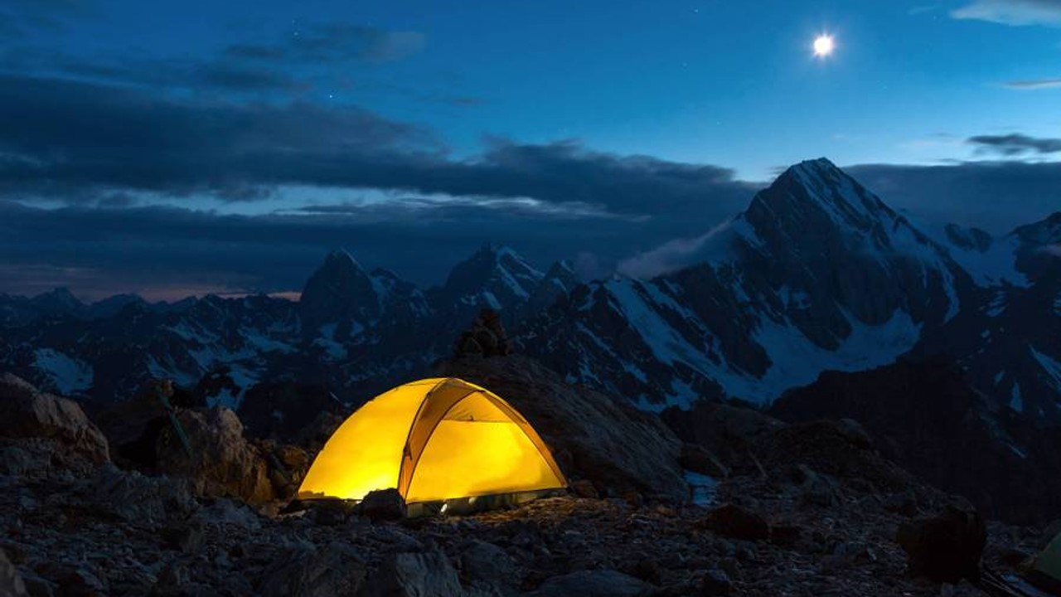
KNOW WHO IS IN THE ROOM
61% of bisexual women face IPV
65% of immigrant victims report some form of immigration related abuse
3 out of 4 disabled people experience some form of abuse

Slide 3

What does safety mean for them?
NCADV interactive guide to safety planning at
https://www.thehotline.org/plan-for-safety/create-your-personal-safety-plan
How are they meeting basic needs?
What are their goals?
What are important considerations for them?
Are there connections you can help them make?
Reinforce and build good practices to address immediate safety, identify escape routes, gather important documents, and build an emergency kit

Slide 4
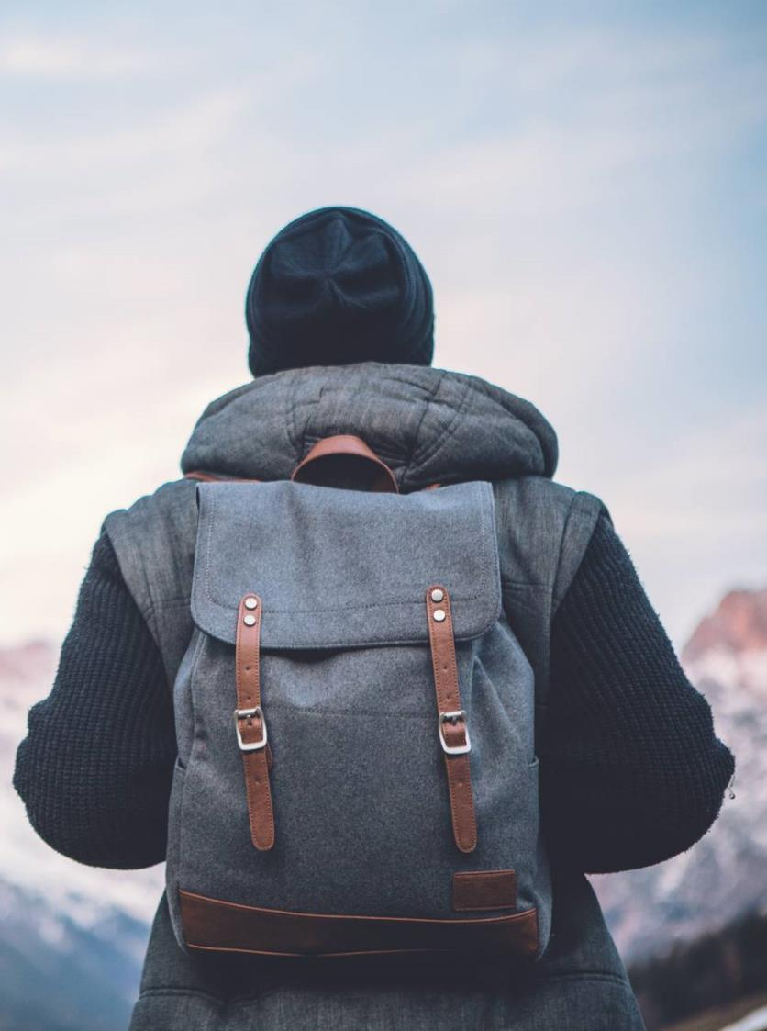
Physical Safety
Safety in shelter: locks, security systems, safety apps
Discuss safe spaces—if you do meet, do so in these conditions
$$$--Discuss bills, necessary expenses, and how those are going to be met
Identify shared spaces (routes, stores, public areas, and how to minimize them)
Know their options—are you prepared to describe what life in shelter might be like? What kind of a relationship do you have with local domestic violence shelters, victim advocates, and homeless shelters?

Slide 5

Digital Safety
Social Media
Secure Communication
Location sharing and passwords
Pictures
Air tags
RING Doorbells,
Amazon Alexa and Echo
Google Home Hub
Nest systems/smart thermostats
Smart TVs
Smart Plugs
Fitness trackers/Smartwatches
Wireless systems
Smart locks
CCTV Cameras
Recommend:
The Safety Net Project by NNEDV
https://www.techsafety.org/resources-survivors/technology-safety-plan

Slide 6
Tech Check
List all devices and accounts
Note which of these the perp. has access to
Think about what info is on those accounts
Change all passwords
Do not use the same password
Use a unique passphrase for each account or password manager
Change password to WiFi
Consider security question answers—fake
Auto saved passwords—OFF
Sign out when not in use
2 Factor Authentication
Do not use one account to log in to another
Remove email addresses from shared accounts/devices/Trusted Devices
Block, delete, unfriend
  After gathering evidence
Camera cover
Different device
Guard personal information online
Location sharing/GPS/Find My Phone, Find My Friends—turn off
**Delete history**
Check out of checking in
Change privacy settings
Use screenshot v. photo for metadata
Check Last Account Activity
P.O. Box

Slide 7
Tech Check
Untether phone/other devices
Search belongings
Examine gifts/unusual items for hidden cameras
Check children’s accounts
Home security system access
Network scanners/port scanners/etc. to detect hidden cameras
Check apps! Delete anything unfamiliar
Spyware—law enforcement can check (running slow, battery draining, data being used, device hot, lighting up when not in use, clicks/sounds/calls, long time to shut down
Devices up to date! Then check privacy settings
Replacing devices entirely if an option—do not back up
Unusual hardware (keyloggers between keyboard/desktop)
Alternate email accounts, social media—do not sign into on personal or shared devices
Consider automatic content uploaded/connected
List images/videos they may access
Reverse image search
Google alert for name
Back ups for your back ups—evidence

Slide 8

Emotional safety
“That is emotional manipulation that only benefits you”
Plan for boundary crossing
Parenting apps
Parenting conduct orders
Emergency plan
Identify triggers/traumas/reactions
Create a safe space—grounding techniques
  Discuss how to do this in public
Identify self care for body and mind
Affirmations—Identify what is uplifting and good (books, podcasts, tv, movies, social media, people
Coping strategies—discuss the s word.
Support—build connections
Set boundaries
  Emotional, mental, physical

Slide 9
Legal Options : Protective Orders
Advantages
  Documentation
  Speaking their truth can be freeing, even if they don’t “win”
  Temporary Custody Orders
  Get basic belongings
  No guns!....?
Disadvantages
  Reveals county location
  Must stay for court proceeding
  Can be re-traumatizing
  What if they lose?
  The cost of dismissal
  *Immigration*

Slide 10
Update your safety plan!
Needs change
  Example: Before, During, and After Court
Wants change
Circumstances change
Use basic building blocks so survivors can adjust—without you.
  Consider where they may see the abuser
  Thought experiment re: safety
  Share local, state, and national resources
  Discuss risks…but help them plan for the future

Slide 11

Speak life.
We are uniquely situated to point out all the times survivors were strong, smart, kind, good, resourceful, and capable.
Remind them of these times, often, so they can start reminding themselves.

Slide 12

Thank you
Michelle Fisher, Esq.
michellef@ardfky.org
(606)679-7313 Ext. 7209

