Slide 1



AppalReD
Legal Aid
Pro Bono Program
Who we are, what we do, and the ethics of offering free legal help for victims

Slide 2
Who We Are
AppalReD began in 1970 and had three operating offices in Prestonsburg, Barbourville, and on the campus of the University of Kentucky in Lexington. AppalReD now serves 37 eastern and south-central Kentucky counties, and today has six offices throughout the region.
In the early days, AppalReD addressed many devastating environmental and coal mine-related issues such as black lung disease, abusive land use practices, and disfigured mountain tops caused by strip mining. AppalReD clients still face some of these same challenges, but even more devastating to the region are the socioeconomic challenges that promote instability and threaten to keep the region mired in poverty.

Slide 3
What we do
Today, AppalReD operates six local law offices across the region. Each covers a defined service area and is staffed by attorneys, paralegals, and legal secretaries with a high degree of specialized training in the legal matters we handle.
Our experts in housing law, consumer law, family law, domestic violence, and public benefits do more than serve our clients. Annually, our attorneys and support staff host trainings open to private attorneys and legal staff, like our well-known, annual Domestic Violence Conference and Poverty Law seminars. AppalReD engages in outreach efforts, attending community events and making contact with people to learn more about what is going on in the area. AppalReD offers a unique Volunteer Lawyers Program, and our Low-Income Tax Clinic stretches to provide help with income tax problems to residents of all 120 Kentucky counties.

Slide 4
Our mission
AppalReD’s mission is to promote equal access to justice, encourage self-sufficiency, and empower and improve the lives of low-income and other vulnerable people and families in eastern and south-central Kentucky by providing them high-quality legal assistance.

Slide 5

Our values

Slide 6

Why volunteer with us?

Slide 7
Professional responsibility in providing services to victims
Kentucky Rules of Professional Responsibility
Preamble: A Lawyer’s Responsibilities
II. A lawyer, as a member of the legal profession, is a representative of clients, an officer of the legal system and a public citizen having special responsibility for the quality of justice.

Slide 8
Kentucky Rules of Professional Responsibility preamble (cont’d)
VII. As a public citizen, a lawyer should seek improvement of the law, access to the legal system, the administration of justice and the quality of service rendered by the legal profession…A lawyer should be mindful of deficiencies in the administration of justice and of the fact that the poor, and sometimes persons who are not poor, cannot afford adequate legal assistance…Therefore, all lawyers should devote professional time and resources and use civic influence to ensure equal access to our system of justice for those who because of economic or social barriers cannot afford or secure adequate legal counsel.

Slide 9

SCR 3.130(6.1) Donated Legal Services
A lawyer is encouraged to voluntarily render public interest legal service. A lawyer is encouraged to accept and fulfill this responsibility to the public by rendering a minimum of fifty (50) hours of service per calendar year by providing professional services at no fee or a reduce fee to persons of limited means, any/or by financial support for organizations that provide legal service to persons of limited means.

Slide 10

Other rules of professional responsibility apply
SCR 3.130(6.5) Nonprofit and court-annexed limited legal services programs
(a) A lawyer who, under the auspices of a program sponsored by a nonprofit organization or court, provides short-term limited legal services to a client without expectation by either the lawyer or the client that the lawyer will provide continuing representation in the matter:
  (1) is subject to Rules 1.7 and 1.9(a) only if the lawyer knows that the representation of the client involves a conflict of interest; and
  (2) is subject to Rule 1.10 only if the lawyer knows that another lawyer associated with the lawyer in a law firm is disqualified by Rule 1.7 or 1.9(a) with respect to the matter.
  (b) Except as provided in paragraph (a)(2), Rule 1.10 is inapplicable to a representation governed by this Rule.
Notes:
Rule 1.7
Except as provided in paragraph (b), a lawyer shall not represent a client if the representation involves a concurrent conflict of interest. A concurrent conflict of interest exists if:
the representation of one client will be directly adverse to another client; or
there is a significant risk that the representation of one or more clients will be materially limited by the lawyer's responsibilities to another client, a former client or a third person or by a personal interest of the lawyer.
(b) Notwithstanding paragraph (a), a lawyer may represent a client if:
the lawyer reasonably believes that the lawyer will be able to provide competent and diligent representation to each affected client;
the representation is not prohibited by law;
the representation does not involve the assertion of a claim by one client against another client represented by the lawyer in the same litigation or other proceeding before a tribunal; and
each affected client gives informed consent, confirmed in writing. The consultation shall include an explanation of the implications of the common representation and the advantages and risks involved.
Rule 1.9(a)
A lawyer who has formerly represented a client in a matter shall not thereafter represent another person in the same or a substantially related matter in which that person's interests are materially adverse to the interests of the former client unless the former client gives informed consent, confirmed in writing.
Rule 1.10
While lawyers are associated in a firm, none of them shall knowingly represent a client when any one of them practicing alone would be prohibited from doing so by Rules 1.7 or 1.9, unless the prohibition is based on a personal interest of the prohibited lawyer and does not present a significant risk of materially limiting the representation of the client by the remaining lawyers in the firm.
When a lawyer has terminated an association with a firm, the firm is not prohibited from thereafter representing a person with interests materially adverse to those of a client represented by the formerly associated lawyer and not currently represented by the firm, unless:
the matter is the same or substantially related to that in which the formerly associated lawyer represented the client; and
any lawyer remaining in the firm has information protected by Rules 1. 6 and 1.9(c) that is material to the matter.
(c) A disqualification prescribed by this rule may be waived by the affected client under the conditions stated in Rule 1.7.
(d) A firm is not disqualified from representation of a client if the only basis for disqualification is representation of a former client by a lawyer presently associated with the firm, sufficient to cause that lawyer to be disqualified pursuant to Rule 1.9 and:
the disqualified lawyer is screened from any participation in the matter and is apportioned no specific part of the fee therefrom; and
written notice is given to the former client.
(e) The disqualification of lawyers associated in a firm with former or current government lawyers is governed by Rule 1.11.
Rule 1.11
Except as law may otherwise expressly permit, a lawyer who has formerly served as a public officer or employee of the government:
is subject to Rule 1.9(c); and
shall not otherwise represent a client in connection with a matter in which the lawyer participated personally and substantially as a public officer or employee, unless the appropriate government agency gives its informed consent, confirmed in writing, to the representation.
(b) When a lawyer is disqualified from representation under paragraph (a), no lawyer in a firm with which that lawyer is associated may knowingly undertake or continue representation in such a matter unless:
the disqualified lawyer is timely screened from any participation in the matter and is apportioned no part of the fee therefrom; and
written notice is promptly given to the appropriate private public body or government agency to enable it to ascertain compliance with the provisions of this Rule.
(c) Except as law may otherwise expressly permit, a lawyer having information that the lawyer knows is confidential government information about a person acquired when the lawyer was a public officer or employee, may not represent a private client whose interests are adverse to that person in a matter in which the information could be used to the material disadvantage of that person. As used in this Rule, the term “confidential government information” means information that has been obtained under governmental authority and which, at the time this Rule is applied, the government is prohibited by law from disclosing to the public or has a legal privilege not to disclose and which is not otherwise available to the public. A firm with which that lawyer is associated may undertake or continue representation in the matter only if the disqualified lawyer is timely screened from any participation in the matter and is apportioned no part of the fee therefrom.
(d) Except as law may otherwise expressly permit, a lawyer currently serving as a public officer or employee:
is subject to Rules 1.7 and 1.9; and
shall not:
participate in a matter in which the lawyer participated personally and substantially while in private practice or nongovernmental employment, unless the appropriate government agency gives its informed consent, confirmed in writing; or
negotiate for private employment with any person who is involved as a party or as attorney for a party in a matter in which the lawyer is participating personally and substantially, except that a lawyer serving as a law clerk to a judge, other adjudicative officer or arbitrator may negotiate for private employment as permitted by Rule 1.12(b) and subject to the conditions stated in Rule 1.12(b).
(e) As used in this Rule, the term “matter” includes:
any judicial or other proceeding, application, request for a ruling or other determination, contract, claim, controversy, investigation, charge, accusation, arrest or other particular matter involving a specific party or parties, and
any other matter covered by the conflict of interest rules of the appropriate government agency.
Rule 1.12(b)
(b) A lawyer shall not negotiate for employment with any person who is involved as a party or as attorney for a party in a matter in which the lawyer is participating personally and substantially as a judge or other adjudicative officer, or as an arbitrator, mediator or other third-party neutral. This rule does not prohibit an arbitrator, mediator, or third-part neutral from negotiating future cases. A lawyer serving as a law clerk to a judge or other adjudicative officer may negotiate for employment with a party or lawyer involved in a matter in which the clerk is participating personally and substantially, but only after the lawyer has notified the judge or other adjudicative officer.

Slide 11
Make a difference
Legal Representation changes lives.
Individuals who cannot afford an attorney or access critical information are unlikely to prevail in complex court systems designed for those with legal representation. But with you by their side, clients win. And we all win when the result is safer and more secure lives for members of our communities.
AppalReD Legal Aid’s Pro Bono program helps meet the tremendous need for civil legal help in eastern and south-central Kentucky.

Slide 12
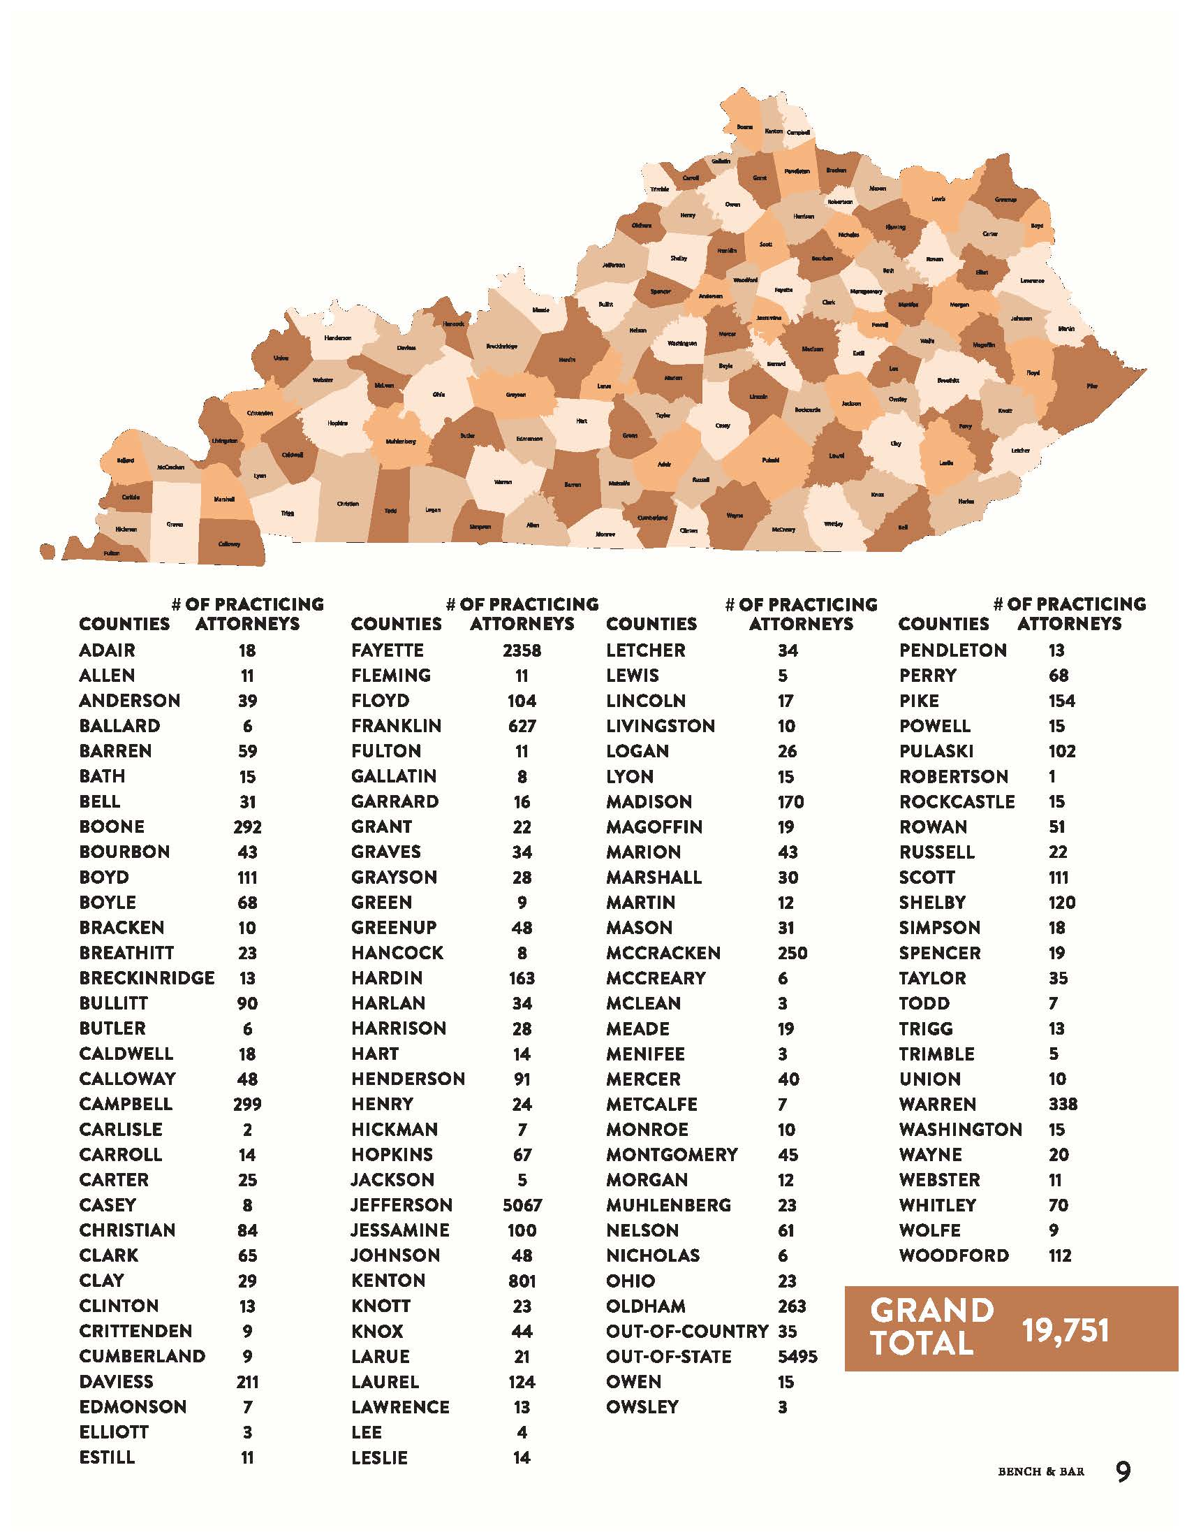
Kentucky population as of 2020 census was 4.5 million.
That is 1 attorney for every 228 Kentuckians.
But…

Slide 13
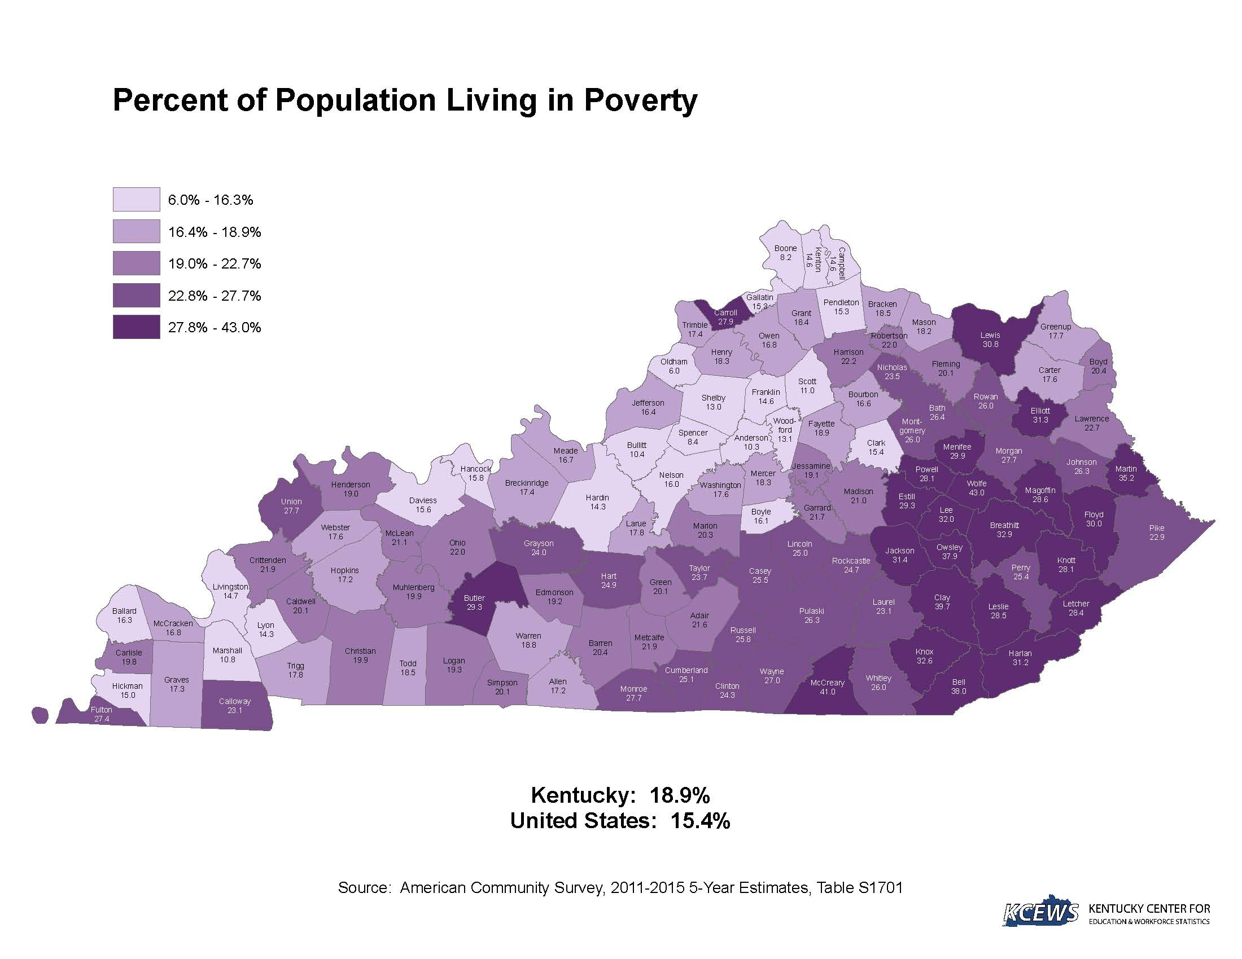
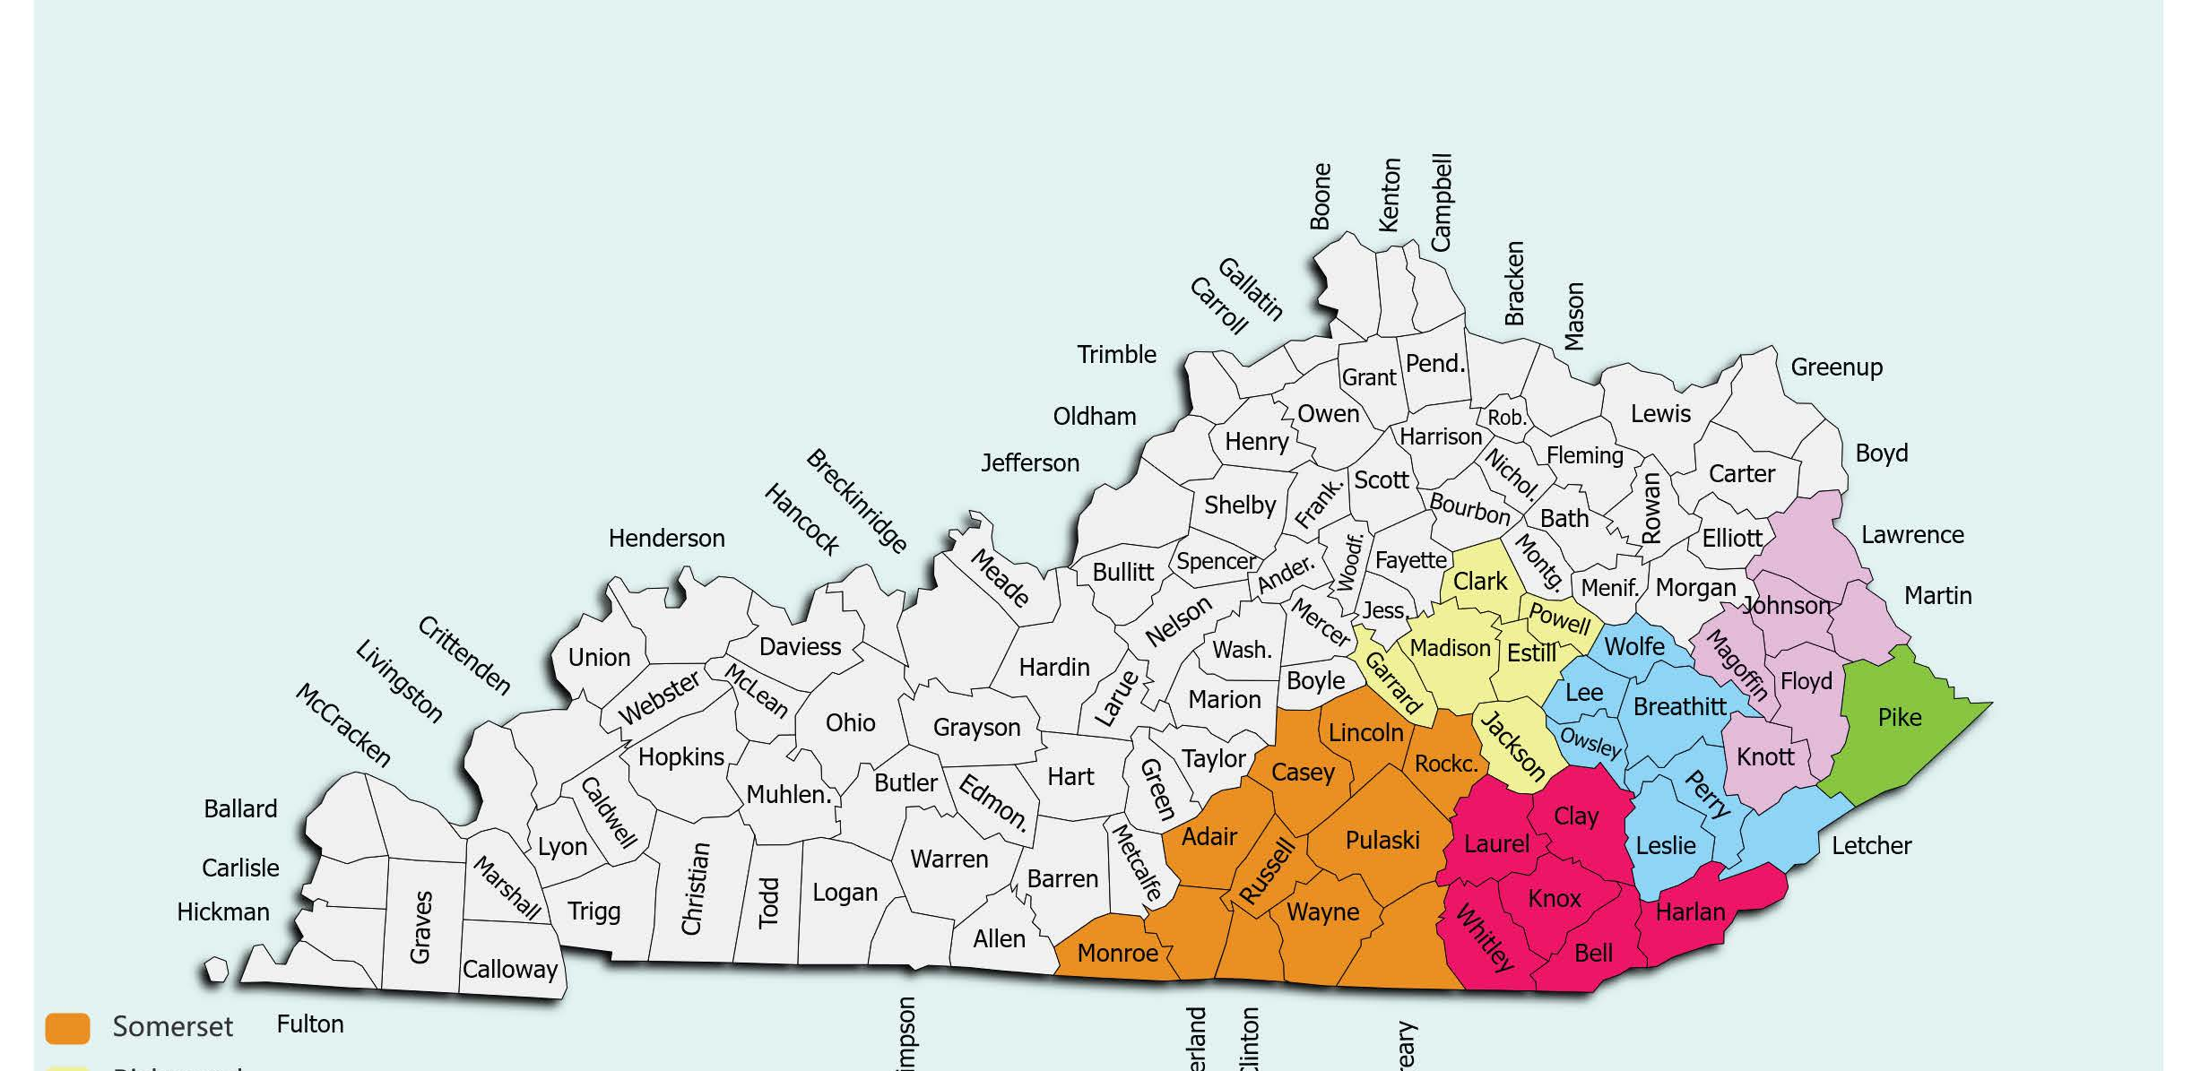

Slide 14
Training and support for pro bono volunteers
Support: AppalReD provides training, mentoring, and co-counseling opportunities for volunteer attorneys.
Coverage: AppalReD Legal Aid’s malpractice insurance covers the activities of our volunteer attorneys.
Meeting Space: AppalReD Legal Aid’s six offices can provide space to meet with clients.
Fees: “Low Bono” or Private Attorney Involvement contracts are available! Volunteer attorneys receive the maximum fee to assist.

Slide 15

Attorney pro bono opportunities
AppalReD offers the following pro bono attorney opportunities:

Slide 16
Pro Bono Case Referrals
We can send you case referrals for pro bono representation in the following areas:
family law, bankruptcies, collection cases, and evictions.
1
Low-Income Taxpayer Clinic
You can volunteer to provide pro bono help to clients with IRS tax issues.
2
Reduced-Fee Case Referrals
We can send you case referrals in family law, bankruptcy, eviction, and collections for you to handle at a reduced fee.
3
Pro Se Clinics
AppalReD holds clinics to help pro se litigants with divorces and other family law cases. You can volunteer to help at a clinic.
4

Slide 17

For more information
Contact:
Charnel M. Burton
Pro Bono Director
Office: 606-886-3876 ext. 1315
Fax: 606-886-0079
Email: charnelb@ardfky.org
Or go to our website at: www.ardfky.org

