Slide 1
Communication and language access
Providing quality services for people who communicate differently from you
Meg Savage (she/her), CLO
Olivia Spradlin (she/her) Sr Program Specialist

Slide 2
Introducing ZeroV
  Mission
    To abolish the social conditions and systems that spark, enable, and amplify Intimate Partner Violence, and to create communities where all Kentuckians can live and thrive in safety and peace.
  Vision
    All individuals, families, and communities have what they need to live in safety and thrive.
    We are still the statewide coalition for our 15 designated member programs and fulfill the role of advocating at the state level for survivors and victims of intimate partner violence.

Slide 3
Learning objectives
Attendees will understand the importance of language access.
Attendees will learn best practices for providing advocacy by utilizing interpretation and/or translation services.
Attendees will become familiar with resources and tools to assist in providing advocacy with people needing language services.

Slide 4
Individual/program responsibilities
To provide non-discriminatory services, specifically to not discriminate on the basis of English proficiency
To provide language access, as defined in the federal register, includes providing notice, available and accessible documents, investment in policies and procedures, periodic training and monitoring, and training.
Familiarize yourself with your agency’s Limited English Proficiency Plan and Language Access Policies and Procedures

Slide 5
Federal Register
Vol. 67, NO. 117 Tuesday June 18, 2002/Notices, p 41455-41472
Comports with Meaningful Access
All staff serve all persons, all persons receive equitable services

Slide 6
What are discriminatory services?
Limiting participation in a program or activity on the basis of an aspect of identity
Subjecting people from underserved communities to unreasonable delay in services
Failing to inform members of underserved populations about their right to access services and reasonable accommodations and to do so free of charge
Providing services that are more limited or lower in scope than those provided to other persons
Notes:
This is what we’re trying to make a plan to avoid and how your LEP plan can help you.

Slide 7
Notice
Letting LEP persons know that services and accommodations are available, free of charge
Providing notice in languages other than English
Examples:
  Posting signs in intake areas, entry points, and common areas
  Stating availability of information, accommodations, and services in documents
  Working with and sharing information with community-based organizations and stakeholders
  PSAs and Media
  Public Awareness and Community Engagement and Education
Notes:
What are the ways you are providing notice?
Also think virtually, like social media and website?
Where in your community do you need to be?
What stake holders do you need to be working with?
What languages do you need to provide notice in?

Slide 8
Policy and Procedure
Each agency’s needs vary, and every agency should have a tailored Limited English Proficiency plan.
All volunteers and staff should be reasonably prepared to serve all people requesting services and communicate with them (and their families or other stakeholders as appropriate) effectively and efficiently, in order to perform best interest advocacy.
Reach out to your agency for specific guidance, policies, and procedures. Read them; know them.

Slide 9
Interpretation vs translation
Translating refers to written text, documents, forms
Interpretation refers to spoken interactions

Slide 10
Available and Accessible Documents
What materials do you need translated so that LEP persons can fully participate in your services?
What materials do you have available?
Who can you get to translate?

Slide 11
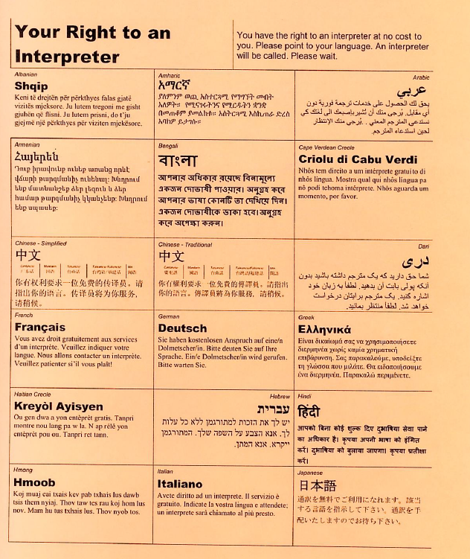
Language identification sheet
Sample: CASA of Lexington
Laminated language sheet to identify language needs
Useful for home visits

Slide 12
Interpreters
You may interact with a variety of interpreters:
  Court-provided interpreters
  DCBS-provided interpreters
  Interpreters provided by the CASA program
  Telephone interpreters, virtual meetings
You would most likely need an interpreter during a home visit or phone call.
Consult with your program on how to access an interpreter when needed.

Slide 13
Best practices when working with interpreters
Introduce the interpreter
Speak directly to your client, not to the interpreter
Physically position yourself aligned with client
Do not switch to third person pronouns (she/he/they); use second person pronouns (you) when referencing your client
Modulate speed rather than volume
Speak at an even pace and in short segments
Be patient, possibly allow for extra time
Do not use idioms; speak directly

Slide 14
Best practices when working with interpreters
Encourage interpreter to ask you questions if they need clarification
Repeat back important information to make sure everyone understands
Remember the interpreter’s job is to interpret accurately anything that is said in the meeting. If there are things you don’t want the interpreter to relay, then don’t say them. Similarly, if any party is divulging information that may be harmful, you may want to remind them of this, re-steer the conversation, or suggest that another meeting be scheduled with appropriate parties.

Slide 15
Who cannot be an interpreter?
Children
Family member of the child
Family member of the alleged abuser
Friend of the family
Interpreter used by the alleged abuser
Notes:
Children: Putting a child in the middle of a parental conflict creates incredible pressure on the child, who is likely to feel torn regarding with whom to side; the child may be fearful of the batterer and feel pressured to interpret in his favor; children may not have the necessary vocabulary to interpret legal information to the parent.
Family Member of the Victim: Despite the fact that a family member of the victim offers or volunteers to interpret, he or she may be blaming the victim for the abuse and not have a sufficient understanding of the dynamics of domestic violence to effectively provide support to the victim. The family member may also exaggerate the victim's testimony in order to support her, which can lead to discrediting the victim-witness on cross-examination. Additionally, the family member might not have the necessary vocabulary to interpret legal information to the victim.
Family member of the perpetrator/primary aggressor: A family member of the perpetrator / aggressor could intentionally volunteer to interpret in order to control what the victim says or manipulate the victim's words. A family member of the defendant might blame the victim for the abuse. The family member also not understand the dynamics of domestic violence to effectively provide support to the victim.
Friend of the family: As with family members, a friend who offers to interpret may wish to control what the victim says, reporting back to the family what the victim is saying or blaming the victim for abuse. A friend may not sufficiently understand the dynamics of domestic violence to effectively (through their role as an interpreter) provide support to the victim. He or she may also not have the necessary vocabulary to interpret legal information to the victim.
Interpreter used by the primary perpetrator/aggressor: A person who interprets for the batterer should not be allowed to interpret for the victim. This would create a significant risk of replicating the same dynamic of power and control that is used in a the perpetrator's battering behavior. It could also inhibit what the victim is willing to discuss with the service provider.
By and large, this is a list of individual who might influence the message or who we would be compromising to ask to fulfill this service.

Slide 16
Who should be an interpreter?
Someone who has a commitment to interpreter ethics
Received training in interpreter skills
Proficient in both languages.
Non-judgmental
Adult

Slide 17
Qualified interpreters
Certified Interpreters aren’t always available
How are you and your programs determining if an interpreter is qualified?
Qualified and community interpreters are subject to codes of ethics
  Check with your program or agency as to these codes
Notes:
Certified, Qualified and community interpreters
Language proficiency-understand that your role isn’t to explain certain court proceedings, but the interpreter might still need to know what the equivalent of that court proceeding is in the language they’re interpreting

Slide 18
Language Line
Service that provides interpretation for phone calls, virtual meetings, and limited in-person communication
Use for Video Remote Interpreting (VRI) for ASL
Can be accessed through phone, apps, internet, tablets, and for video with devices with cameras
Can be scheduled ahead of time or accessed as needed

Slide 19
Use of bilingual advocates/service providers
-May still need to offer an interpreter – be aware of what role you are filling if you are interpreting for your client
-Familiarize yourself with your agency’s expectations for interpretation and for interpretation ethics
-Pay attention to the person speaking and then address the person you are speaking to
-In this dual role, you may need to attribute who is saying what to avoid confusion
-Ask both parties to speak at a moderate speed and to offer pauses so that you can interpret smaller sections rather than having to remember multiple sentences or paragraphs.
-If you are serving as the interpreter, may need to have a pre session with the parties separately and before your meeting to set expectations and roles
-Not a reason for your agency to not provide interpreters - the goal is that all staff serve all persons and that all persons receive equitable services.

Slide 20
Ethics for interpreters
Maintain Confidentiality
Never Give Medical or Legal Advice
Remain Impartial
Interpret faithfully and accurately to convey the content and spirit of what is being said; do not paraphrase; should interpret everything said
If you make a mistake, acknowledge it and go back and fix it. If you do not know a word, inform the client
May not accept tips or gratuity from clients
Notes:
Massachusetts Medical Interpreters Association
California Standards for Medical Interpreters
Ethics for Community Interpreters by M. Eta Trabing

Slide 21
Special populations
Deaf or Hard of Hearing
  Access Kentucky Relay Service, through Kentucky Commission on Deaf and Hard of Hearing
  TTY machines
  Video Remote Interpreting for ASL
  School for The Deaf in Danville, Kentucky

Slide 22
Special populations
Complex communications needs – CCN
Limited use and/or understanding of speech
  Developmental disability
  Genetic condition
  Acquired conditions such as dysarthria, stroke, acquired brain injury
  Progressive disorders like motor neurone disease
  Cognitive communication disorders like aphasia
AAC – Augmentative and alternative communication - Provides language input and output
Includes all the ways someone can communicate without using spoken language – gestures, facial expressions, limited speech, sign language, pictures, high or low technology, or a combination

Slide 23
Complex Communication Needs
Use their systems and strategies, provide ample time for communication – ask “What is the best way to communicate with you?”
Just as with other types of interpreters, communicate with the person, not the interpreter (if there is one)
Remember CCN does not equate to an intellectual disability; receptive language may be greater than expressive language
Speak in a normal tone and at a normal pace using short sentences. Communicate one idea at a time.
Give specific choices rather than open-ended questions.
Do not pretend to understand when you don’t. If you don’t understand, let the person know and ask them to repeat or say it differently
Communication partner – someone familiar with the person and how they communicate
Caution – that person may be the person doing harm!

Slide 24
Language accessibility and the courts
KRS 30A.410 – when an interpreter shall be provided
In any matter, criminal or civil, the court shall appoint a qualified interpreter, paid by the state, for a party, juror, or witness who is
  Deaf or Hard of Hearing;
  Cannot communicate in English; or
  Has a disability which prevents them from understanding the proceeding and substantially prejudices their rights

Slide 25
Supreme Court of KY, Rules of
Administrative Procedure, Part IX
Court proceeding – in court-proceeding or a court-ordered proceeding in which court officials or Court of Justice personnel are directly involved
Direct service – out of court services provided by Court of Justice entity which enables it to carry out its duties and responsibilities
The Court will appoint a qualified interpreter for “non-parties” as well as parties, jurors, witnesses, and Deaf or Hard of Hearing attorneys during court proceedings or for direct services
A non-party is a person whose presence and participation are necessary and appropriate, such as a parent, guardian, or family member of a juvenile, or a family member, friend, or associate of the party who is an appropriate individual with whom the Court should communicate
The person needing an interpreter, or their advocate or attorney, should make the request for an interpreter in writing to the clerk as far in advance of the hearing as possible

Slide 26
Auxiliary aids and services
The Court should assess each situation on an individualized, case-by-case basis to determine if the court needs to provide auxiliary aids and services to ensure effective communication with people who are Deaf/Hard of Hearing or have a disability
Assistive Listening Devices – a mic, transmission system, and receptive device
CART – Communication Access Realtime Translation – word for word realtime speech to text display
Qualified sign language interpreters – using the same sign system as the individual who is deaf
The Court should give primary consideration to the aid or service preferred by the person who needs it because they are best able to identify the communication barriers that hamper participation

Slide 27
When does the Court not have to provide/pay for an interpreter?
KJOC does not have to pay for or provide interpretation services for non-Court proceedings or direct services, even if the individual is court ordered to obtain services from a non-Court of Justice entity (for example, parenting classes or substance abuse counseling or batterers’ intervention classes)
BUT any entity that receives any federal funding must provide ADA accessible AND nondiscriminatory services, which includes language access for people who are non-English speaking or have Limited English Proficiency, people who are Deaf or Hard of Hearing or people who have Complex Communication Needs
If you are a private or nonprofit business that provides services to the public, the ADA applies to you, and you must be accessible to people who are Deaf or Hard of Hearing

Slide 28
Resources
Complex Communications Needs:
  Statewide Independent Living Council https://silc.ky.gov/Pages/cil.aspx
    centers in Hazard, Murray, Bowling Green, Louisville, Lexington
Disability Rights Advocacy:
  KY Protection & Advocacy (502) 564-2967 http://www.kypa.net/

Slide 29
Questions?
Olivia Spradlin ospradlin@zerov.org
Meg Savage msavage@zerov.org

Slide 30
Grant acknowledgement
This project was supported by VAWA grant VAWA-2022-Kentucky-00056, awarded through the Kentucky Justice and Public Safety Cabinet. The opinions, findings, conclusions, and recommendations expressed in this document are those of the author(s) and do not necessarily reflect the views of federal, state, local, and/or private funders.

