Slide 1
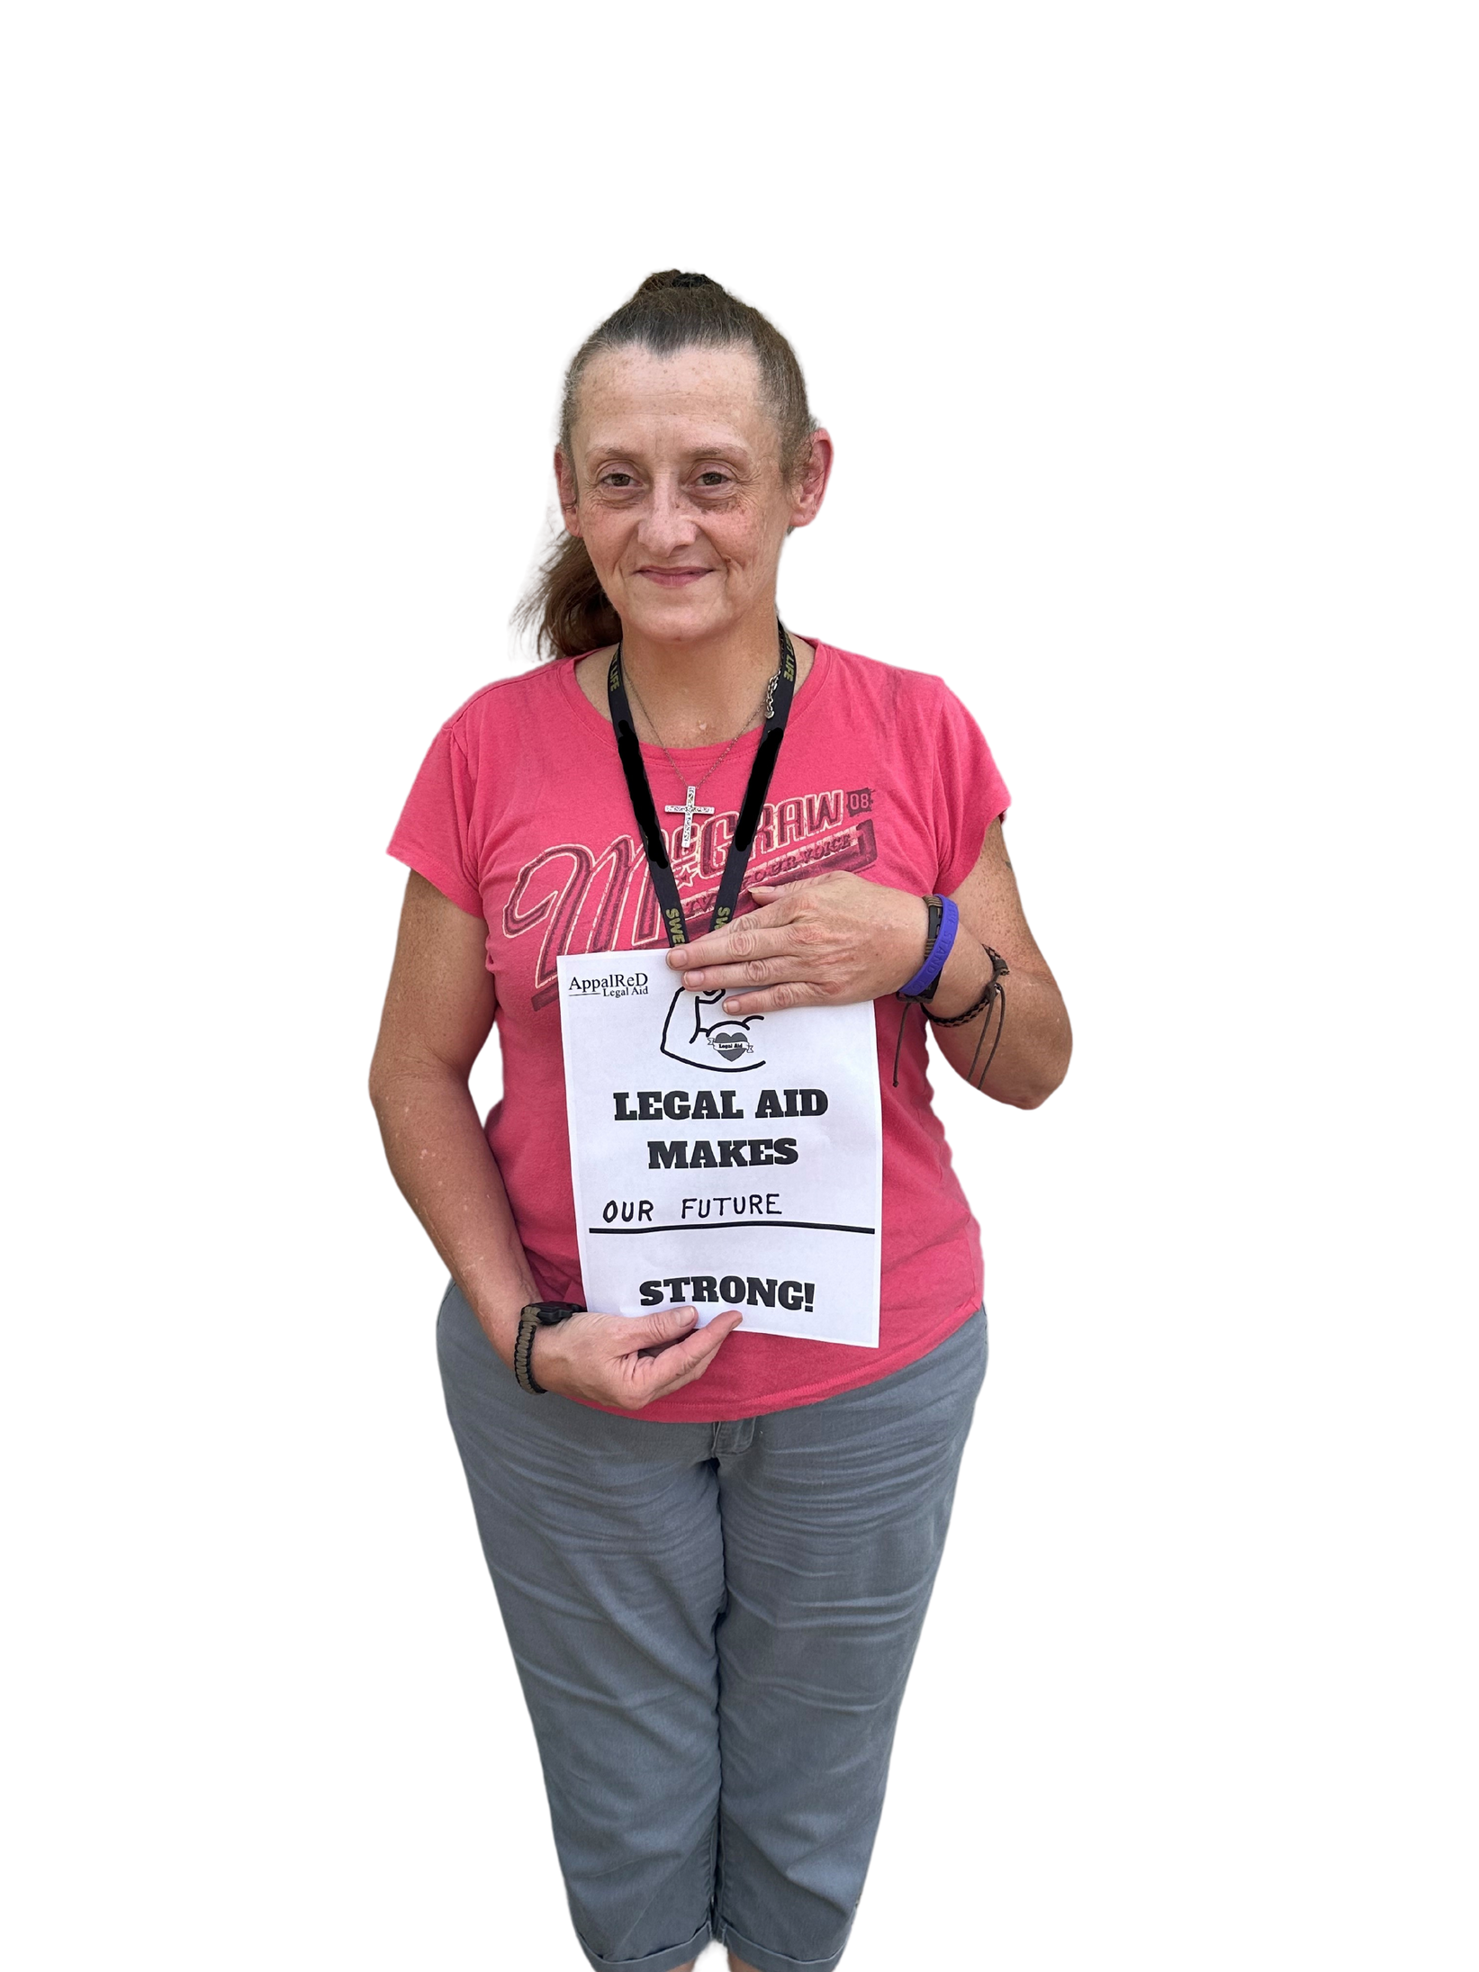

No Excuse for
Elder Abuse
Being prepared for end of life decisions as a way to prevent abuse
Emma Jones
Staff Attorney

Slide 2
Preventing Elder Abuse through early decision making
— The Problem
— The Planning
— The issues
— Client Centered
— The Process
— Contact Us
ARDFKY.ORG

Slide 3

About us
AppalRed Legal Aid has been fighting poverty and providing equal access to justice for folks struggling to make ends meet for nearly 50 years. We give people in our community the legal tools they need to build a secure life for their families.

Slide 4
The National Council on Aging says 1 in 10 Americans aged 60 and older have experienced some form of elder abuse. Some estimates say as many as 5 million elders are abused each year. Experts on elder abuse say the crime occurs far more often than it is reported, as often as 24 times for every case reported, and expect the problem to worsen as our population ages.
ARDFKY.ORG

Slide 5

ARDFKY.ORG

Slide 6
What makes an older adult vulnerable to abuse?
Social isolation and mental impairment (such as dementia or Alzheimer’s disease ) are two factors. Recent studies show that nearly half of those with dementia experienced abuse or neglect. Interpersonal violence also occurs at disproportionately higher rates among adults with disabilities.

Slide 7

Financial Abuse
  Scams and Fraud
  Unauthorized transactions
  Misappropriation of Assets
  Caregiver or Family Exploitation
  Undue Influence
01
APPALRED LEGAL AID

Slide 8
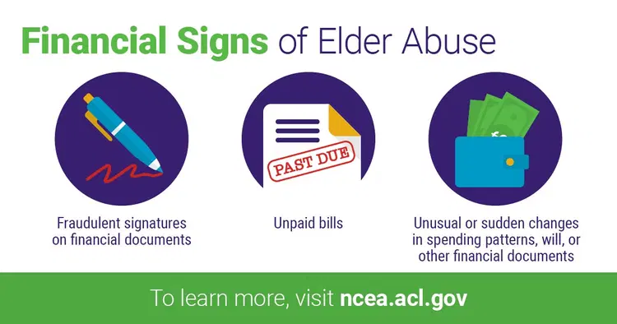

Slide 9
The annual losses incurred by older adults who are victims of financial abuse total over $28 billion each year. Elder financial abuse extends beyond the immediate losses as well; family caregivers and social safety net programs often have to assist with paying for care when an older loved one is exploited.
Most states have penalties for those who victimize older adults. Increasingly, across the country, law enforcement officers and prosecutors are trained on elder abuse and ways to use criminal and civil laws to bring abusers to justice.

Slide 10

Preventative
Steps for Seniors
  Advance Directives
  Powers of Attorney
  Wills and Trusts
01
APPALRED LEGAL AID

Slide 11
Powers of Attorney
ARDFKY.ORG

Slide 12
2 types of power of attorney
  Limited
    Power to perform a SPECIFIED transaction in a specified manner.
    Ex. – “I appoint my son, Billy Bowles, to act as my agent in negotiation with my mortgage company from April 2, 2023 through April 30, 2023.”
    Can also be limited to begin only upon certain conditions – i.e., incapacitation.
    General
      Provides power to conduct ALL business and ALL affairs of the principal.
      Should generally only be given to someone the principal really trusts.
      Still revocable as long as principal is still competent.
01
APPALRED LEGAL AID

Slide 13
Execution
  A power of attorney must be signed in the presence of two disinterested witnesses.
  It is recommended to also have the power of attorney document notarized so it is “acknowledged” and capable of being filed to transfer real estate and for the purposes of being accepted by 3rd parties.
01
APPALRED LEGAL AID

Slide 14
Recording
  “Recording” means that the POA is filed with the County Clerk’s office and becomes a matter of public record.
  Recording is only necessary in Kentucky if the POA grants the agent the power to handle real estate matters (e.g., selling, buying, or transferring real property). In this case, the POA must be recorded with the county clerk in the county where the property is located.
  If the POA deals only with healthcare or other non-real estate issues, it does not need to be recorded.
  It is very important that if a POA is recorded and then revoked, the revocation must also be recorded.
  KEEP COPIES!
01
APPALRED LEGAL AID

Slide 15
Fiduciary Duties
  At a minimum, the power of attorney must act in good faith, within the scope of the written power of attorney document, and in accordance with the grantor’s “reasonable expectations or best interests.”
  A grantor may waive certain duties such as the duty of loyalty and to avoid conflicts of interests; however, it is not recommended and may not be appropriate when a close family member or personal friend is the power of attorney.
01
APPALRED LEGAL AID

Slide 16
Acceptance by third parties
  A 3rd party MUST accept a power of attorney which was acknowledged by a notary.
  In the past, banks, insurance companies, etc. might refuse to accept an otherwise valid POA if it did not match up with the internal policies or procedures of the 3rd party.
  The 3rd party may ask for a certification/translation, or opinion of legal counsel regarding the POA, however, the 3rd party may not require an additional or different form of POA.
01
APPALRED LEGAL AID

Slide 17
Notes
  Although it is not required that an attorney be used to prepare a POA, it is always advisable to seek legal advice/services if possible, to ensure compliance with law.
  Any POA validly executed in Kentucky prior to July 14, 2018, continues to be valid even though POA law has significantly changed since then.
  A POA cannot be executed after the person is incompetent or incapacitated. At that point, a legal guardianship proceeding is the only option.
  A POA can be revoked at any time, but needs to be done in WRITING.
01
APPALRED LEGAL AID

Slide 18
Last Will and Testament
ARDFKY.ORG

Slide 19
Kentucky Requirements
  18 or older (however, parents who are under 18 may have a legal document designating a guardian for their child or children).
  Be of sound mind at the time of execution.
  Must be signed by two disinterested witnesses.
01
APPALRED LEGAL AID

Slide 20
“Sound Mind”
  Kentucky courts interpret “sound mind” broadly.
  Basically, they expect a person of sound mind to know:
    They are making a will.
    The general nature of their property and how much property they have.
    The names of descendants or other relatives who would ordinarily be expected to share in the estate.
01
APPALRED LEGAL AID

Slide 21
Two Witnesses
  Cannot be beneficiaries of the will itself.
  Cannot have spouses who are beneficiaries, either.
  The wrong witnesses can (and often do) make a will invalid and this can change the amount received by beneficiaries.
01
APPALRED LEGAL AID

Slide 22
Holographic Wills
  Kentucky requires the entire will be written in your own handwriting, signed, and dated. No witnesses needed.
  Will require someone with familiarity with your handwriting to testify to its authenticity in probate court after your death.
  Handwritten joint wills are invalid because they are either not written in one’s own handwriting, or are written in the handwriting of two separate people.
01
APPALRED LEGAL AID

Slide 23
What Assets Can Be Willed?
  You can be as specific as you want, but most choose to keep the will simple.
  Some assets like life insurance or pension funds will already have beneficiaries, and do not need to be named.
  Bank accounts held jointly with rights of survivorship also do not need to be mentioned.
01
APPALRED LEGAL AID

Slide 24
Can a Will Be Changed?
  Yes, in fact it’s a good idea to review your will from time to time and make any changes necessary.
  Some events in life will make it necessary to change your will.
    Marriage, remarriage, divorce
    Birth of a child
    Move to another state
    Acquisition of additional or different assets
    Changes in law
01
APPALRED LEGAL AID

Slide 25
Living Wills
ARDFKY.ORG

Slide 26
Living Will Directives
  Allows adults to express their wishes regarding medical treatment and designate a healthcare surrogate to make decisions if they become unable to do so.
  Legal basis is Kentucky Living Will Directive Act, found in KRS 311.621 to 311.643.
01
APPALRED LEGAL AID

Slide 27
Living Will Directives
  Allows a person to:
    Designate a healthcare surrogate to make healthcare decisions on your behalf.
    Specify your preferences regarding life-sustaining treatments, including whether to provide or refuse them (sort of).
    Indicate wishes regarding artificial nutrition and hydration.
    Designate whether to donate your organs.
01
APPALRED LEGAL AID

Slide 28
Living Will Directives
  Must be in writing.
  Must be signed.
  Must either be witnessed by two adults unrelated to the signer, their physician, or anyone responsible for their healthcare costs, or it must be notarized.
  Must be on the form found in the statute (KRS 311.625).
01
APPALRED LEGAL AID

Slide 29
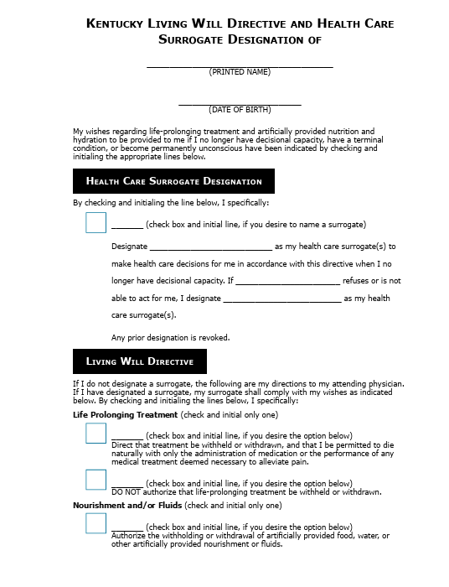
Statutory Form
01
APPALRED LEGAL AID

Slide 30
Effectiveness, Exceptions, Notification Requirements
  Effective when the grantor is no longer able to make their own healthcare decisions, and their doctor and one other physician have determined that they are in a terminal condition or a permanently unconscious state.
  Living Wills do not apply if a patient is known to be pregnant.
  Healthcare facilities are required to ask patients if they have a living will upon admission and will need a copy in order to be bound by it.
01
APPALRED LEGAL AID

Slide 31
Surrogate’s Powers
  Can authorize withdrawal or withholding of artificial nutrition and hydration only under specific circumstances:
    When death is imminent
    Patient is permanently unconscious
    Burden of providing such care outweighs the benefits
01
APPALRED LEGAL AID

Slide 32
Do Not Resuscitate Orders
ARDFKY.ORG

Slide 33
DNR Complications in Kentucky
  The only direct statutory authority for mandatory recognition of a do-not-resuscitate order is a statute which authorizes a Kentucky Emergency Services Do Not Resuscitate Order.
  This statute requires the EMS DNR to be embodied on a standard form approved by the Kentucky Board of Medical Licensure.
01
APPALRED LEGAL AID

Slide 34
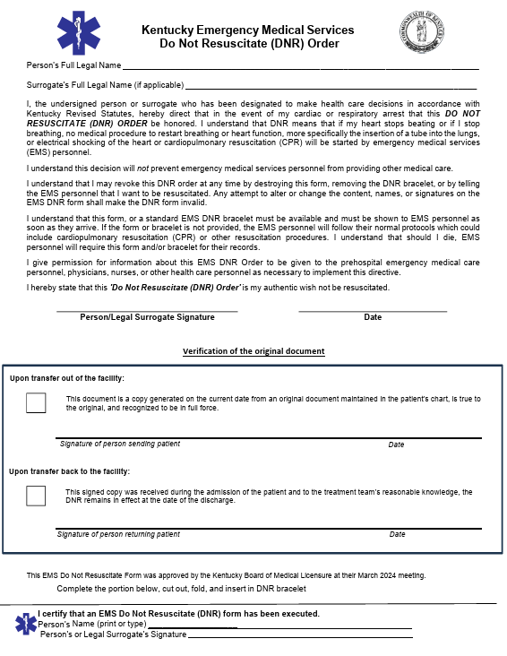
EMS DNR
01
APPALRED LEGAL AID

Slide 35
DNR Complications in Kentucky
  The problem is, an EMS DNR only applies to medical intervention in a prehospital setting.
  This will be insufficient to prevent life-saving intervention in a hospital setting.
  “From the living room floor to the hospital doors…”
01
APPALRED LEGAL AID

Slide 36
But can’t a living will provide DNR?
  It does not appear so.
  Kentucky law provides that a healthcare facility is only held to the DNR wishes of a living will if it is provided on a standard form approved by the Kentucky Board of Medical Licensure or a standard Medical Order for Scope of Treatment (MOST) form.
  So, even though a living will contains sections related to resuscitation wishes, it is not enough to be effective under KY law.
01
APPALRED LEGAL AID

Slide 37
Additional Complications
  The original MOST form is required to accompany the patient when they appear for treatment in order to be valid.
  Must also be completed in consultation with and signed by the patient’s physician prior to it being effective.
  Not difficult to think of circumstances when having the original form, completed by the physician ahead of time, would not practically be possible during the time when emergency care is being administered.
01
APPALRED LEGAL AID

Slide 38



How to Reach Us
WE ARE HERE FOR YOU
Call 1-866-277-5733
ardfky.org/gethelp
Walk in to any of our five offices.
ARDFKY.ORG

Slide 39
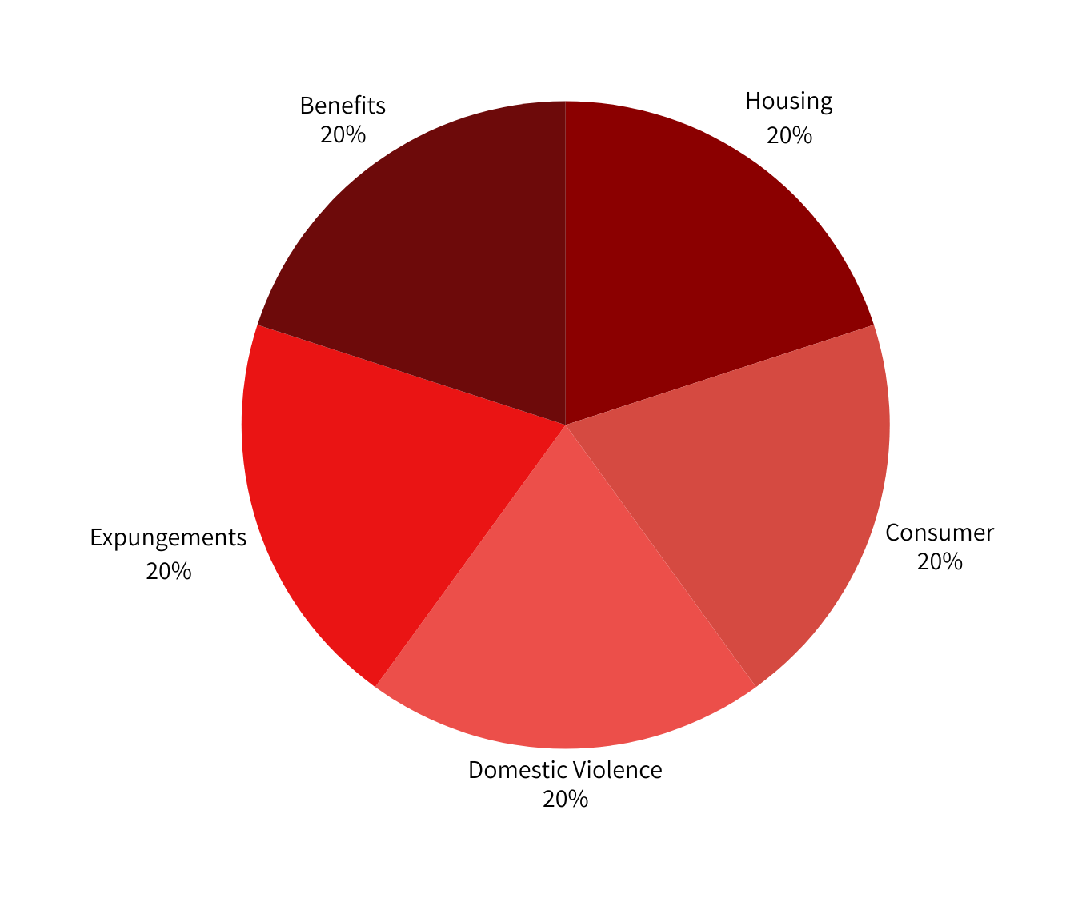
Types of Cases
You can edit this chart directly in Canva. In PPT, go to insert chart.
You can then choose fill and when a color comes up you can select colors that are part of our brand palette: dark red, black, navy, dark green, grey or a spectrum of reds.

Slide 40
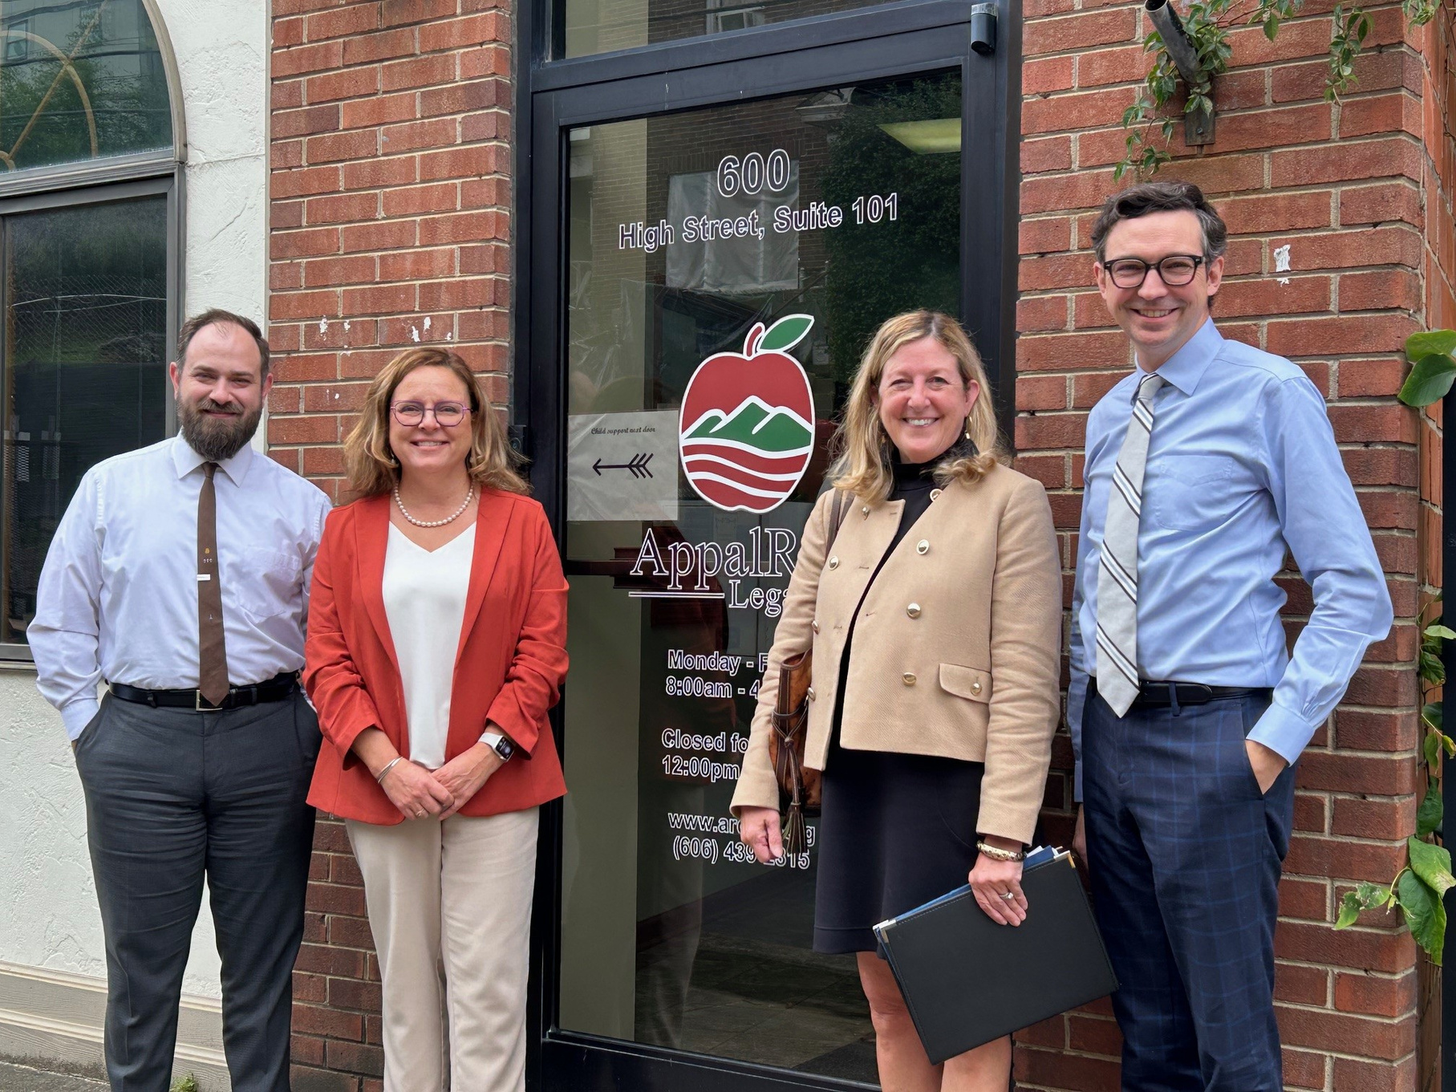



Contact Us
Call 1-866-277-5733
600 High St. Suite 101
Hazard Kentucky 41701
www.ardfky.org
10

Slide 41
Thank you!

