Slide 1
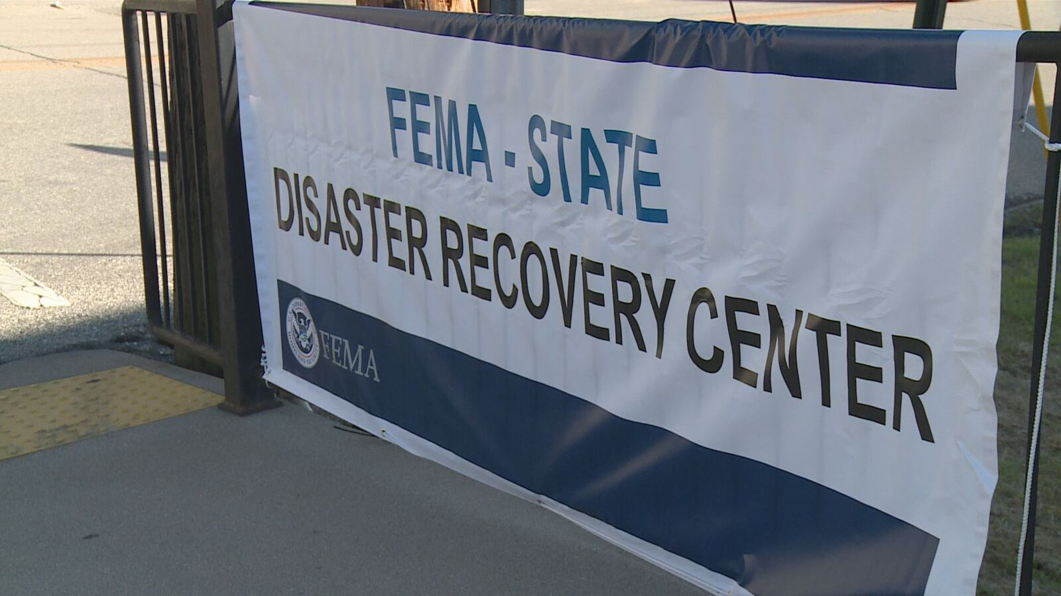


Drafting an Effective FEMA Appeal
Whitney Bailey
Erica Fields

Slide 2
What will this session cover?
FEMA Individual Assistance overview
Eligibility
Types of assistance
Application process
Composing an effective FEMA appeal letter
Managing client expectations
Reasons to submit a FEMA appeal
Piecing the appeal together

Slide 3
FEMA Individual Assistance (IA) is provided through the FEMA Individuals and Households Program (IHP)

Slide 4
General Eligibility for Individual Assistance
    Applicant U.S. Citizenship and Identity
    Primary Residence
    Ownership
    Occupancy
    Insurance and Disaster Damage
    Additional Eligibility Considerations: IAPPG Chapter 3(II)(B)
      E.g., Roommates and boarders, separated households, military personnel, students, unhoused ("homeless")

Slide 5
General Eligibility for Individual Assistance
Citizenship
  Applicant must be a U.S. citizen, non-citizen national, or qualified non-citizen
Identity
  FEMA must confirm applicant's identity
    FEMA runs a public records search with the information provided on the application. If FEMA cannot confirm identity, applicant can provide proof.

Slide 6

General Eligibility for Individual Assistance
Identity of Applicant
        Document received from federal entity containing last four of SSN
        Social security card, if sent with valid state or federal ID
        Payroll document containing last four of SSN
        Military ID
        Marriage license (if maiden name is at issue)
        US passport

Slide 7
General Eligibility for Individual Assistance
Ownership
For certain types of Housing Assistance, FEMA must confirm that the applicant owned* the disaster-damaged property at the time of the disaster
Disaster Damage
Damage must be a result of the active declared disaster
  Not eligible for FEMA assistance if house was damaged by a kitchen fire before a tornado; may be eligible if can prove kitchen fire occurred due to tornado
But see March 2024 IAPPG Update

Slide 8
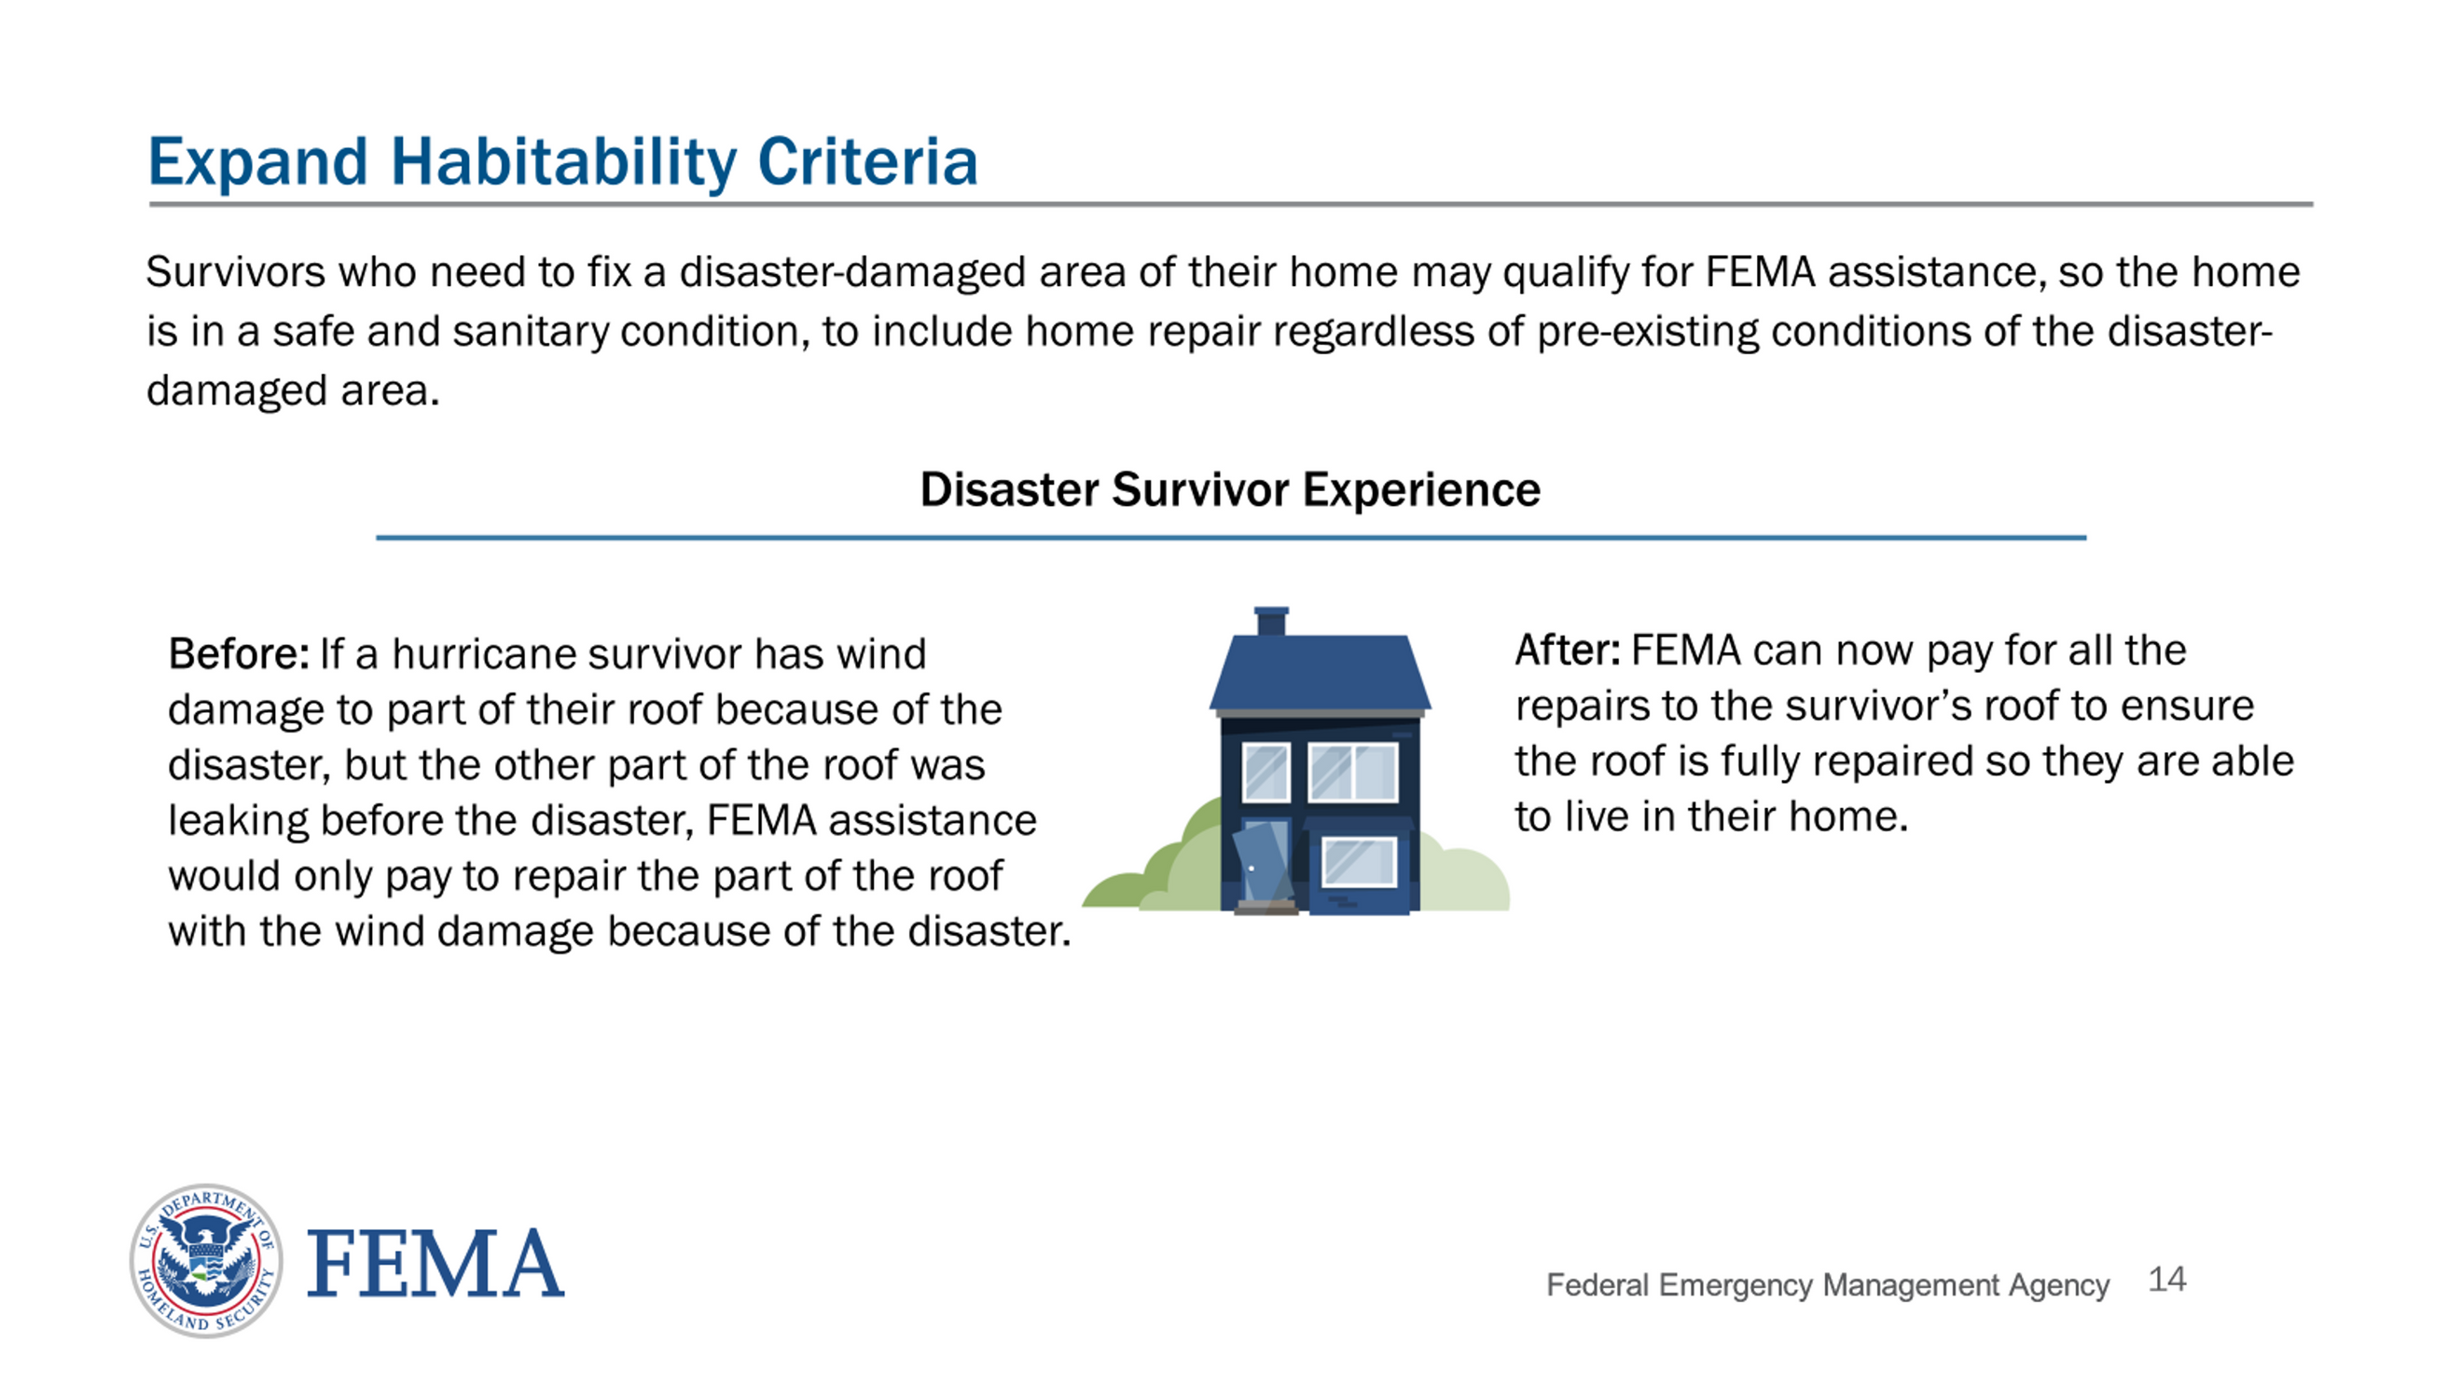
March 2024 IAPPG Update

Slide 9

General Eligibility for Individual Assistance
Documents Used to Prove Ownership
    Deed or official record
    Quitclaim deed
    Contract for deed transfer
    Mortgage documents
    Insurance policy or bill/payment record
    Property tax bill/proof of payment
    Land installment contract
    Bill of sale or bond for title
    Mobile home park letter
    Title for manufactured home
    Court documents
    Public official’s letter
    Will or affidavit of heirship naming applicant heir, and death certificate
Mobile home exception: self-declarative statement

Slide 10
General Eligibility for Individual Assistance
Primary Residence
Disaster-damaged property must have been applicant's primary residence
  No secondary homes, vacation homes
  Landlords generally ineligible unless also residing at home
Occupancy
Applicants (both owners and renters) must be able to prove they occupied the disaster-damaged primary residence before receiving Housing Assistance and some types of Other Needs Assistance (i.e., Personal Property Assistance and Moving and Storage Assistance)
Certain types of ONA do not require verification of occupancy of a primary residence (i.e., Transportation Assistance, Funeral Assistance, Medical and Dental Assistance, and Child Care Assistance)
All household members at the time of the disaster are considered occupants

Slide 11

General Eligibility for Individual Assistance
Documents Used to Prove Occupancy
    Utility Bills
    Employer's Documents
    Lease/Housing Agreement
    Rent Receipts
    Public Official's Documents
    Identification Cards
    Local School Documents
    Federal or State Benefit Documents
    Motor Vehicle Registration
    Affidavits of Residency or Court Documentation
    Mobile Home Park Documents
    Mobile Home Exception: Self-Declarative Statement

Slide 12

General Eligibility for Individual Assistance
Insurance
If the property was covered by insurance, FEMA will only pay for damages not covered by insurance
  No double-dipping a/k/a "Duplication of Benefits" (DOB)
  FEMA will require a statement of coverage/denial letter from insurance company if applicant states they had insurance at time of disaster

Slide 13

General Eligibility for Individual Assistance
Insurance
Prior Flood Insurance Requirement: IAPPG Chapter 3(II)(B)(11)
  If property located in a Special Flood Hazard Area (SFHA) AND previously received FEMA assistance, then most likely have a flood insurance requirement on the property
    Flood insurance requirement stays with the property, not the person
  If do not maintain flood insurance, then ineligible for FEMA assistance for flood-damaged real or personal property that would have been covered
    Limited eligibility for Housing Assistance for HVAC, furnace, well, septic, and other items not covered by flood insurance

Slide 14

Housing Assistance
Other Needs Assistance
Max for FY 2025: $43,600
Max for FY 2025: $43,600
  Serious Needs Assistance
  Displacement assistance: Award not count toward max; knocks applicant out of lodging reimbursement
  Personal Property Assistance
  Medical Assistance
  Funeral Assistance
  Childcare Assistance
  Transportation Assistance
  Cleaning and Sanitizing Assistance
  Computing devices (March 2024 IAPPG Update)
  Assistance for self-employed survivors (March 2024 IAPPG Update)
  Home repair or replacement
  Hazard Mitigation
  Lodging Reimbursement (but see Displacement Assistance)
  Rental Assistance: Award not count toward max

Slide 15
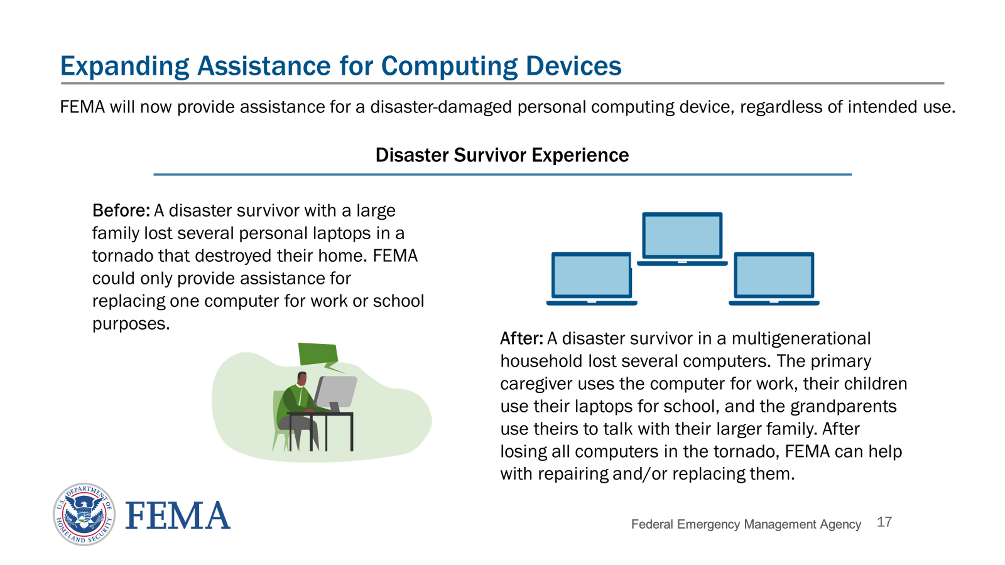

Slide 16
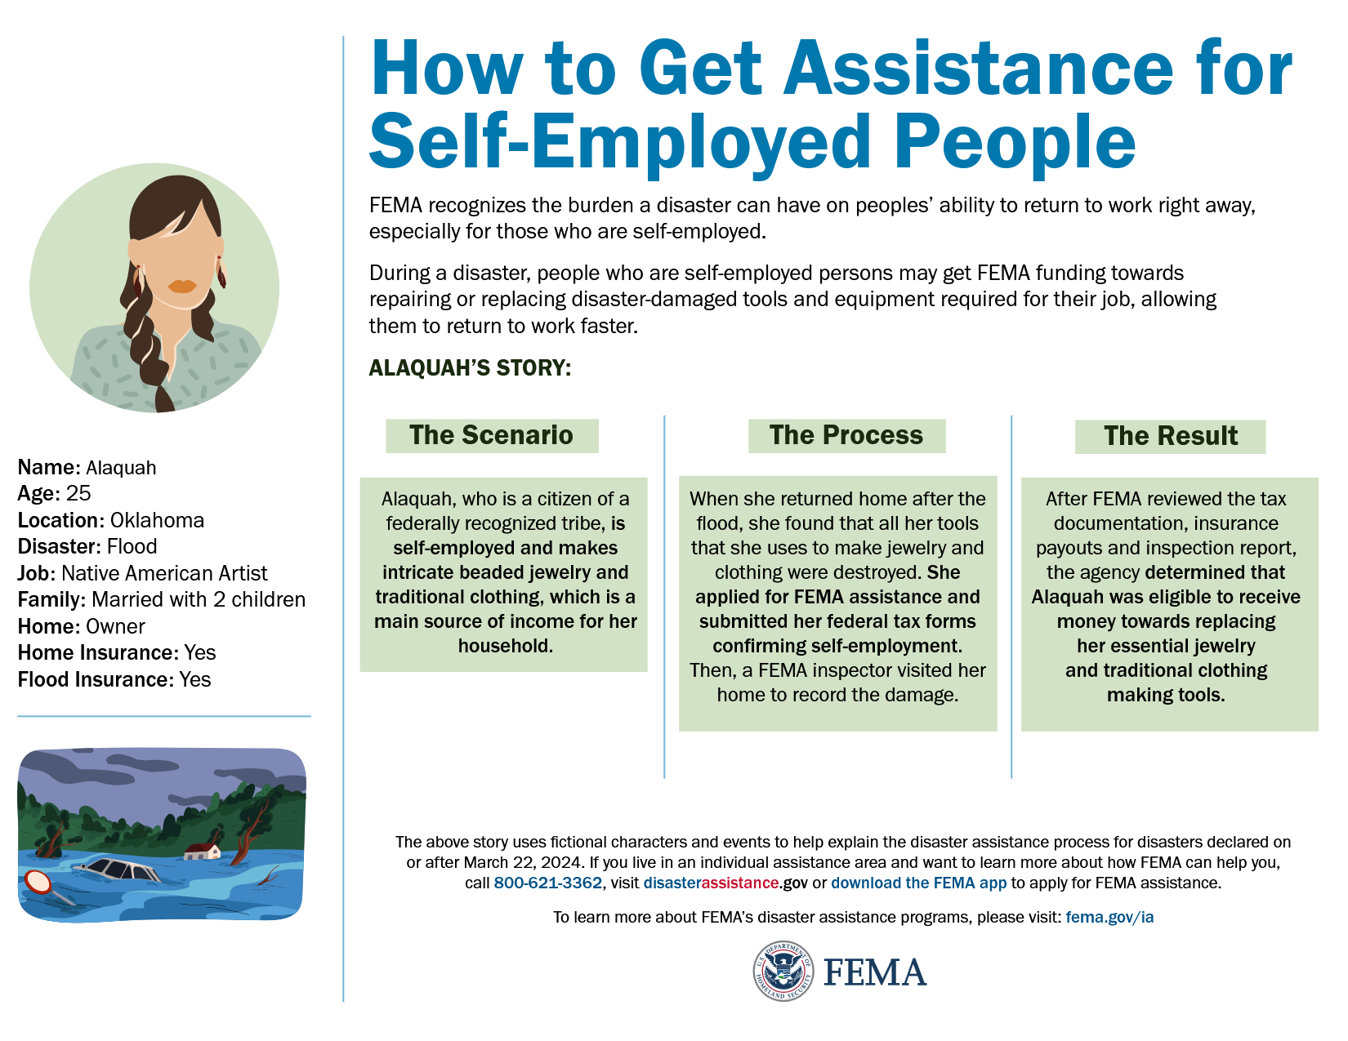

Slide 17

Maximum Housing Assistance (HA) available:
$43,600 (FY25)
Maximum Other Needs Assistance (ONA) available:
$43,600 (FY25)
  Survivors can max out in both categories
  Some subcategories of assistance have their own limits

Slide 18
    Rental Assistance
    No monetary maximum but only offered for up to 18 months after major disaster declared (NOT 18 months after survivor applied).
    Rental assistance does NOT count toward HA maximum
    Serious Needs Assistance (SNA)
    Pre-March 2024 Update, Critical Needs Assistance
    For essential items like food, water, baby formula, breast feeding supplies, medication replacement and other serious disaster-related needs
      SNA is not a form of reimbursement for loss of power or replacing food—intended for emergency needs only
    Max: $770 for FY 2025
    Counts toward ONA maximum

Slide 19
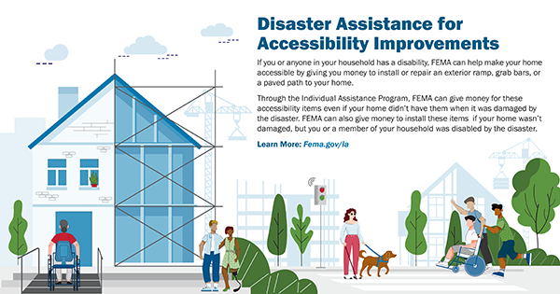
Assistance for Accessibility Improvements does not count toward any assistance maximum (HA or ONA)

Slide 20
FEMA Individual Assistance Application Process
The Initial Application
Survivor has 60 days after disaster declaration to apply (unless extended)
After application is submitted, FEMA inspector will contact applicant directly to set up date and time for home inspection.
Before or after the home inspection, FEMA may send letter to applicant to request supporting documentation to verify eligibility.
FEMA will send decision letter to the applicant stating whether they were approved for assistance and if so, how much, or request more information.

Slide 21
FEMA Recoupment
If FEMA believes the applicant double-dipped (e.g., didn’t tell FEMA their home insurance covered certain damages and got FEMA assistance for those damages), spent their assistance improperly, or committed fraud, FEMA can seek repayment.
It is very important to tell clients to spend FEMA Assistance EXACTLY as described in their decision letter. Examples of improper use may include:
Received auto insurance settlement that covered the cost of vehicle repair AND received Transportation Assistance for the same repairs
Using Home Repair Assistance to purchase a new dirt bike instead of repairing their roof
Signed Uncle’s name on a Land Contract 2 years after Uncle passed away
Notes:
*Here, we can add note about not having essential personal property list from the state

Slide 22
Managing Client Expectations

Slide 23
Managing Client Expectations
  Patient, kind, listen
  Positive, but realistic
    Not uncommon to receive more money especially if the issue was lack of supporting documents & correct documents are being submitted
    "I can't guarantee an outcome because the final decision is on FEMA"
  Most clients will not max out on assistance
    FEMA can only give you money for needs you can prove, regardless of how much you think you need or deserve
    Purpose of FEMA money is to restore survivor to minimum living conditions. Not like damages--not meant to make them whole

Slide 24
Reasons to Submit a FEMA Appeal

Slide 25

Why should a survivor appeal, and why might they need an attorney?
  Every applicant has the right to appeal
  It is NOT uncommon for survivors to get more money when they file an appeal!
  Initial application process can be difficult to understand in general, especially for folks with cognitive impairments
    For many applicants, including the appropriate supporting documents can make a big difference
  Some appeals involve true “legal” issues
    E.g. title clearing to prove home ownership

Slide 26

Analyzing a FEMA appeal case
Review decision letter & application
Identify the issue: was client denied assistance, or did they receive some money but want more?
  If denied, why?
    Lack of correct supporting documents v. clear ineligibility
      E.g., Need contractor estimate v. not primary residence
  2. If client believes they should have gotten more, why?
    How can you help the client get supporting documents to prove they should get more?

Slide 27
Common reasons for denial of assistance
  Proving general eligibility (e.g., identity, ownership/occupancy, insurance)
  Proof of ownership or occupancy of the home
    Ownership: Client has legal “bundle of sticks”
    Occupancy: Home was client’s primary residence
      “Owner-occupied means that the residence is occupied by: (1) The legal owner; (2) A person who does not hold formal title to the residence and pays no rent, but is responsible for the payment of taxes or maintenance of the residence; or (3) A person who has lifetime occupancy rights with formal title vested in another.” 44 CFR § 206.111

Slide 28
Proof of ownership/occupancy
  Help client find the correct supporting documents
    Might need to do title search, write simple deed of transfer, etc. to prove ownership
    Might need to draft lease to prove occupancy if client and landlord had oral agreement
  FEMA has become more flexible on documents they will accept
    See FEMA September 2, 2021 Memo Amending IAPPG

Slide 29
Common reasons for denial of assistance, continued
  Could not verify identity
    Client may need help replacing IDs or vital statistics documents
    Identity verification letter-Whitney’s example
  Client indicated property was insured
    FEMA assumes insurance covered damage unless provided with denial letter OR proof that some damage was covered but not all
  Client missed property inspection
    Call FEMA helpline at (800) 621-3362
    Client must answer calls from unknown numbers-could be FEMA inspector
  Prior Flood Insurance Requirement

Slide 30
Common reasons for denial of assistance, continued
  Home safe to occupy
    Client may need help getting contractor estimate or attestation from local official
      Estimate needs to be itemized
      Contractors booked up after disaster-ask AppalReD for help finding one
FEMA inspector issues
      Inspectors not always well-trained
      Findings of inspection can be inconsistent from one inspector to the next
        CAN REQUEST NEW INSPECTION!
          Call FEMA Helpline and follow-up with request in writing

Slide 31
Prior Flood Insurance Requirement
If client lives in Special Flood Hazard Area (good possibility in EKY) and has received FEMA assistance in the past, FEMA may have placed a Prior Flood Insurance Requirement (PFIR) on their home.
This means that, if they did not have flood insurance at the time of the disaster, they are not eligible for most types of FEMA Assistance.
Runs with the property—if prior owner had PFIR, still applies to current owner*
If current owner/applicant has received FEMA assistance in the past, PFIR would have been discussed in decision letter
Notes:
*We are currently looking into whether current owner can be held to PFIR if they can prove they had no notice

Slide 32
Can client still get some FEMA Assistance even if they have Prior Flood Insurance Requirement? YES!
Per FEMA: Survivors who failed to purchase and maintain flood insurance may still be eligible for the following forms of assistance through FEMA:
Referrals to local community partners and volunteer organizations active in disasters
Medical, Dental, Funeral, Assistance for Miscellaneous Items, Child Care, Moving and Storage costs over $1,000
Transportation Assistance
Serious Needs Assistance
Rental Assistance or Direct Temporary Housing Assistance
Uninsurable damaged items, such as wells, septic systems, HVAC, furnace

Slide 33
Piecing the Appeal Together

Slide 34
The Appeals Process
An applicant has the right to file an appeal. 42 U.S.C. § 5189a. FEMA should never discourage an applicant from filing an appeal.
Applicant has 60 days from date on decision letter to appeal. Late appeals aren’t the end of the world but best practice—stick to deadline.
Applicant can appeal an outright denial of assistance OR ask FEMA for more money.
Applicant should consider requesting a copy of their FEMA case file along with their appeal letter (includes inspection report).
Applicant should consider requesting a second home inspection in their appeal letter.
FEMA may contact the applicant seeking additional information. The applicant must respond in 30 days.
FEMA has 90 days from the date of appeal to send a decision letter.
An applicant may submit multiple appeals.

Slide 35
Before submitting appeal, send initial packet via fax or mail:
  Include FEMA Release of Information (ROI) form
    For parties authorized to discuss case, include applicant, advocate, and AppalReD Legal Aid
  Include request for client’s entire FEMA case file
    Possible to file a second appeal if there is new or updated information that wasn’t included in application or first appeal
    Case file may clue you in on what FEMA is looking for

Slide 36
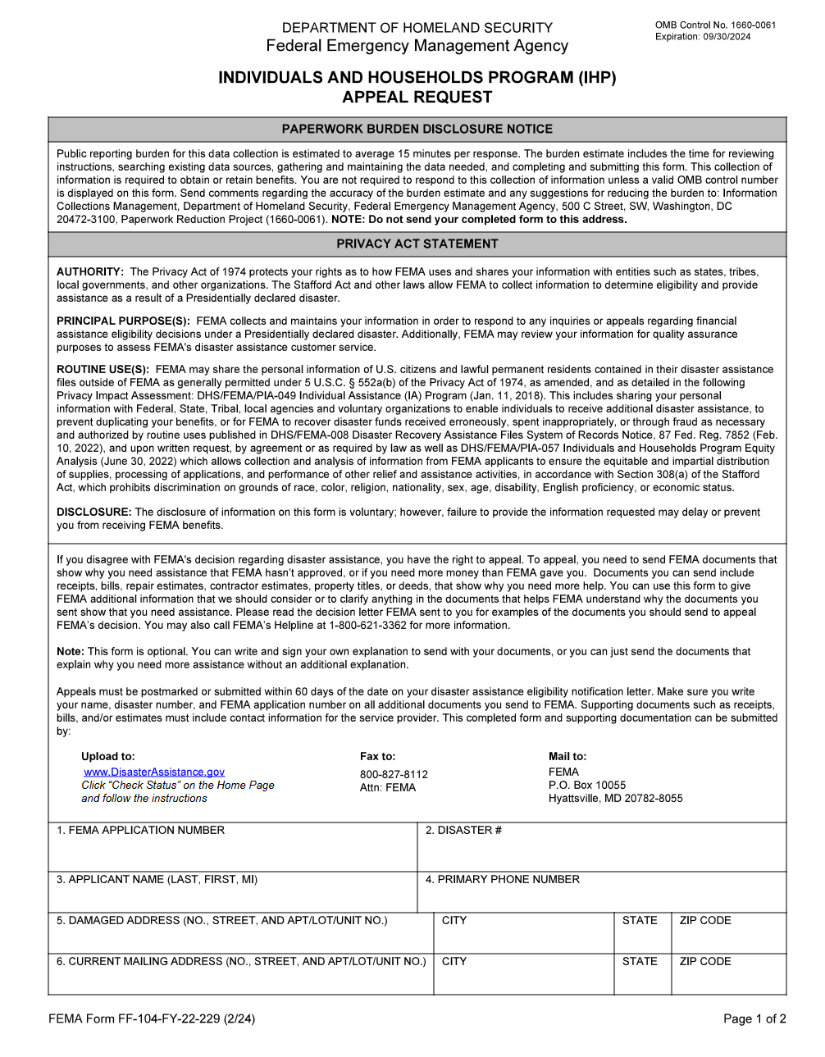
See this appeal request form?
You don’t have to use FEMA’s form.
We’ll provide ours.

Slide 37
Drafting and submitting the appeal
  On each page, ensure the following is included
    Applicant’s full name
    Applicant’s FEMA application number and disaster number
    Address of applicant’s pre-disaster primary residence
    Applicant’s current phone number and post-disaster address; and
    Date of appeal.
  INCLUDE ALL SUPPORTING DOCUMENTS
  Use AppalReD templates – don’t re-invent the wheel

Slide 38
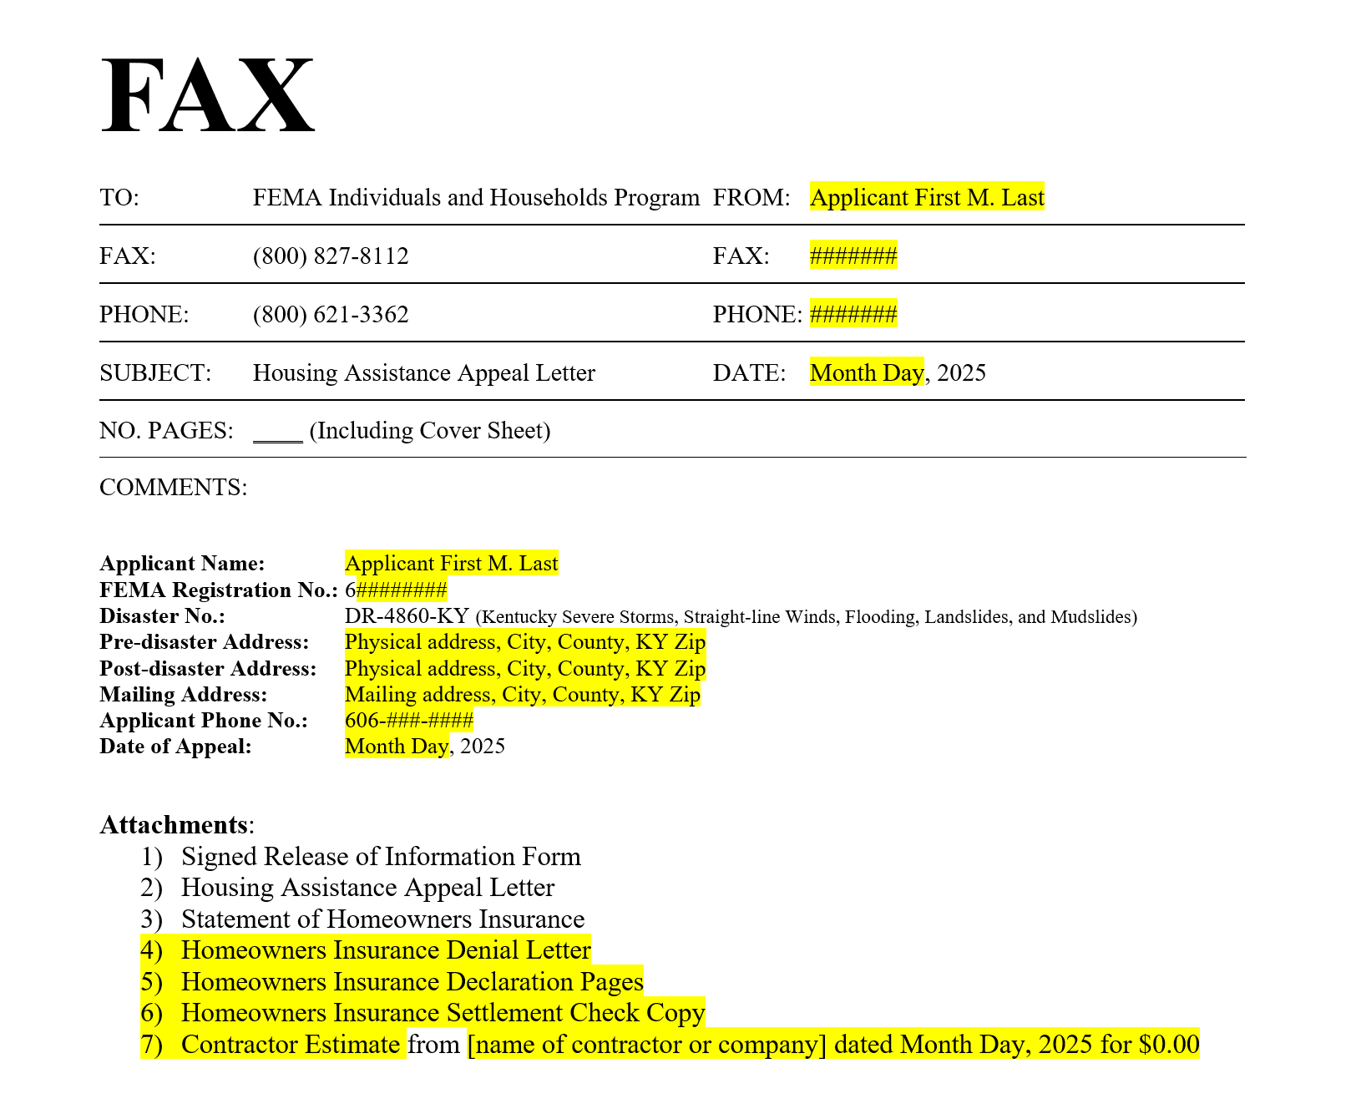
On each page of the appeal, enter the correct information in the highlighted sections.
Before you submit the appeal, ensure that the “Attachments” section has been filled out and identifies each document you have included in the appeal packet. This serves as a “table of contents” for FEMA.
Before you submit the appeal, review everything again, add page numbers on coversheet at bottom of appeal packet.

Slide 39
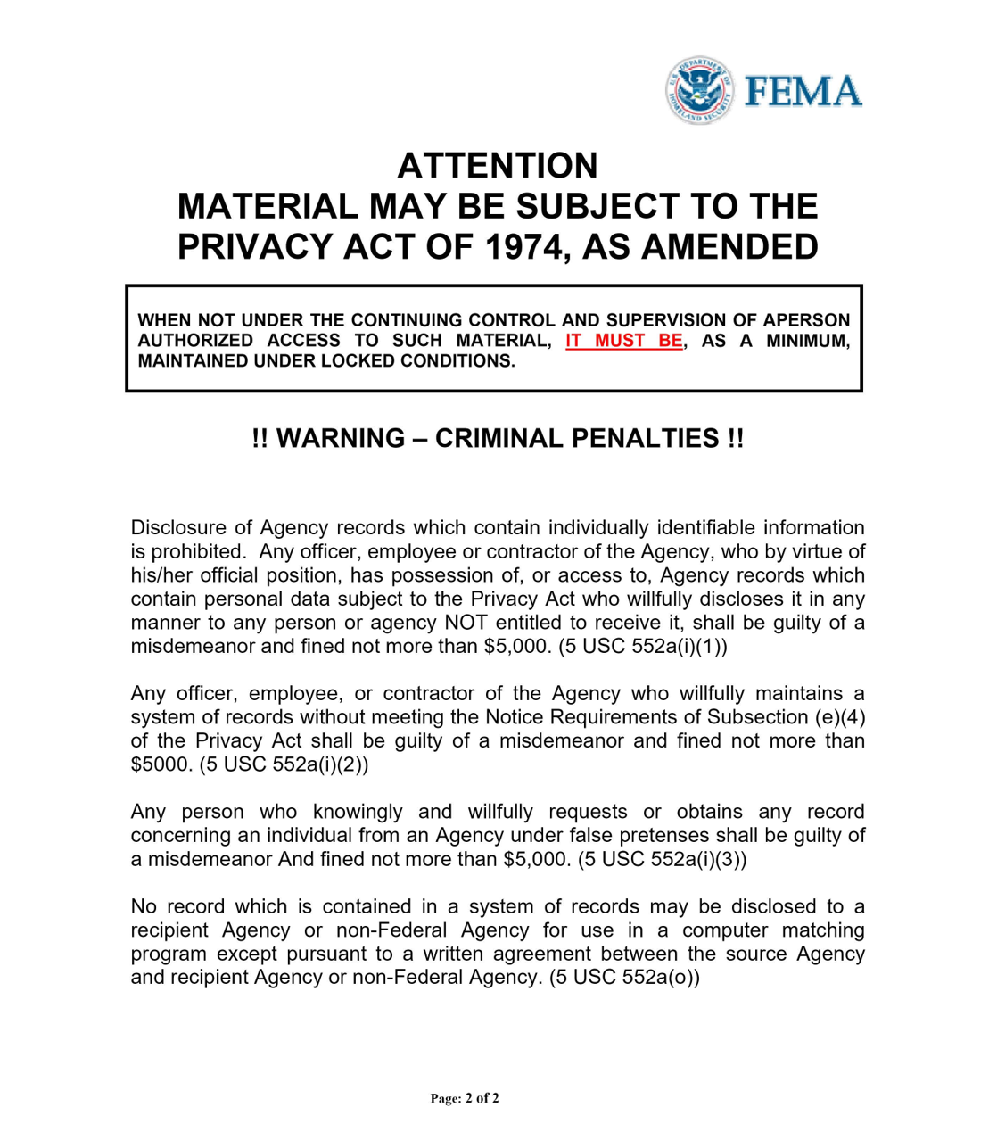
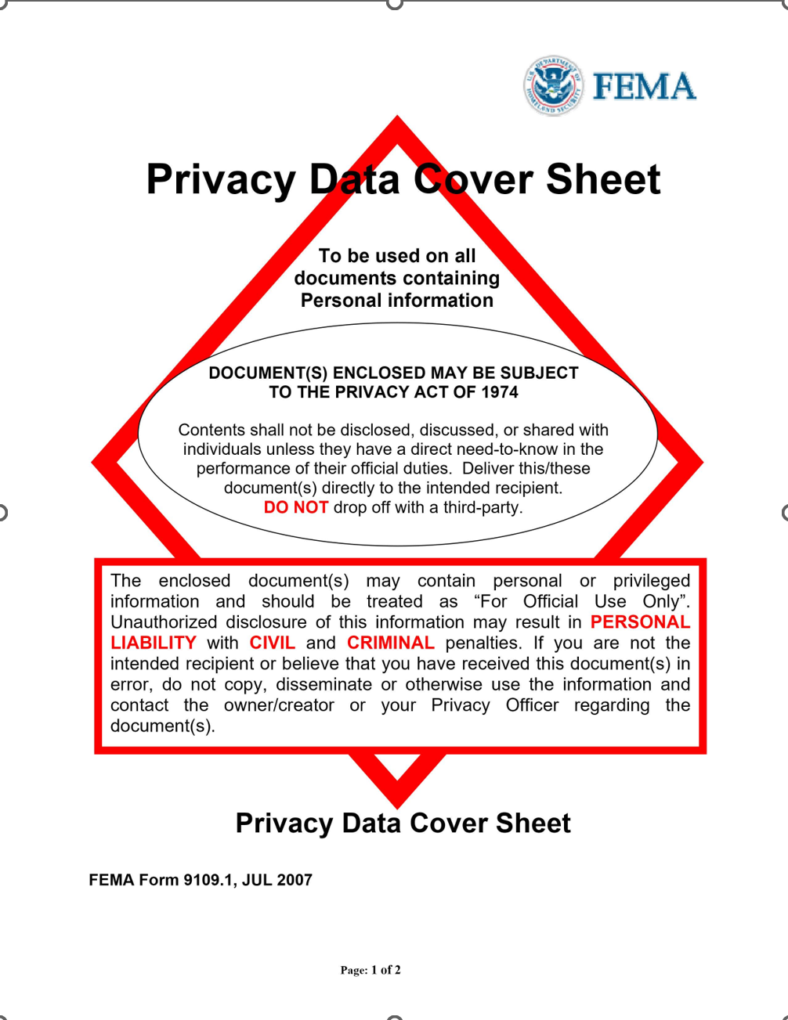
FEMA’s Privacy Data Cover Sheets are included in our templates. Before you submit the appeal, make sure they are positioned after the cover page and before the release of information form.

Slide 40
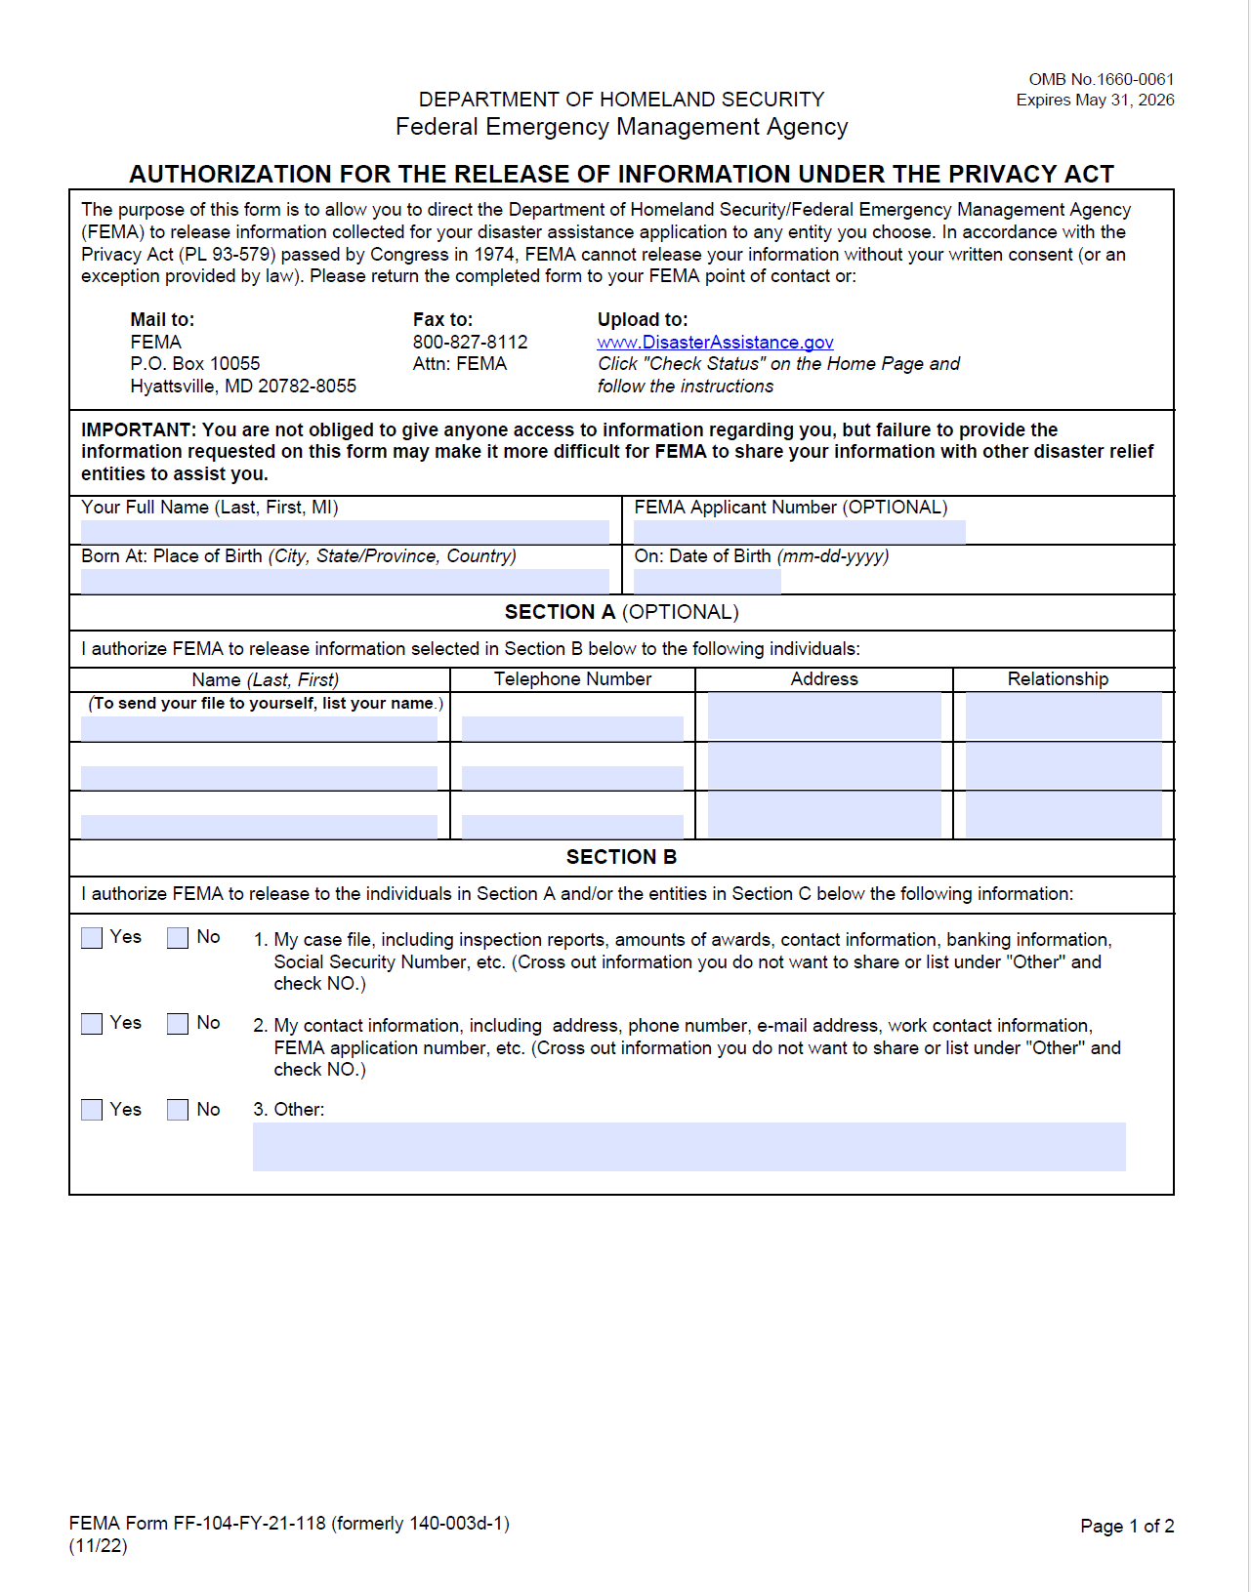
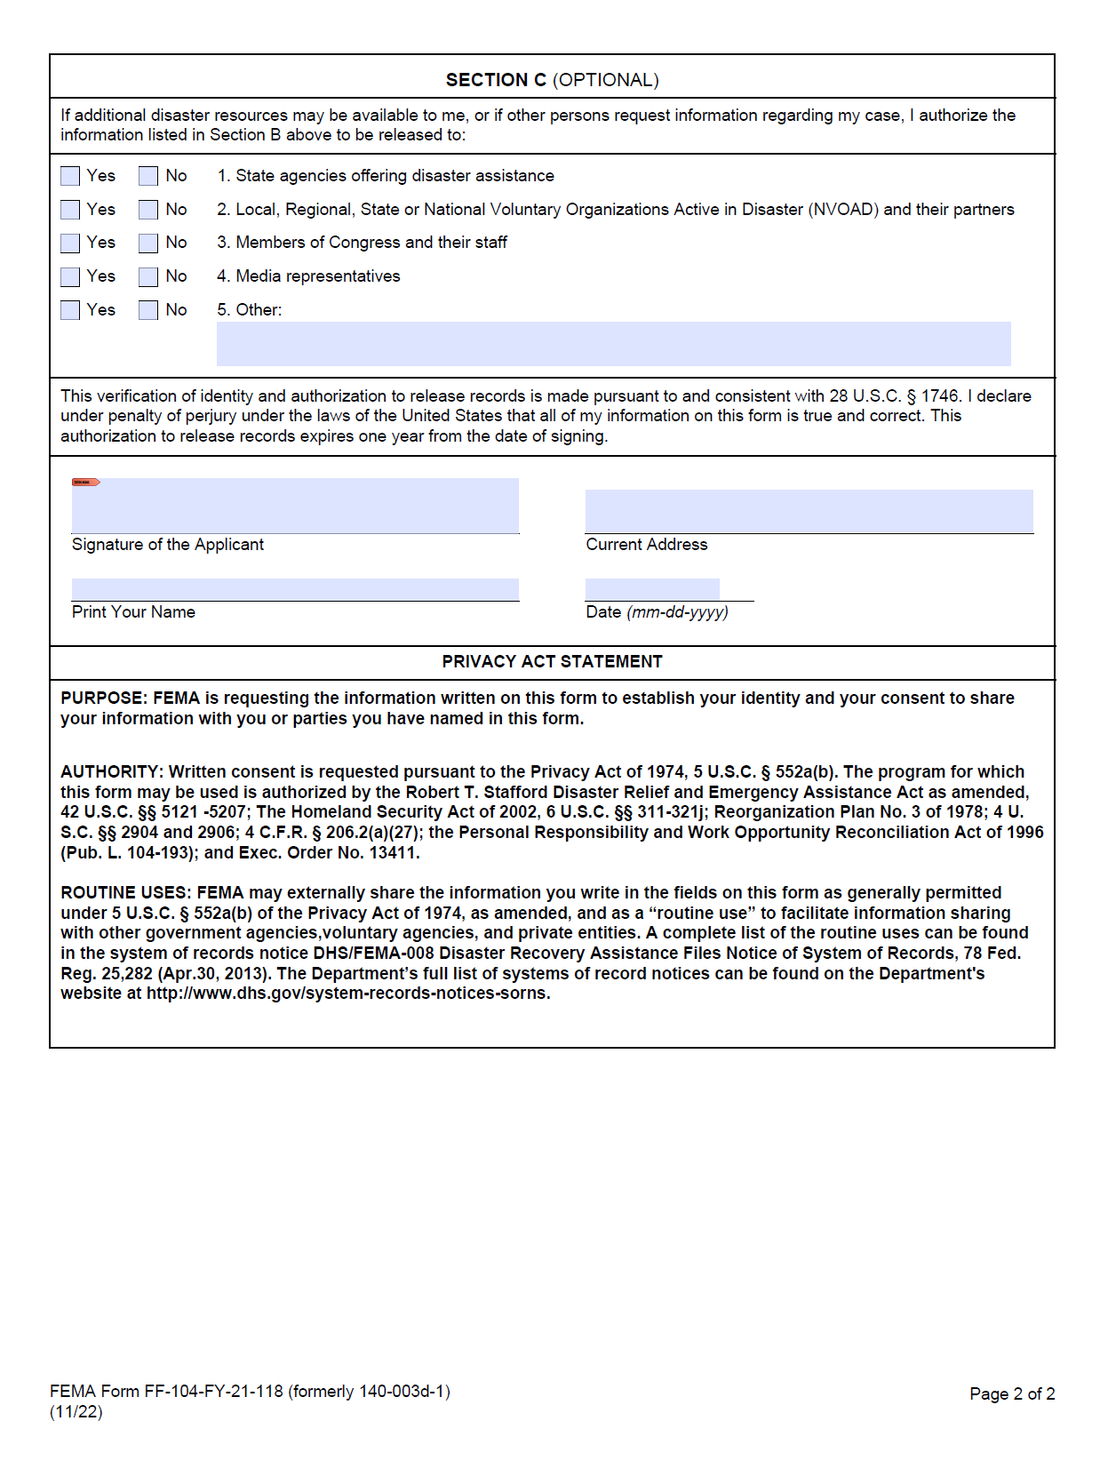
Ensure a completed, signed, dated Release of Information form is included with every appeal.
Section A: applicant and advocate
Section B: Check “Yes” to all and include “Request for entire FEMA Case File” in 3. Other.
Section C: We recommend checking “Yes” to all

Slide 41
Submit the appeal
  Online: Disasterassistance.gov
  In person at Disaster Recovery Center
  By mail
  By fax
Appeal deadlines
  General deadline is 60 days after date of decision letter
  Late appeals not the end of the world
    Include a statement asking for extension and providing a reason for the late appeal
      Supporting documents not needed
18-Month Period of Assistance: Monday, August 24, 2026

Slide 42
Questions?
Raise your hand or drop ‘em in the chat!
Email us:
WhitneyB@ardfky.org
EricaF@ardfky.org

