Slide 1
Trauma informed legal advocacy for EPO/DVO/TIPO/IPO: overview
Aubrey M. Girouard

Slide 2
Introduction
456.030 Petition for Interpersonal Protective Order

Slide 3
What is a protective order?
Judge’s order designed to prevent further acts of DV, dating violence, sexual assault, or stalking
  Petitioner = person seeking the protection
  Respondent = aggressor
Protective order may order:
  No contact
  No violent contact
  Leave a shared home
  Stay away from home, school, workplace, etc.
Civil court order, not criminal court
  Don’t need to be convicted of a crime to be placed under orders
  But if the order is violated, may be charged with a crime

Slide 4
Kinds of protective orders
TIPO = Temporary Interpersonal Protective Order
Sexual assault, stalking, or dating violence
Becomes IPO after hearing
EPO = Emergency Protective Order
Domestic violence
Becomes DVO after hearing
DVO/IPOs in effect for up to 3 years; can be renewed if requested

Slide 5
Who is protected?
Victim
If requested: pets and children (under 18)

Slide 6
The law
KRS 456.030 Petition for interpersonal protective order. (1) A petition for an interpersonal protective order may be filed by: (a) A victim of dating violence and abuse; (b) A victim of stalking; (c) A victim of sexual assault; or (d) An adult on behalf of a victim who is a minor otherwise qualifying for relief under this subsection.

Slide 7
Cont.
(2) The petition may be filed in the victim's county of residence or a county where the victim has fled to escape dating violence and abuse, stalking, or sexual assault. (3) The petition shall be verified and contain: (a) The name, age, address, occupation, residence, and school or postsecondary institution of the petitioner; (b) The name, age, address, occupation, residence, and school or postsecondary institution of the person or persons who have engaged in the alleged act or acts complained of in the petition; (c) The facts and circumstances which constitute the basis for the petition; and (d) The names, ages, and addresses of the petitioner's minor children, if applicable.

Slide 8
KRS 456.010 Definitions
"Dating relationship" means a relationship between individuals who have or have had a relationship of a romantic or intimate nature. It does not include a casual acquaintanceship or ordinary fraternization in a business or social context. The following factors may be considered in addition to any other relevant factors in determining whether the relationship is or was of a romantic or intimate nature: (a) Declarations of romantic interest; (b) The relationship was characterized by the expectation of affection; (c) Attendance at social outings together as a couple; (d) The frequency and type of interaction between the persons, including whether the persons have been involved together over time and on a continuous basis during the course of the relationship; (e) The length and recency of the relationship; and (f) Other indications of a substantial connection that would lead a reasonable person to understand that a dating relationship existed;

Slide 9
Definitions cont.
"Dating violence and abuse" means: (a) Physical injury, serious physical injury, stalking, sexual assault, strangulation, or the infliction of fear of imminent physical injury, serious physical injury, sexual abuse, strangulation, or assault occurring between persons who are or have been in a dating relationship; or (b) Any conduct prohibited by KRS 525.125, 525.130, 525.135, or 525.137, or the infliction of fear of such imminent conduct, taken against a domestic animal when used as a method of coercion, control, punishment, intimidation, or revenge directed against a person with whom the perpetrator is or has been in a dating relationship, when that person has a close bond of affection to the domestic animal;

Slide 10
Sexual assault - refers to conduct prohibited as any degree of rape, sodomy, or sexual abuse under KRS Chapter 510 or a criminal attempt, conspiracy, facilitation, or solicitation to commit any degree of rape, sodomy, or sexual abuse, or incest under KRS 530.020;
Stalking - refers to conduct prohibited as stalking under KRS 508.140 or 508.150, or a criminal attempt, conspiracy, facilitation, or solicitation to commit the crime of stalking;
Strangulation - refers to conduct prohibited by KRS 508.170 and 508.175, or a criminal attempt, conspiracy, facilitation, or solicitation to commit the crime of strangulation; and
Substantial violation- means criminal conduct which involves actual or threatened harm to the person, family, or property, including a domestic animal, of an individual protected by an order of protection.

Slide 11
Sexual assault krs:
.040 Rape in the first degree.
.050 Rape in the second degree.
.060 Rape in the third degree.
.070 Sodomy in the first degree.
.080 Sodomy in the second degree.
.090 Sodomy in the third degree.
.100 Sodomy in the fourth degree.
.110 Sexual abuse in the first degree.
.120 Sexual abuse in the second degree.
.130 Sexual abuse in the third degree.

Slide 12
Stalking first degree
KRS 508.140 Stalking in the first degree. (1) A person is guilty of stalking in the first degree, (a) When he intentionally: 1. Stalks another person; and 2. Makes an explicit or implicit threat with the intent to place that person in reasonable fear of: a. Sexual contact as defined in KRS 510.010; b. Serious physical injury; or c. Death; and (b) 1. A protective order has been issued by the court to protect the same victim or victims and the defendant has been served with the summons or order or has been given actual notice; or 2. A criminal complaint is currently pending with a court, law enforcement agency, or prosecutor by the same victim or victims and the defendant has been served with a summons or warrant or has been given actual notice; or 3. The defendant has been convicted of or pled guilty within the previous five (5) years to a felony or to a Class A misdemeanor against the same victim or victims; or 4. The act or acts were committed while the defendant had a deadly weapon on or about his person

Slide 13
Stalking Second degree
KRS 508.150 Stalking in the second degree. (1) A person is guilty of stalking in the second degree when he intentionally: (a) Stalks another person; and (b) Makes an explicit or implicit threat with the intent to place that person in reasonable fear of: 1. Sexual contact as defined in KRS 510.010; 2. Physical injury; or 3. Death.
"Sexual contact" means the touching of a person's intimate parts or the touching of the clothing or other material intended to cover the immediate area of a person's intimate parts, if that touching can be construed by a reasonable person as being done: (a) For the purpose of sexual arousal or gratification of either party; (b) For a sexual purpose; or (c) In a sexual manner for the purpose of: 1. Exacting revenge or retribution; 2. Humiliating or degrading; or 3. Punishment;

Slide 14
To "stalk" means to engage in an intentional course of conduct: 1. Directed at a specific person or persons; 2. Which seriously alarms, annoys, intimidates, or harasses the person or persons; and 3. Which serves no legitimate purpose. (b) The course of conduct shall be that which would cause a reasonable person to suffer substantial mental distress. (2) "Course of conduct" means a pattern of conduct composed of two (2) or more acts, evidencing a continuity of purpose. One (1) or more of these acts may include the use of any equipment, instrument, machine, or other device by which communication or information is transmitted, including computers, the Internet or other electronic network, cameras or other recording devices, telephones or other personal communications devices, scanners or other copying devices, and any device that enables the use of a transmitting device. Constitutionally protected activity is not included within the meaning of "course of conduct." If the defendant claims that he was engaged in constitutionally protected activity, the court shall determine the validity of that claim as a matter of law and, if found valid, shall exclude that activity from evidence.

Slide 15
PRIMARY GOALs
1. Safety 2. Support 3. Inform 4. Strategy

Slide 16
Safety
What does safety mean to the survivor?
IPOs are for emergency situations, that is why they are technically temporary… what does temporary mean?
Is an IPO what’s best for that person?
Is there a criminal case pending?
Guns involved?
Do they know their aggressors?
  Is it a dating or domestic relationship?

Slide 17
Support
What does the survivor need for mental and emotional support at the time. Trauma Informed Care

Slide 18
Inform
Where do survivors fill out
their TIPO forms?
What will survivors need to be prepared for at hearings?
TIPO/IPO/EPO/DVO is not to argue custody and why?
What are consequences for the aggressors and petitioners legally and personally?
Criminal Case vs. DVO/IPO Court

Slide 19
Strategy
Evidence based prosecution
- Collection of evidence
- Calling Respondent first
- Calling other witnesses first
- Moving for a “DV”

Slide 20
KRS 431.005
  (2)(a) Assault 4th Domestic / dating
    OFFICER MAY ARREST
  (7) Restraining / IPO Protection Order per 508.155. Stalking conviction.
    OFFICER SHALL ARREST
KRS 431.015 (c) Violations of Protective Orders.
  OFFICER SHALL ARREST
DOES NOT HAVE TO BE IN OFFICER’S PRESENCE (still need probable cause)
NO TIME LIMIT on when can arrest (but still needs probable cause)

Slide 21
Protective orders: process
Aubrey M. Girouard

Slide 22
How to get a protective order
Available 24/7 at no cost to the petitioner
Each county has a slightly different process

Slide 23
Step 1: file a petition
Where to do this differs by county. Some common venues:
County clerk
Courthouse
Police station
Domestic violence shelter
Note: there may be one place to go during business hours and another for after hours.
HOMEWORK: find out where to file in each county your RCC serves

Slide 24
Filing a petition for an ipo/epo/dvo
Request a protective order
  Same form for an IPO or DVO
  But better to know which kind of order to request
Fill out the form. It will ask for:
  Contact info for survivor and respondent
  Whether there are children/pets
  A description of the reason you are requesting protection (more on this in a minute!)
  A place to request specific protections
  Signature attesting that everything in the petition is true

Slide 25
What to include
Can request protection for:
  Physical or sexual abuse or assault
  Fear of abuse or assault, if you have a relation to the respondent
  Sexual assault
  Stalking
Describe the incident
Describe any history of violence
Consider violence broadly: include any coercive behavior, implicit or explicit threats
ADVOCATES: accompany survivors to file petitions, help identify what to write, but do not write the petition for them

Slide 26
Step 2: judge’s review
Judges review petitions for protection 24/7
Judge may decide to:
  Accept the petition and issue a temporary order & a summons for a hearing
  Deny the petition
  Issue a summons for a hearing without issuing the temporary protection order

Slide 27
Temporary orders
TIPO or EPO
In effect until the hearing or up to 6 months
Typically, hearing is within 14 days

Slide 28
Step 3: hearing
Hearing for the judge to be presented with evidence and decide whether to issue a long-term order (IPO or DVO)
  Preponderance of evidence standard
  Best to have legal representation, but not provided by the court
Bench trial (no jury)
Survivor provides evidence and testifies
Evidence: pictures, video, witnesses
  Evidence may or may not be accepted, but still important to collect it
Respondent testifies and provides evidence
Both parties have the right to cross-examine the other
At the end of the hearing, judge will decide whether the survivor has proven their case by preponderance of evidence. If so, will issue the IPO/DVO. If not, petition will be dismissed.

Slide 29
Hearing: advocacy tips
Assist survivors in finding legal representation
  Legal aid or other pro bono options
  Note that it is not necessary to have a lawyer, but that a lawyer can help improve chances of persuading the judge to issue the order
Familiarize yourself with your county’s courtrooms
  Courtrooms differ by county
    Sometimes there will be a separate room where the survivor can wait
    Sometimes it’s a hall where everyone waits, petitioners and respondents
  Let the survivor know what to expect. They may be waiting near their aggressor
Go observe hearings in each county if possible
  Proceedings are not confidential; good way to learn how different courts work

Slide 30
Hearing: advocacy tips
Get there early so you can find the best area to wait
Discuss pros and cons of having family/friends present
  Can be a support, but can also make the survivor uncomfortable to talk about things
  Family/friends can wait outside the courtroom
Assist the survivor in finding childcare if necessary
  Children should not attend the hearing. Some judges do not permit children in the courtroom
  If they must bring children, arrange for someone to sit with them outside the courtroom

Slide 31

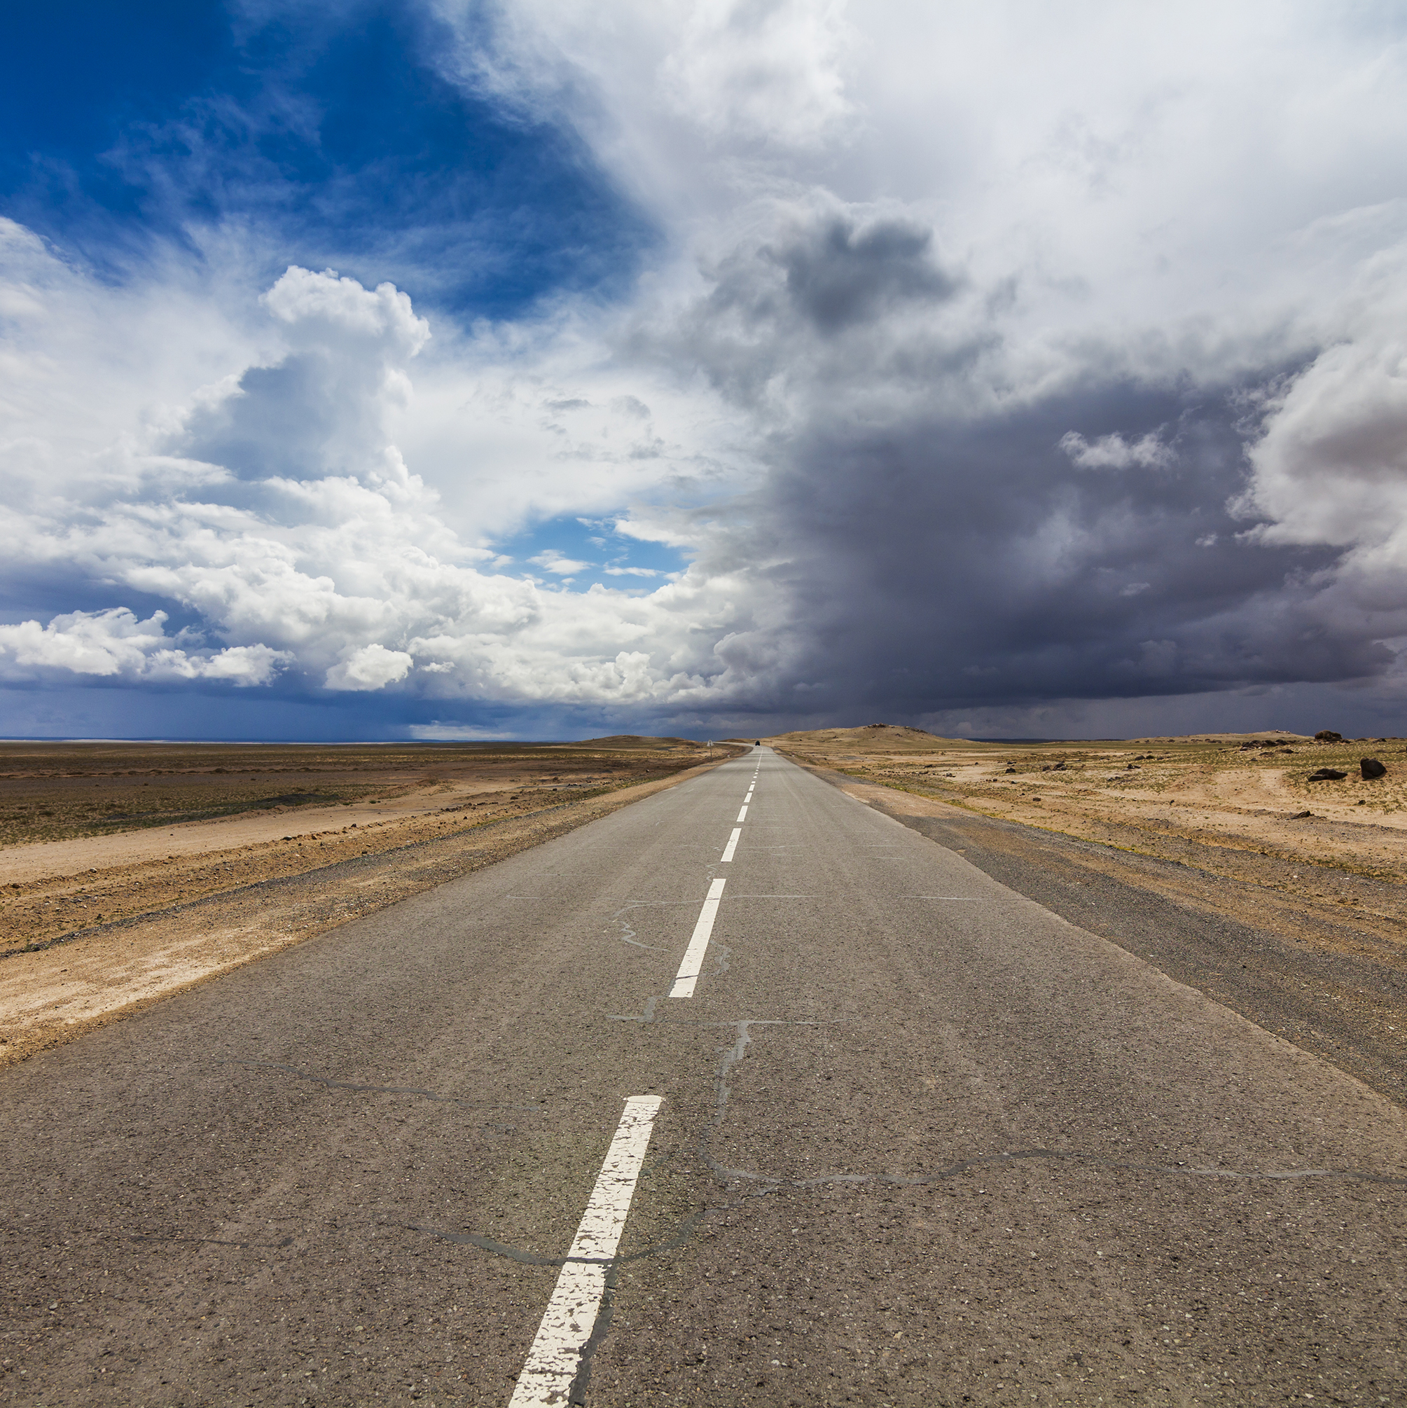

outcomes
honored
continued
dismissed
IPO/DVO issued for 30 days – 3 years
Can be renewed
Summons v. Order
Hearing postponed/rescheduled
Can be for many reasons
E.g. non-service, request for continuance, full docket
Not enough evidence
Petitioner requests dismissal
Petitioner doesn’t attend hearing
Non-service after 6 months

Slide 32
What then?
If the judge issues a DVO/IPO, the respondent is required to abide by what’s in the order
  No contact = no social media, no calls, no texts, no face-to-face, no communicating through another person
  No violent contact = no threatening, no property damage, no causing fear of violence
If the respondent violates the order
  Call law enforcement
  Aggressor may be arrested and charged with a crime
    Another hearing before the judge
    May be sentenced to time in jail
  Or may be charged with a violation of a civil order & held in contempt of court (not a crime)
    May still serve jail time, but doesn’t go on offender’s criminal record
    A finding within the case, but not a conviction

Slide 33
What then?
If the judge continues the hearing, the temporary protective order remains in place
  For up to 6 months or until the hearing
Violating a temporary protective order has the same consequences as a permanent one

Slide 34
What then?
If the judge dismisses the petition, survivors may want to find other means of protection.
  Safety planning with the survivor prior to learning the outcome may be useful
  Consider referrals to domestic violence shelters and other community organizations
  HOMEWORK: find out which organizations in your community provide shelter and other services to protect survivors

Slide 35
extending a protective order
Survivors can file to extend their protective orders by filing a motion.
Typically will happen at the same place the original petition is filed
Must file prior to the date the current order is set to expire
Will be a new hearing for judge to consider the motion
Needn’t be a new incident of violence to request an extension, but do need to explain why the order is still needed, i.e. why there is still a danger or fear of harm
Survivors can also file a motion to change the order.

Slide 36
THANK YOU
Aubrey Girouard
agirouard@thenestlexington.org

