Slide 1
DOMESTIC VIOLENCE and FEDERAL JURISDICTION
How does the United States regulate domestic violence?

Slide 2
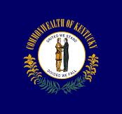
MOST DOMESTIC VIOLENCE ISSUES ARE HANDLED IN STATE COURT
ORDERS OF PROTECTION: EPO/DVO
DISSOLUTION OF MARRIAGE/CUSTODY CASES
JUVENILE DEPENDENCY/NEGLECT/ABUSE CASES

Slide 3
FEDERAL LAW TOUCHES ON DOMESTIC VIOLENCE MATTERS IN SEVERAL WAYS
VIOLENCE AGAINST WOMEN ACT (“VAWA”)
CRIMINAL STATUTES ARISING OUT OF VAWA
FULL FAITH AND CREDIT TO ORDERS OF PROTECTION
VICTIMS’ RIGHTS LAWS
FIREARMS OFFENSES

Slide 4
VIOLENCE AGAINST WOMEN ACT
Signed into law by President Bill Clinton on September 13, 1994
Established the Office on Violence Against Women within the US Department of Justice and funded the investigation and prosecution of crimes against women
Numerous grant programs and services, including: funding for the National Domestic Violence Hotline; community violence prevention programs; and legal aid organizations providing services to victims of domestic violence
Established a federal civil remedy for the victims of gender-motivated violence so they could sue their attackers in federal court (codified in 42 U.S.C. § 13981)

Slide 5
LIMITS ON FEDERAL AUTHORITY: UNITED STATES v. MORRISON, 529 U.S. 598 (2000)
The Supreme Court struck down the VAWA federal civil remedy for victims of gender-motivated violence to sue their attackers in federal court in a sharply divided 5-4 opinion
The Commerce Clause did not provide Congress with the authority to enact the civil remedy provision of 42 U.S.C. § 13981
Rejected Congressional findings that gender-motivated violence affected interstate commerce by deterring victims from traveling, engaging in employment, and transacting in interstate commerce.
Congress cannot “regulate noneconomic, violent criminal conduct based solely on that conduct’s aggregate effect on interstate commerce.”

Slide 6
VAWA CRIMINAL STATUTES RELATING TO INTERSTATE COMMERCE
18 U.S.C. § 2261: Interstate Travel to Commit Domestic Violence
18 U.S.C. § 2261A(1): Interstate Stalking
18 U.S.C. § 2261A(2): Cyber Stalking
18 U.S.C. § 2262: Interstate Travel to Violate an Order of Protection

Slide 7
FULL FAITH AND CREDIT FOR ORDERS OF PROTECTION
18 U.S.C. § 2265 provides that “any protection order” issued by a court of one State, Indian tribe, or territory shall be accorded full faith and credit by the court of another State, Indian tribe, or territory
Has some limitations relating to jurisdiction over the parties, reasonable notice and opportunity to be heard, and mutual protection orders
Registration or filing in foreign jurisdiction is not required for enforceability
Limits internet publication of protection order information

Slide 8
VICTIM’S RIGHTS LAWS
A victim has the right to speak at a detention hearing for a defendant accused of a VAWA crime (Sections 2261, 2261A or 2262) pursuant to 18 U.S.C. § 2263
Important rights under the Crime Victims’ Rights Act, 18 U.S.C. § 3771, including the right to notice of public court proceedings, right not to be excluded from court proceedings, and the “reasonable right to confer with the attorney for the Government in the case.”
Broad Right to Restitution under 18 U.S.C. § 2264
Self-Petitioning for Battered Immigrant Women and Children for independent legal residency pursuant to 8 U.S.C. § 1154

Slide 9
FIREARMS AND DOMESTIC VIOLENCE
18 U.S.C. § 922(g)(8) prohibits possession of a firearm while subject to a protection order. The protection order must have been issued following a hearing as to which the defendant had actual notice and an opportunity to participate, restrain the person from certain specified acts, and include certain findings relating to danger.
18 U.S.C. § 922(d)(8) prohibits the transfer of a firearm to someone subject to a protection order.
18 U.S.C. § 925 provides an exemption from the above for official use by a law enforcement officer or military personnel while on duty
18 U.S.C. § 922(g)(9) prohibits possession of a firearm after conviction of a misdemeanor crime of domestic violence

Slide 10
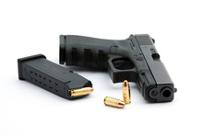
More…
ATF Form 4473—incorporates all of the disqualifiers of § 922, including those relating to domestic violence. A potential purchaser of a firearm from a federally licensed firearm dealer must complete the form and certify that he/she is not subject to a valid protection order and has not been convicted of a qualifying misdemeanor crime of domestic violence. Providing false information is a violation of 18 U.S.C. § 922(a)(6).

Slide 11
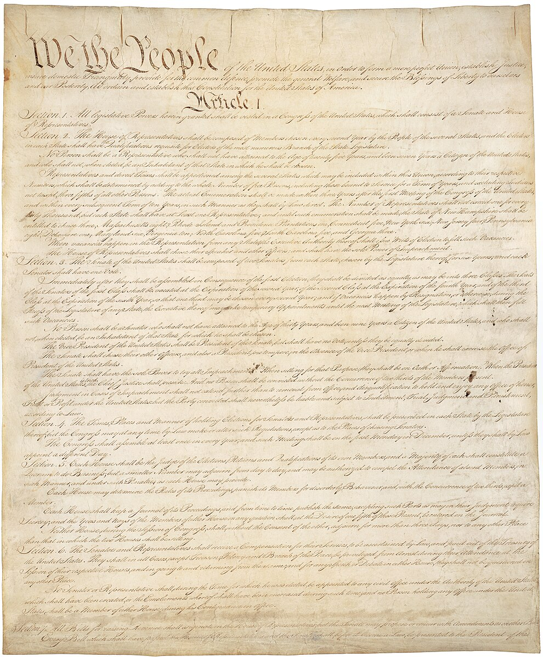
Reasons some doubted constitutionality of § 922(g)(8)
Historical test of Bruen—no protection orders in 1791 or 1868
Protection orders typically do not involve a jury trial
No right to counsel at public expense in a protection order hearing
Preponderance of the evidence legal standard for deprivation of a civil right, NOT beyond a reasonable doubt

Slide 12
BUT § 922(g)(8) IS CONSTITUTIONAL United States v. Rahimi, 144 S.Ct. 1889 (2024)
Upheld the constitutionality of § 922(g)(8) against a facial Second Amendment challenge (reversing Fifth Circuit)
8-1 decision with Justice Thomas dissenting
Defendant grabbed his girlfriend by the wrist, dragged her to his car, and shoved her in, causing her to strike her head against the dashboard. Also fired shots as his girlfriend fled. Later told girlfriend he would shoot her if she reported him to the police.
Analyzed history from the Statute of Northampton in 1328 forward to conclude that history supported disarming those subject to a protection order

Slide 13
Rahimi cont’d
Historical Analogue No. 1: Surety Laws—designed to prevent violence before it occurred. Those suspected of future misbehavior could be required to provide pledges or securities or face jail. Surety laws could be invoked to prevent all forms of violence, including spousal abuse. Wives could demand surety from husbands for good behavior. Surety laws targeted the misuse of firearms.
Historical Analogue No. 2: Going Armed Laws—part of ancient common law prohibition on “affrays.” These laws traced their origin to the Statute of Northampton and prevented riding or going armed to terrify the good people of the land.

Slide 14
Rahimi cont’d Other Considerations
§ 922(g)(8) does not “broadly restrict arms use by the public generally”
Long tradition of regulation of firearms possession by those who represent “a credible threat to the physical safety of another”
Disarmament is temporary—like surety laws
Historical analogue is required, not a historical twin

Slide 15
WHAT’S NEXT?
Possible federal regulation of “coercive control”
An act or a pattern of acts of assaults, threats, humiliation, and intimidation or other abuse that issued to harm, punish, or frighten the victim
Eight states have added coercive control to their protection order statutes
Legislation will be introduced in Kentucky next year

